Slide 1

DNDC’s Survey Updates
2023 ANNUAL MEETING OF THE
BERMUDA DRUG INFORMATION NETWORK
Stephanie Tankard
Research Officer
DNDC
BUEI
Tradewinds Auditorium
November 3rd, 2023

Slide 2

SURVEYS SINCE LAST MEETING
SURVEYS
Omnibus Survey | Annual | August
Treatment Demand Indicators | On-going | Year Round
Consumer Experience Survey | Bi-annual | May & Nov (MT, WTC & RLH)
Employee Climate Survey | Annual | July
Stakeholder Feedback Survey | Annual | June (MT), December (WTC), March (RLH)
National School Survey | Every 4 years | October
Notes:
Surveys provide another category of data collected by the BerDIN. Use to describe a situation in a population at a given point in time.
Funded by DNDC’s Research Unit budget.
Spearhead by DNDC’s Research Unit staff.
Collaborate with international agencies and other departments/ministries, e.g., corrections, education, child and family services.
Use international standardised protocols and methodologies/best-practice approaches.

Slide 3
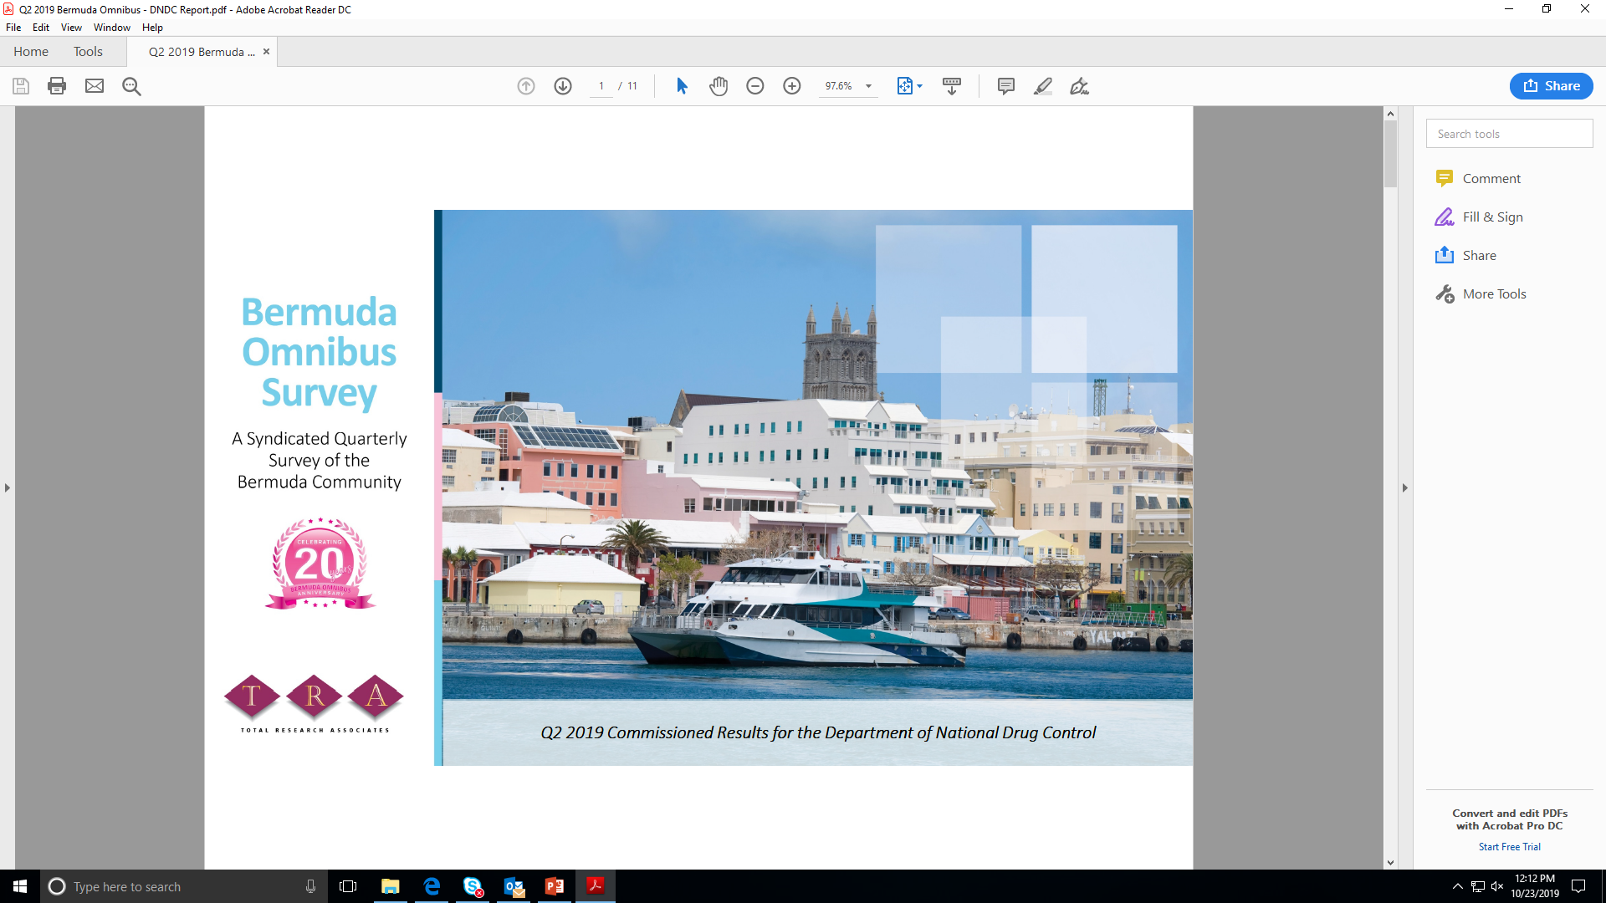
OMNIBUS SURVEY
Commissioned 4 questions in the 2nd Quarter 2023 Omnibus Survey.
Representative sample survey of 400 residents across the entire Island.
Purpose:
  To evaluate community’s perceptions on issues relating to: crime, drug prevalence, and overall health
  Common issues for Bermuda’s residents in recent years.
Residents were asked about:
  how safe they felt in their own neighborhood?
  how their current feelings of safety compared to those from six months ago?
  what types of crime they knew to have occurred in their neighborhood in the past year.
  how they would rate their own health?
Notes:
Survey conducted by Total Research Associates
Safety in Neighborhood
98% reported feeling safe
which is consistent with previous results where residents felt generally safe or safer than 6 months ago.
Crime
Breaking and entering to steal personal property (31%) and a theft (auto or personal property) having occurred (30%) were reported as the crimes that people had knowledge of occurring in their neighborhood.
Health
94% felt that they were in good physical and mental health.

Slide 4
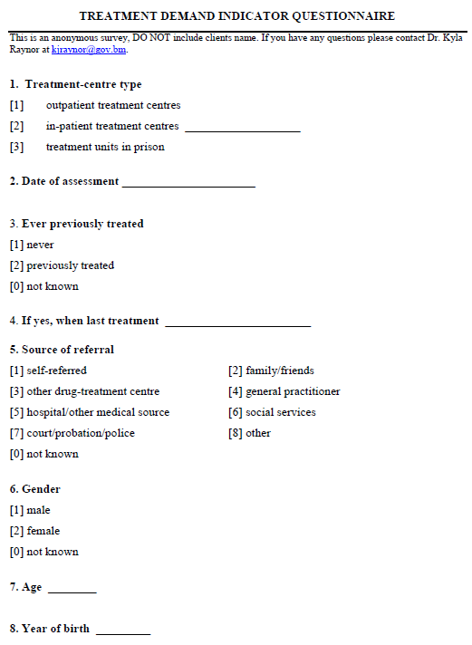
TREAMENT DEMAND INDICATORS
Purpose: used as a surveillance tool to monitor drug trends and identify emerging issues.
  Primary drug of impact
  Drug prices
Priority population:
  Each client presenting for treatment, whether admitted or not (preadmission and admission).
  WTC, MT, Turning Point, Right Living House, Salvation Army – Harbour Lights & Community Life Skills
Administered continuously from 2011 to present; personal interview.
Notes:
In 2018, 39 people sought substance abuse treatment (33 men and 6 females)
Most (15) were clients of the Salvation Army Harbour Light Programme
People requiring treatment ranged from 22 to 69 years old and most were likely to self-refer (58%).
The primary drug of impact that people sought treatment for was crack (32%)
More than half (60%) of the population stated that they made money by selling drugs or being involved in the transportation of drugs.

Slide 5
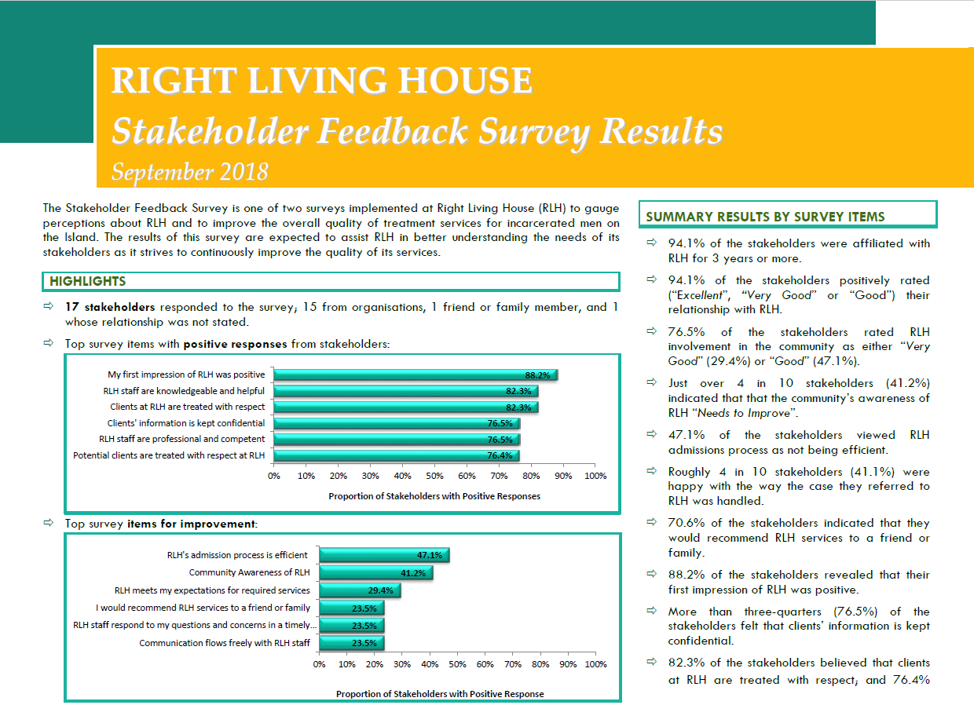
STAKEHOLDER FEEDBACK SURVEY
The purpose of this survey is to obtain stakeholder views on the quality of services the agency provides.
The data collected will assist to better understand the needs of the respective stakeholders to ensure continuous improvement in the quality of its services.
Survey takes approximately 10 minutes to complete and is open for 1 week.
Stakeholders include: organisations and family & friends of clients
Questions:
    Communication ¬ Staff
    Problem Resolution ¬ Experience
    Overall Satisfaction

Slide 6
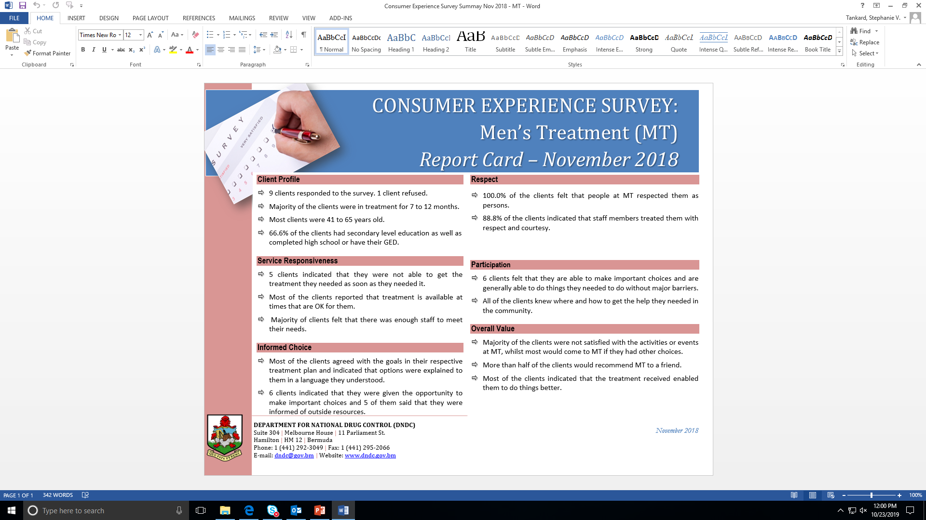
CONSUMER EXPERIENCE SURVEY
The purpose of this survey is to obtain clients views on the quality of services the treatment center provides.
The data collected will assist to better understand the needs of the clients to ensure continuous improvement in the quality of its services.
Survey takes approximately 15 minutes to complete.
Stakeholders include: Clients in treatment
Questions:
    Service Responsiveness ¬ Respect
    Informed Choice ¬ Participation
    Overall Value

Slide 7
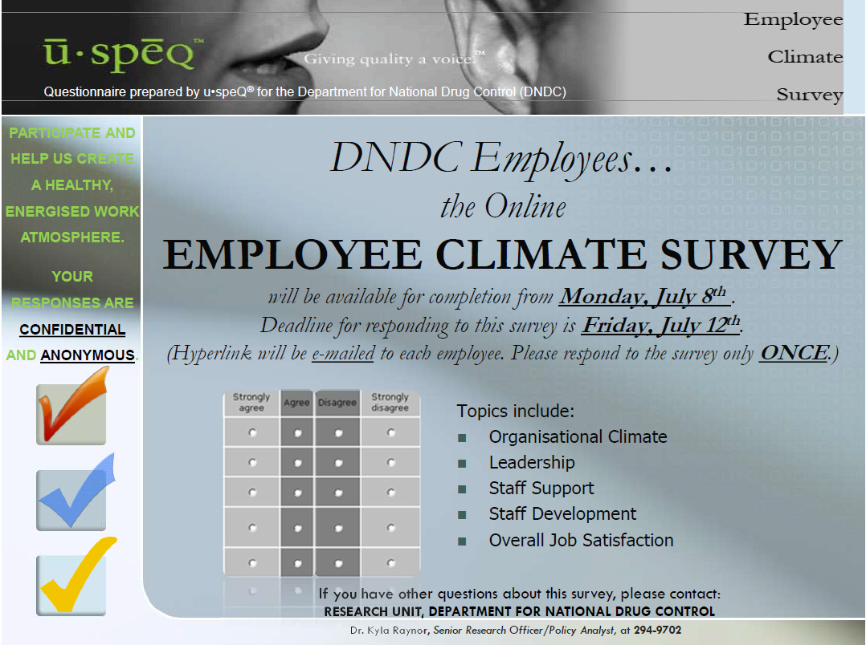
EMPLOYEE CLIMATE SURVEY
The primary purpose of the Employee Climate survey is to gather feedback from employees regarding their perceptions of their work environment and their overall job satisfaction.
The data collected will help management understand overall satisfaction and help create a healthy, and energized work atmosphere.
Survey takes approximately 20 minutes to complete.
Stakeholders include: All full-time staff that come under the DNDC (including Treatment Center staff)
Questions:
    Organisational climate ¬ Workgroup
    Staff support ¬ Overall job satisfaction

Slide 8
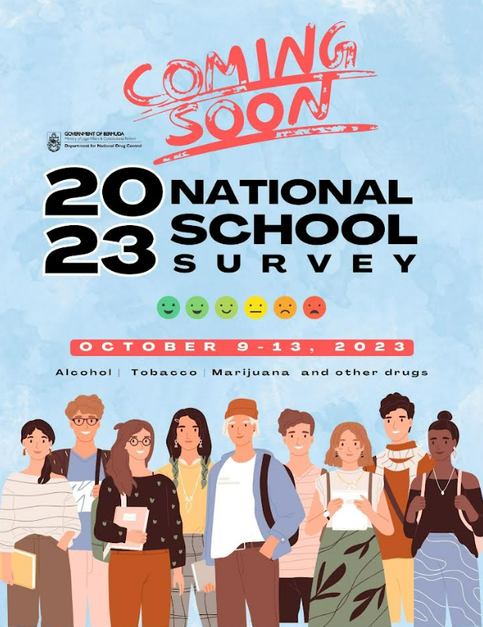
2023 NATIONAL SCHOOL SURVEY
Survey of Middle & Senior School Students on Alcohol, Tobacco, Other Drugs & Health conducted October 9th-13th, 2023.
Collaboration with Ministry of Education
Purpose:
  Prevalence of ATODs
  Risk and protective factors
  Antisocial behaviours
Priority Population:
  M2 to S4 students (12 – 18 years)
  5 public, 7 private, 5 home schools/ special (2023)
  Targets approximately 3,000 students
Administered every 4 years since 2003.
Notes:
Inter- American Drug Abuse Control Commission known as CICAD which the ATOD prevalence section.
Centre for Substance Abuse Prevention, US Department of Health & Human Services: Risk & Protective Factors section.

Slide 9
2023 NATIONAL SCHOOL SURVEY
Advantages:
  Online via Survey Monkey
  Less cost for Government (data entry) in staffing and supplies
Challenges:
  Most public schools required paper questionnaires (lack of Wi-Fi infrastructure)
  Students were not given enough time to complete the survey
  Some students were selecting schools that were not doing their survey that day
  Lack of buy-in from all schools this survey round
1 new school
  Chatmore International School
Notes:
Inter- American Drug Abuse Control Commission known as CICAD which the ATOD prevalence section.
Centre for Substance Abuse Prevention, US Department of Health & Human Services: Risk & Protective Factors section.

Slide 10
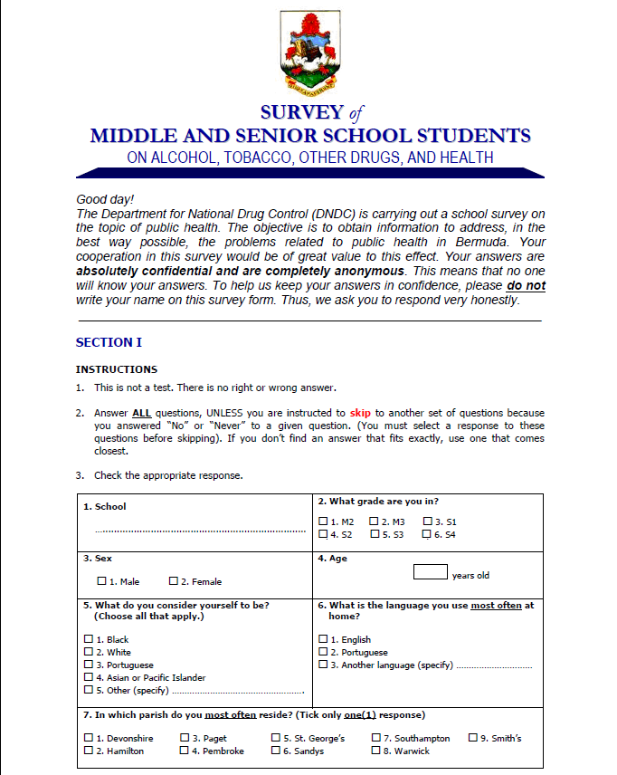
QUESTIONAIRE DESIGN
  Section 1
Adopted from the Inter-American Drug Abuse Control Commission (CICAD) School Survey.
Contains questions on basic demographics and those that measure ATOD consumption.
  Section 2
Adopted from the Communities That Care Youth Survey.
Contains questions that measure a variety of risk and protective factors. The four main domains for each were: Community, Family, School, and Peer-individual as well as Outcome Measures such as; depression & antisocial behavior.
Notes:
New Survey Items
A number of questions about vaping and a more extensive list of synthetic drugs were added.
One question about the amount of cigarettes purchased was added
One question added about seeing a health professional because of alcohol use, drug use, emotional problems or behavioral problems.

Slide 11
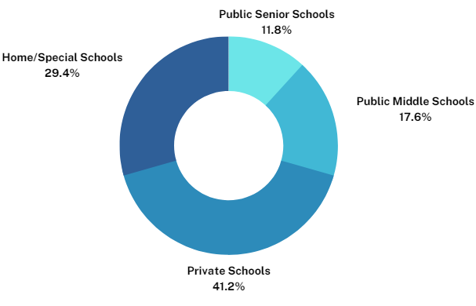
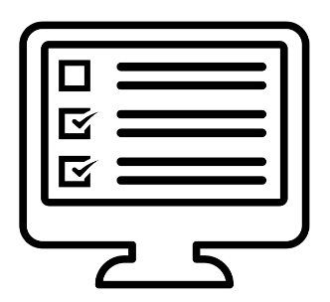
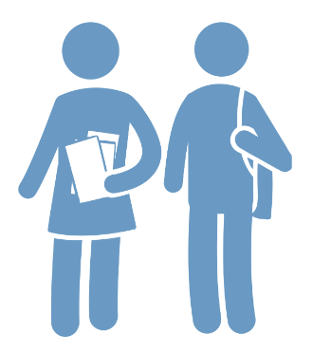
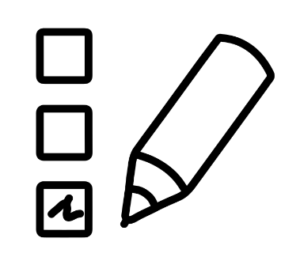
DEMOGRAPHIC CHARACTERISTICS
Total Surveys Collected: 2,701
Females: 1,043
Online: 2,020
17
schools
Paper: 681
Race:
Black: 740
White: 760
Asian: 54
Hispanic/Latino: 45
Mixed: 400
Other: 61
Males: 977
Grade Level:
M2: 377
M3: 311
S1: 393
S2: 335
S3: 345
S4: 259
*preliminary data based on ¾ of the respondents.
Notes:
Survey Administration
Consent: student participation was voluntary- subject to the consent of a parent/ guardian.
Pre-Administration
Enrollment numbers collected and established a contact person
Survey materials prepared
Flyers sent out to schools
Delivered survey materials
Administration
Administered in classrooms under teacher supervision (usually done during advisory/homeroom period).
We asked that schools allot 50 minutes for students to take the survey (which is normally a class period).
Teachers were given instructions to read out to students
Staff from DNDC were sent to each school as an observer (where they assisted with any immediate issues and observed the process).
Survey items were put together and collected to be returned to DNDC
Report Dissemination is hoped to be in March.

Slide 12
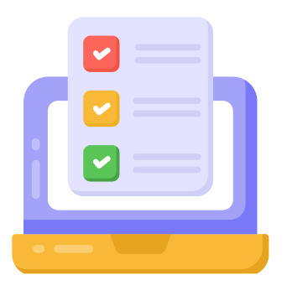
2023 NATIONAL SCHOOL SURVEY
Access was reported “Easy” for alcohol (62.7%), marijuana (31.3%) and 13.5% for cocaine, crack and heroin
12.9% reported having seen a health professional for emotional or behavioral issues.
45.2% reported having behavioral/discipline problems in the last school year.
29.1% have ridden in a car or bike with someone who had drank alcohol.
2.5% reported having seen a health professional for alcohol or drug issues.
Majority of students were 12 years or younger when they first tried most drugs/substances.
1
2
3
4
5
6

Slide 13
2023-2024 DRUG ABUSE MONITORING SURVEY
Drug Abuse Monitoring Survey is being conducted from May 1st, 2023 to April 30th, 2024. Collaboration with Department of Corrections
Purpose:
  Surveillance of drug use among high risk populations
  Severity of substance use: drug of choice and length of use (those who require substance abuse treatment)
  Gauge drug consumption and criminality
  Highlights types of crimes committed by substances users
Population:
  Inmate population at Westgate and Co-ED facilities
  Surveys are voluntary (Refusal:5 and Released before taking survey:4)
  Urine screens test for 12 substances (new: morphine)
Administered every 4 years. (last completed in 2017)
Notes:
Inter- American Drug Abuse Control Commission known as CICAD which the ATOD prevalence section.
Centre for Substance Abuse Prevention, US Department of Health & Human Services: Risk & Protective Factors section.

Slide 14
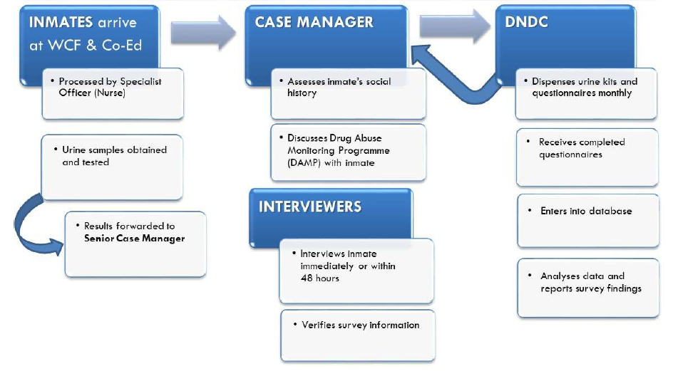
2023-2024 DRUG ABUSE MONITORING SURVEY
DATA COLLECTION PROCESS
Notes:
Inter- American Drug Abuse Control Commission known as CICAD which the ATOD prevalence section.
Centre for Substance Abuse Prevention, US Department of Health & Human Services: Risk & Protective Factors section.

Slide 15
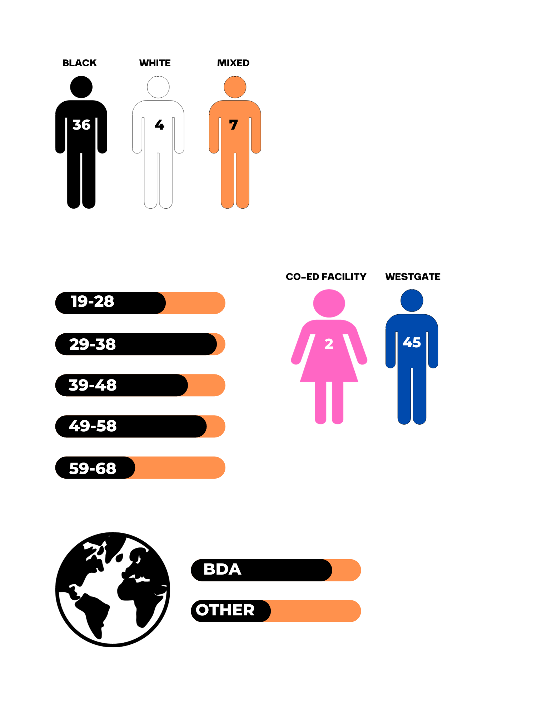
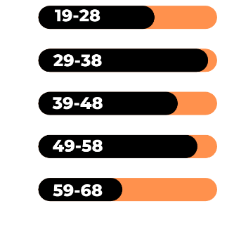

DEMOGRAPHIC CHARATERISTICS
A survey is completed by the interviewer and a urine drug screen is completed by the nursing staff.
Total Inmates: 47*
Age:
Race:
Country of Birth:
2
45
*completed questionnaires
Note: 64 total records (17 just urine screens)
Notes:
Inter- American Drug Abuse Control Commission known as CICAD which the ATOD prevalence section.
Centre for Substance Abuse Prevention, US Department of Health & Human Services: Risk & Protective Factors section.

Slide 16
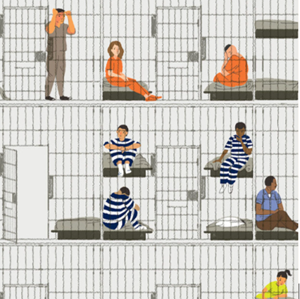
2023-2024 DRUG ABUSE MONITORING SURVEY
2 inmates reported being HIV positive
Most in prison for Property Offences (i.e. burglary & larceny/theft)
27% of inmates reported being self-employed.
15 inmates had been to prison more than 5 times
Urine Screens: Most tested positive for Cocaine with 3 testing positive for Morphine (new)
1
2
3
4
5

Slide 17
Thank You!
Questions
BUEI, Tradewinds Auditorium
November 3rd, 2023
Stephanie Tankard
Research Officer
DNDC

