Slide 1
2018 Annual berdin meeting
Update from the Government Laboratory
Chalsey Symonds
Government Analyst
Notes:
Good day to you all. I believe most of you know me, at least by name. I am Chalsey Symonds one of the Government Analyst at the Central Govt Lab. I am before you today to give you an update regarding Cannabis and it’s evolution in Bermuda over the past 2 years through the eyes of us, the analyst at the lab.

Slide 2
Cannabis in Bermuda
Appears to be the recreational drug of choice
Rise in total case submitted each year
72% of the total drug cases submitted to the lab are cannabis related
2017 starts the spike in cannabis liquids
Border seizures have kept us very busy this season
Notes:
Cannabis seems to be the recreational drug of choice in Bermuda. From the graph you can see that each year from 2014 until now there has been a steady increase in the number of cases that have been submitted into the lab for testing. This year being the highest and we still have just over 2 months left in the year. On average from 2014 until 2018, cannabis related cases makes up 72 percent of the total drug cases that were submitted to the lab. In 2017 we see an increase in the “products” which indicates something that contains a cannabinoid whether it is an oil, an edible, butter etc. We received only 1 submission in 2015 which was a CBD oil – this was received prior to the legislation changes surrounding CBD. There were 8 cases in 2017 and so far in 2018 (thanks mainly to our busy cruise ship season) we have seen 30 and counting…

Slide 3
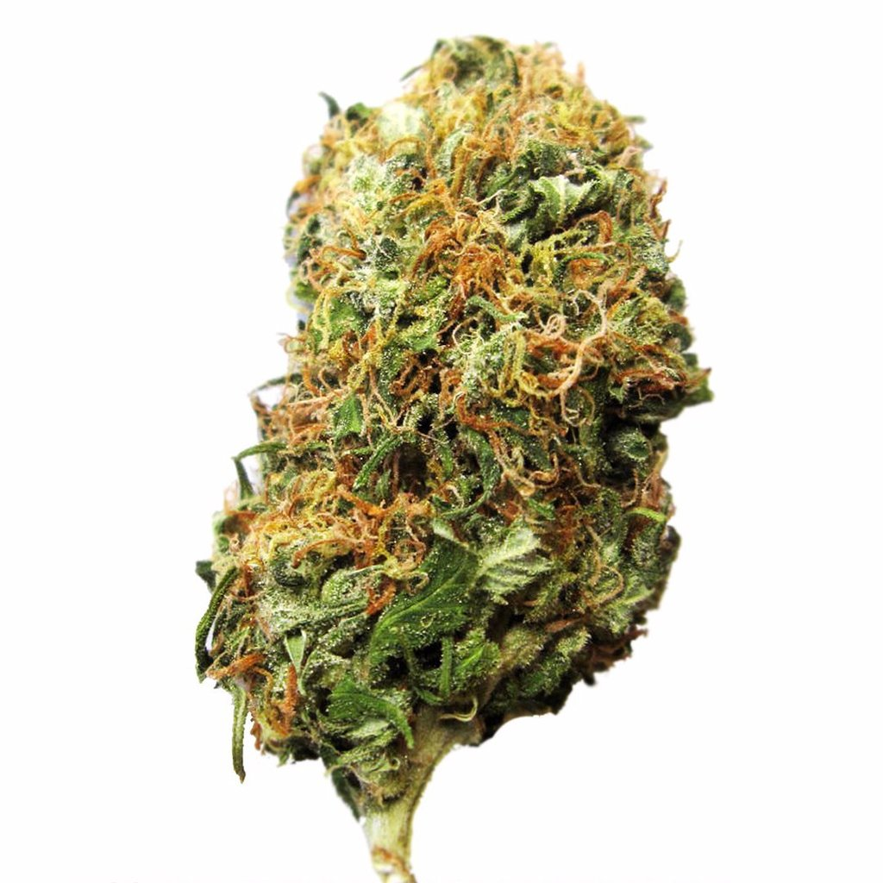
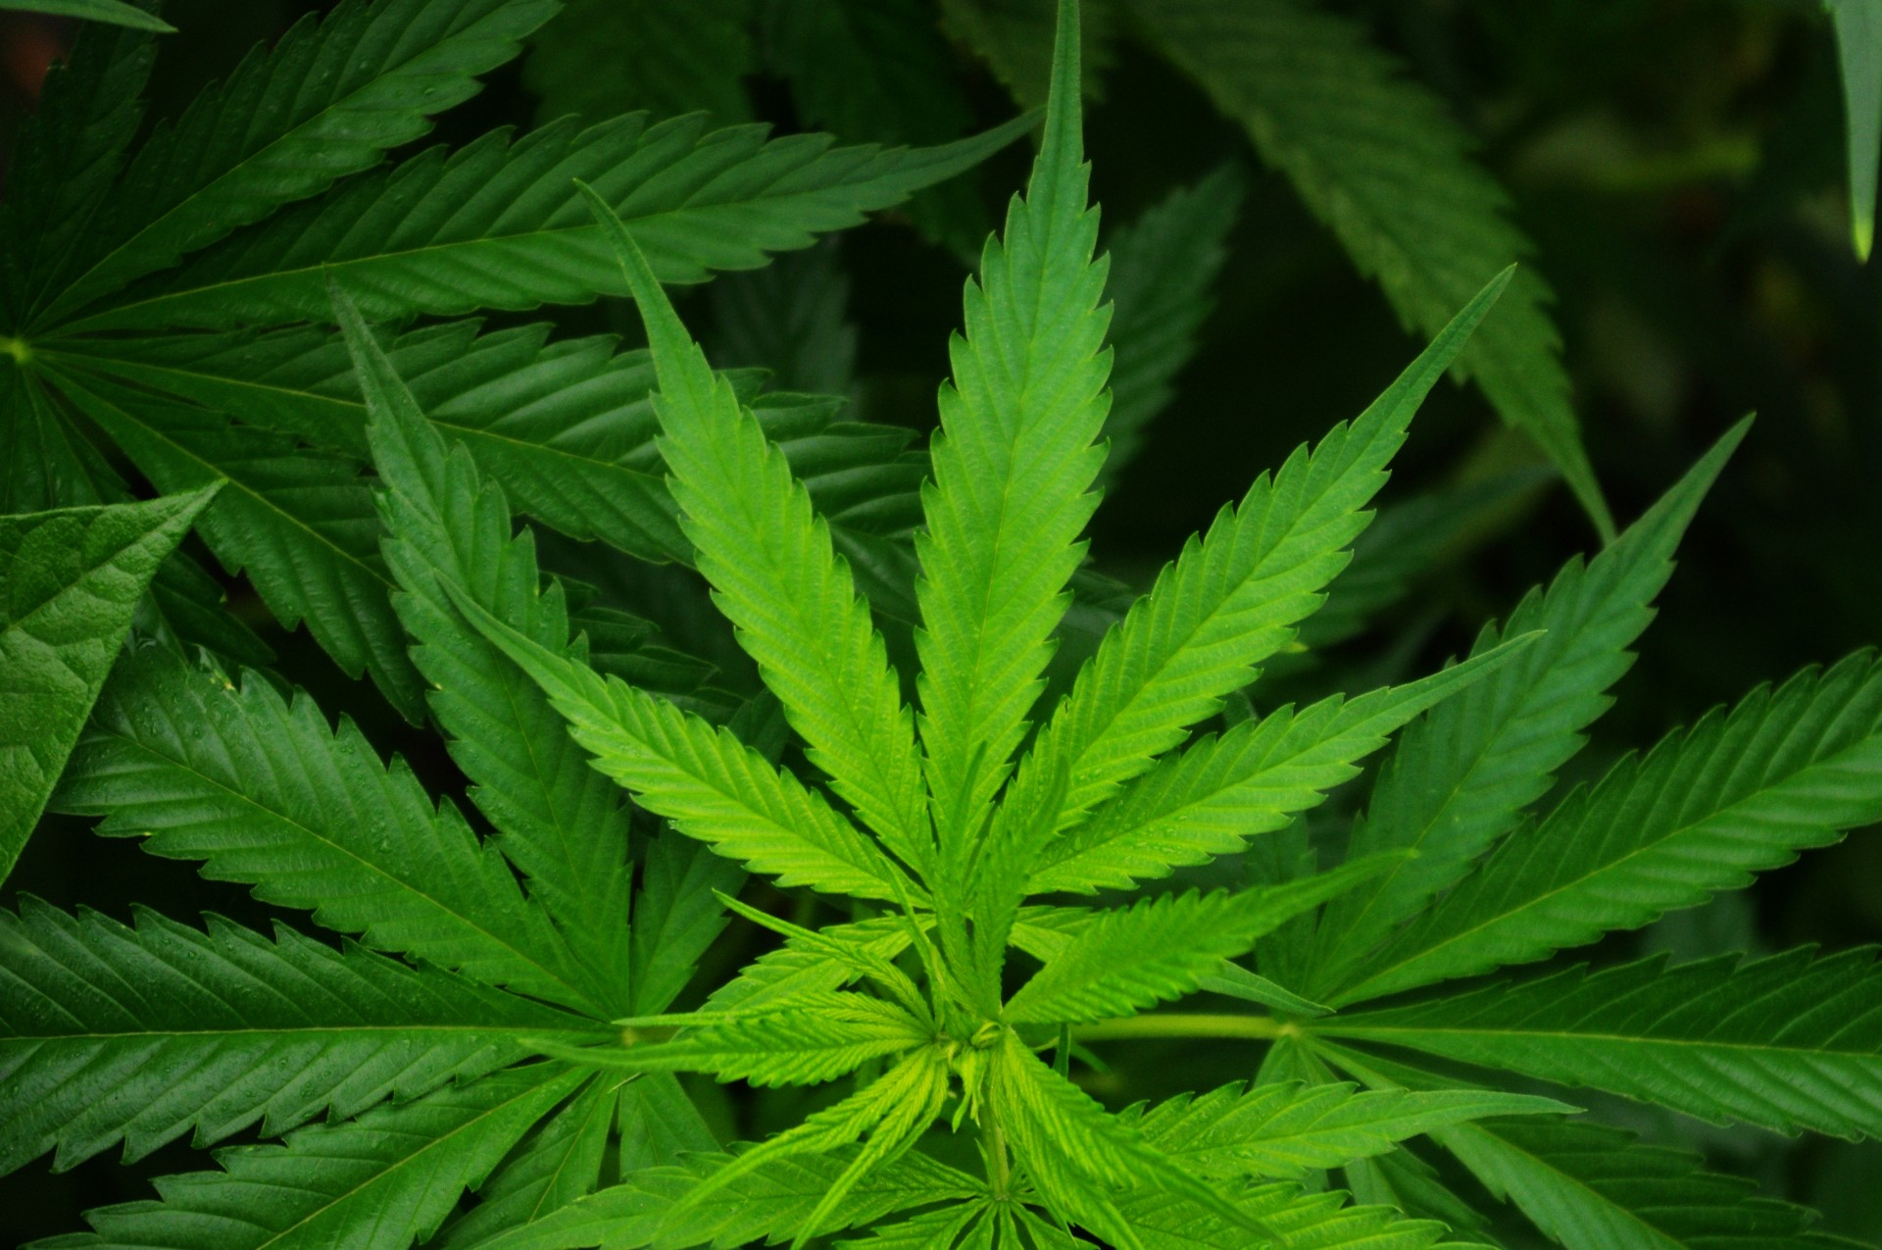
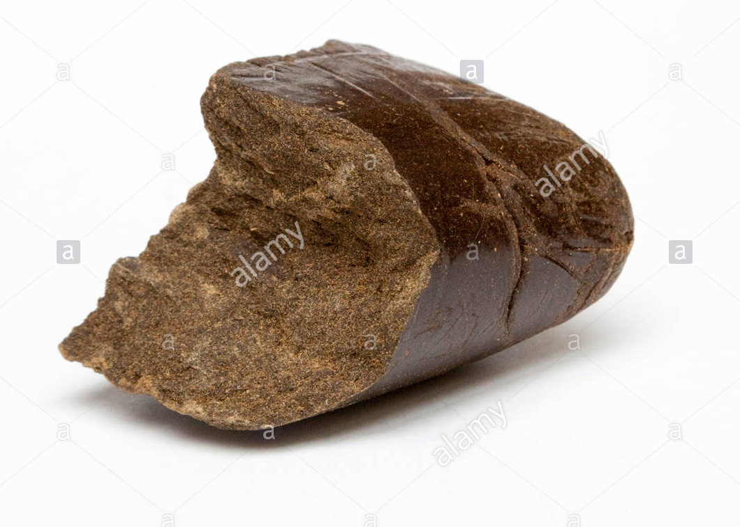
Marijuana use in bermuda
Buds/ Flowering Heads Leaves
Resin
Notes:
Traditionally we would see these 3 forms of cannabis. Buds/ flowering heads (usually from the female plant) which typically had the highest THC content. They can be quite pretty to look at and give that marijuana aroma. The leaves which have the lowest THC content of the 3 forms shown here and then resin. Resin is the sticky substance produced by the plant and is preferred to smoke in a pipe.

Slide 4
Legislative changes
Misused of Drugs Decriminalization of Cannabis Act 2017
7 grams or less
Does not include resin
Cannabis is STILL illegal
Increase in the number of ‘personal use’ cases with 7grams or less
Pharmacy & Poisons Schedule 4 Amendment Order 2017
Allowance of CBD products containing <1% THC
Oils
Vape Pens/ E-Cigarettes
Chews & Gummies
Notes:
Last year this act was passed which allows the courts (in my opinion) to operate using their disgression pertaining to cannabis if someone is found in possession of the drug. If they have a possession amount which was determined to be 7g or less, the person can be cautioned. HOWEVER the possession of the drug is still illegal. I think some people get confused about this assuming that they are “allowed” to have the drug as long as they have 7g or less. No. This allowance amount does not include resin or the cultivation of the plant.
Once this law was passed I noticed a slight increase in the number of submissions with 7g or less of cannabis. I had to wonder if people were weighing just less so that they could ‘get away’ with possession of this drug.
PP Amendment order: CBD products NOT THC products. The problem is that there are products that can contain mostly THC, only THC, no THC etc but we don’t know what they contain until we test them.

Slide 5
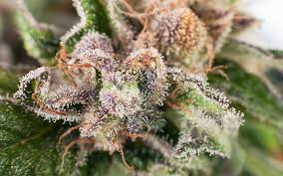
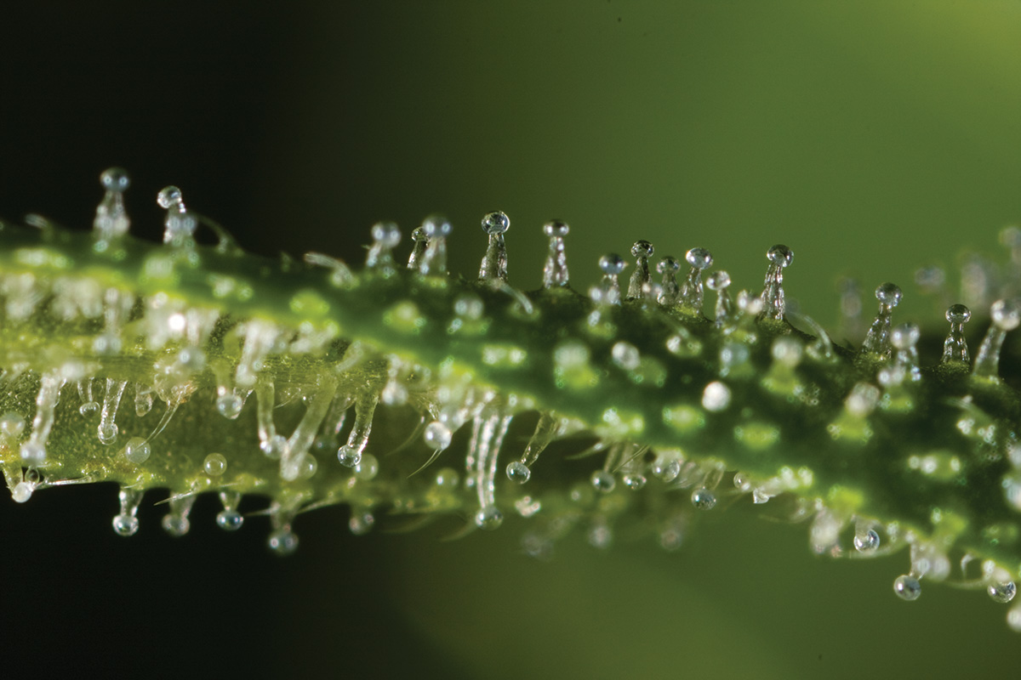
concentrates
Kief (dry sift/ pollen)
hash/ resin
THC-A crystalline
Made of resin glands found on the trichomes of cannabis flowers
Used to make hash
Applied to spliffs to increase the high
20-30% THC concentration
Compressed cannabis resin
Resin is naturally produced by the plant (no greater than 20% THC)
4-30% THC concentration
Higher levels come from kief resin
The purest form of THC
99.9% THC
Extremely addictive and dangerous
dabbing: usage method
Notes:
There are so many variations of the plant now so I want to just discuss some of the terms with you.
Kief (aka dry sift/ pollen) consists of the trichomes which are found on the leaves and can be removed from the plant to form a fine powder. This powder can be then compressed to make hash, sprinkled to increase the high on a joint, used to make butter or added to coffee. The options appear to be endless
Hash/ Resin is an “old school” concentrate that is naturally produced by the plant to protect it’s leaves from the harsh environment of the sun/ heat. Naturally occurring resin has low concentration of THC between 4% – 18% however if the hash is made from kief the THC levels can be as high as 40%.
THC-A is created in a lab and is the purest form of THC available currently at almost 100%. Essentially, this product is comprised solely of THC-A taken from the trichomes of the plant itself. It is extracted and due to it’s form it crystallizes and visually it resembles cocaine. It contains no other cannabinoids or terpenes like the concentrates made to include plant material. The only compound present is THC-A. Users claim it tastes like “snowflakes” which essentially means it tastes like water. It is interesting to note that unless THC-A is heated it remains in this acid form. In this form no psychoactive affects will be experienced which makes this product appealing to persons who need THC medicinally but do not want to experience the high that THC gives.

Slide 6
BHO concentrates
wax
shatter/sap
live resin
Softer more opaque consistency/ texture
heat, moisture, terpenes can create a gooey wax (budder) or soft & brittle wax (crumble/ honeycomb)
Between 60-80% THC concentration
Amber glass transparency
Up to 80% THC concentration
Appearance depends on heat, moisture & high terpene content
Fuctions as a purified man-made resin
Capturing the terpene profile of the live plant
70- 80% THC concentration
Notes:
A cannabis extract is any oil that concentrates the plant’s chemical compounds like THC and CBD. This is achieved through a variety of extraction processes and solvents, the most common being butane. Advancements in extraction technology have enabled the use of other solvents like carbon dioxide and pure hydrocarbons in a process that utilizes pressure in a safe closed-loop system. The end product is a highly potent BHO (butane hash oil) of varying consistencies most popularly used for vaporization and dabbing.
Cannabinoids are drawn out of the plant through butane extraction, which leaves behind a wax that will either maintain its sticky consistency or harden up, resulting in a crumbly “honeycomb” or a solid, glasslike substance referred to as “shatter.” Because its THC content stretches up to 80%, BHO is a popular remedy for chronic pain and other intractable symptoms. Live resin is created using a similar BHO extraction method but with fresh, flash frozen buds, as opposed to bud that has been dried and cured. Flash freezing the buds helps to retain the cannabinoid and terpene profile of the plant which is what add to the affects of the live resin.

Slide 7
CO2 concentrates
vape cartridges
THC oils
50% - 75% THC concentration
Used with vape pens
Variety of flavors and strengths
-50% - 75% THC concentration
Notes:
CO2 oils are produced using a CO2 supercritical fluid extraction technology. This method is said to be safer than BHO methods because CO2 is a gas instead of a solvent (butane). CO2 oils are those found in vape pens, CBD/THC oils can also be produced using this method.

Slide 8
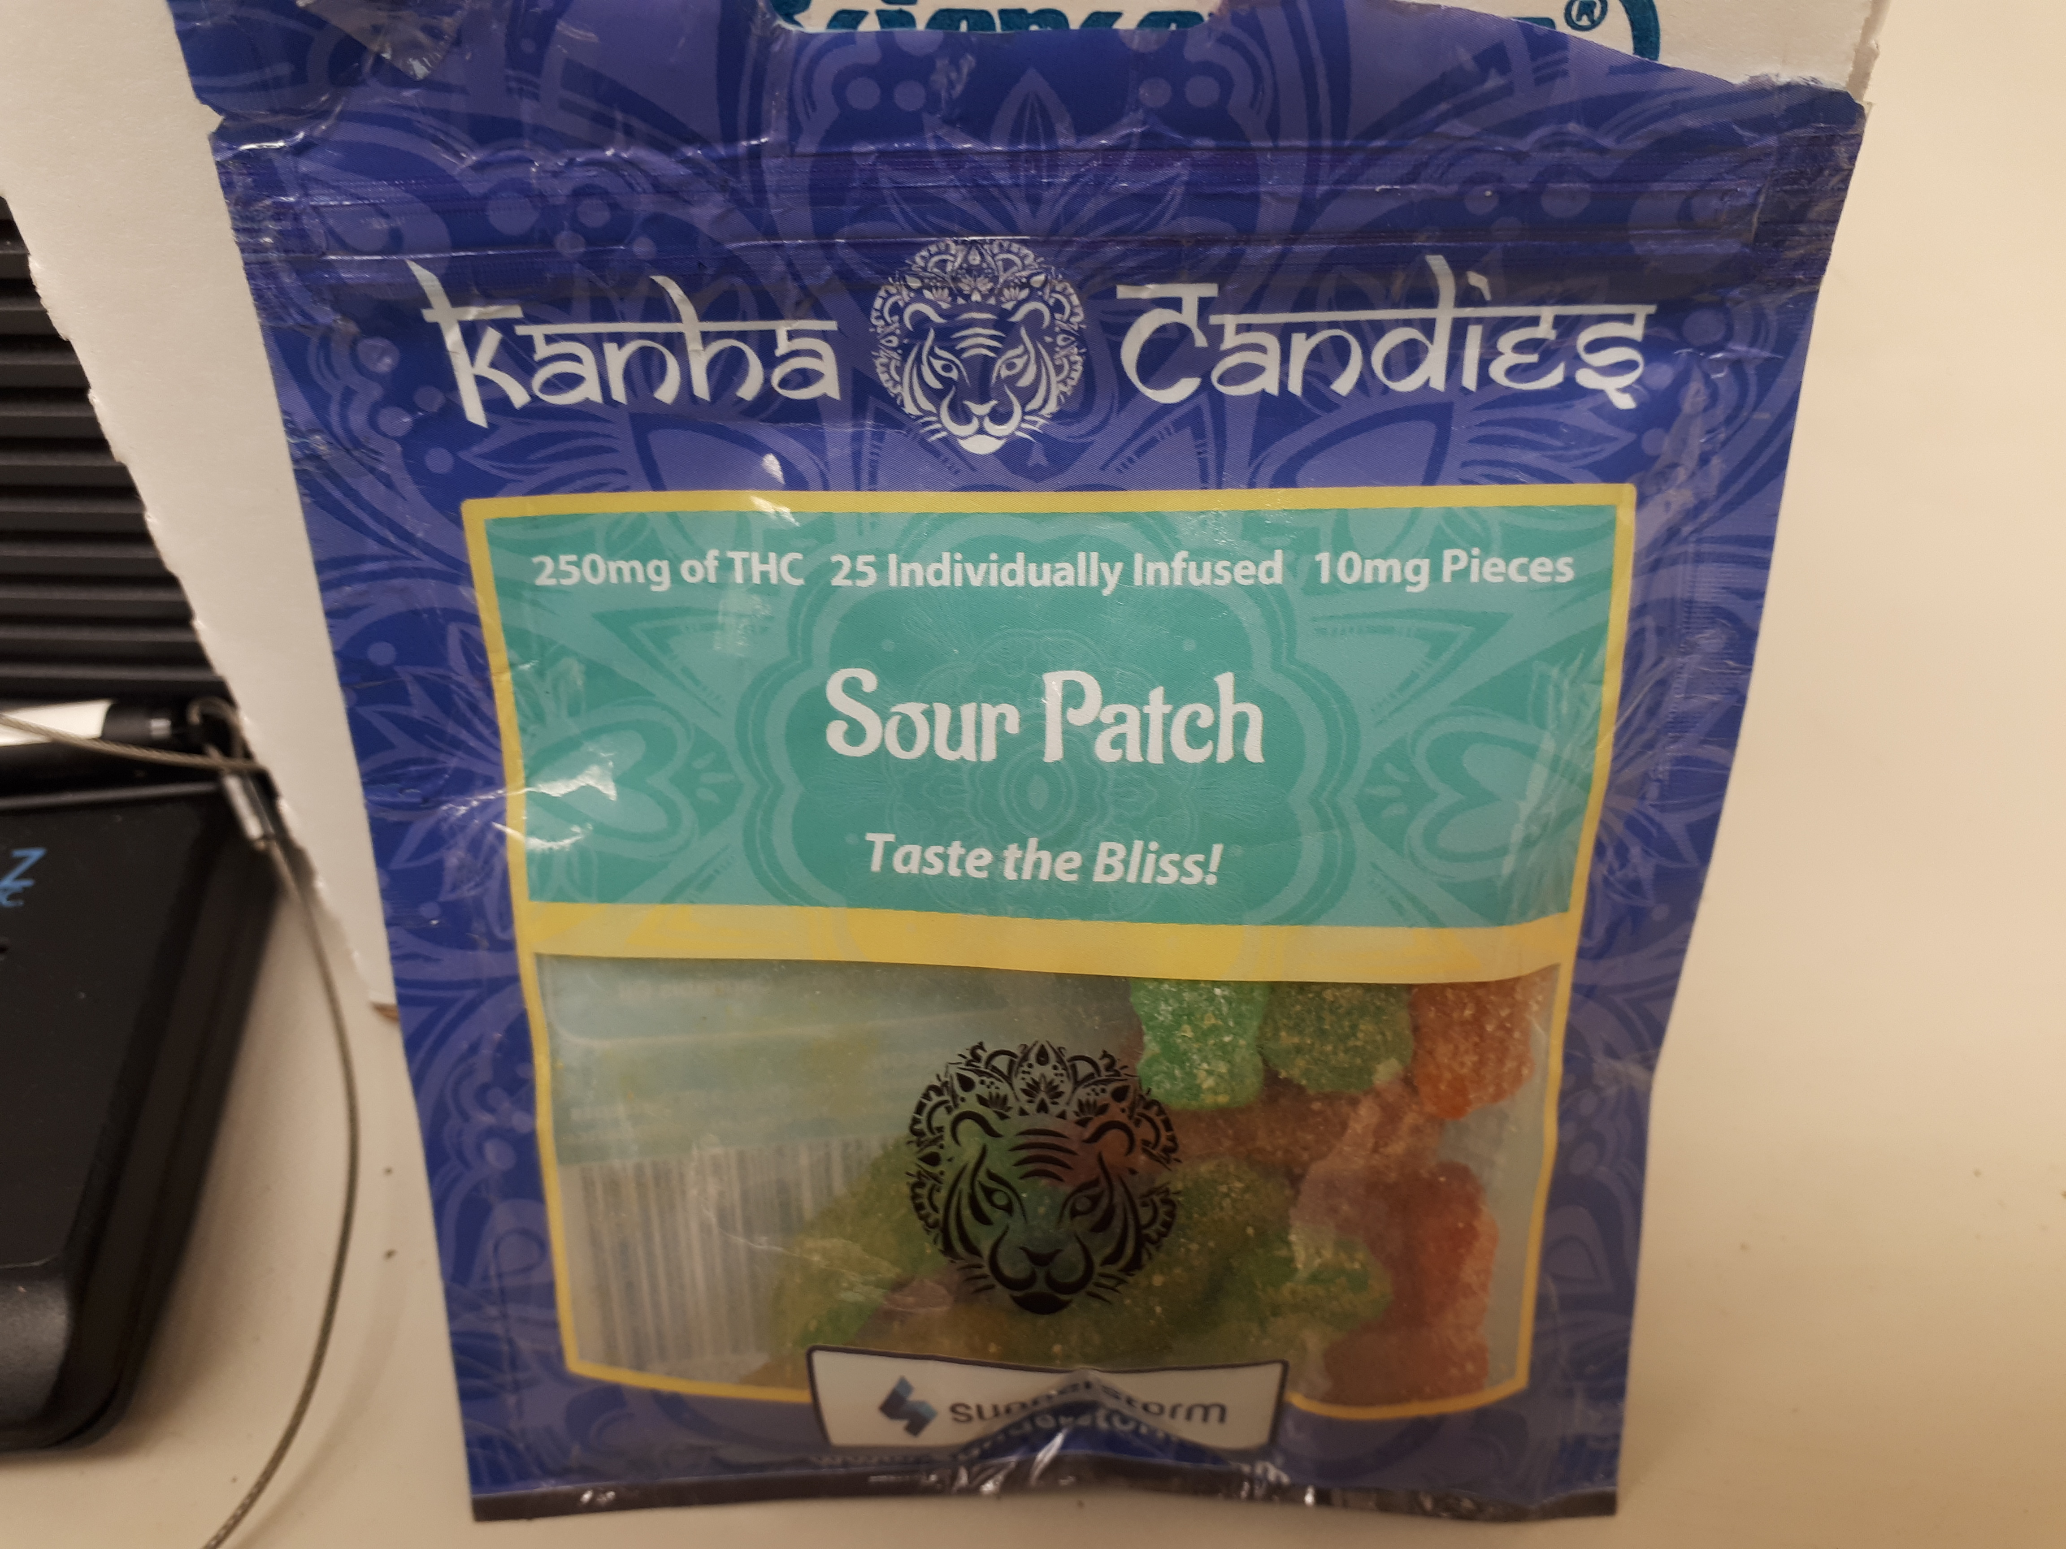
Cannabis edibles
Butter- ‘cannabutter’
Gummy Candy
Various shapes & colors
Can contain varying levels of either THC/ CBD or both
Infused with cannabis plants
Concentration varies due to the instability of THC
Used to make infused foods and treats
Fatty Oils
Coconut oil
Olive Oil
Notes:
Many “at home” cannabis edibles are made by first producing cannabis butter. This butter is infused with the cannabis plant to create Cannabutter. Cannabinoids are fat soluble which means that it will not easily dissolve in water-like substances. Fatty oils like butter, coconut oil/ olive oil are all known to be good carriers of cannabinoids. There are companies who also manufacture edibles containing varying levels of THC/CBD and other cannabinoids. Usually this information is visible on the packaging stating which cannabinoid and the weight (usually in mg). Examples of this can be seen on the these two packages on the far side of this slide.

Slide 9
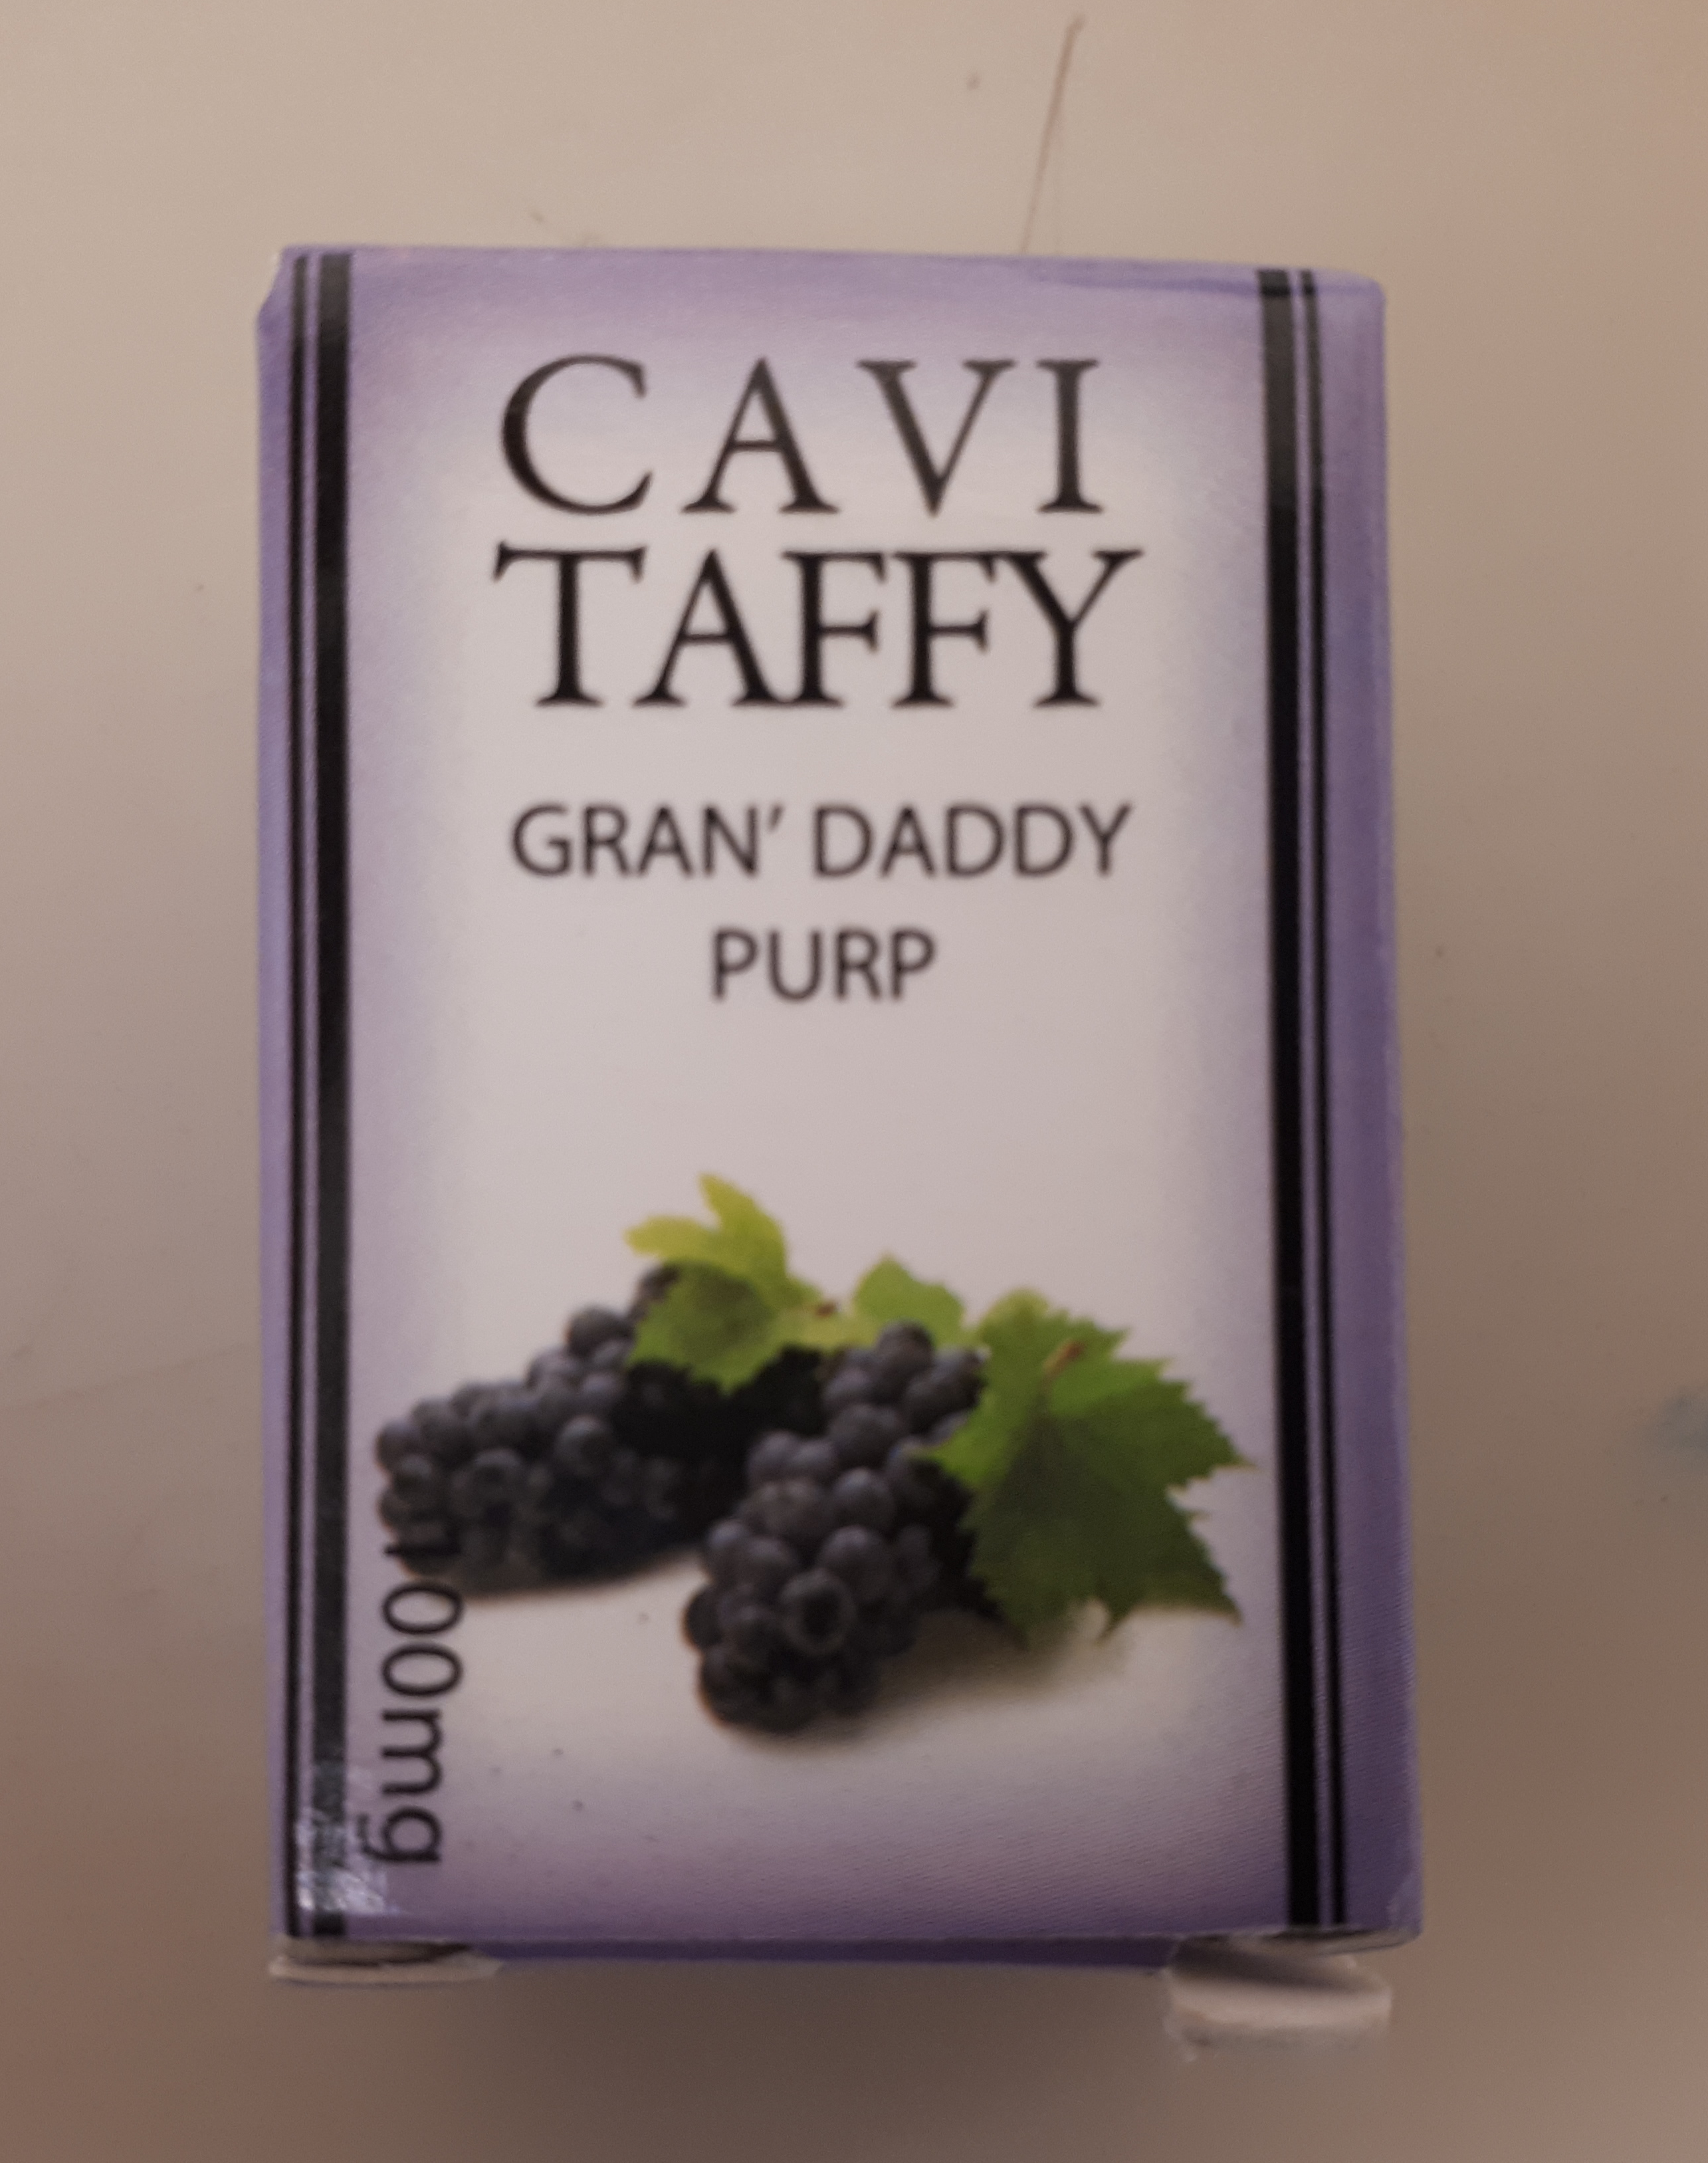
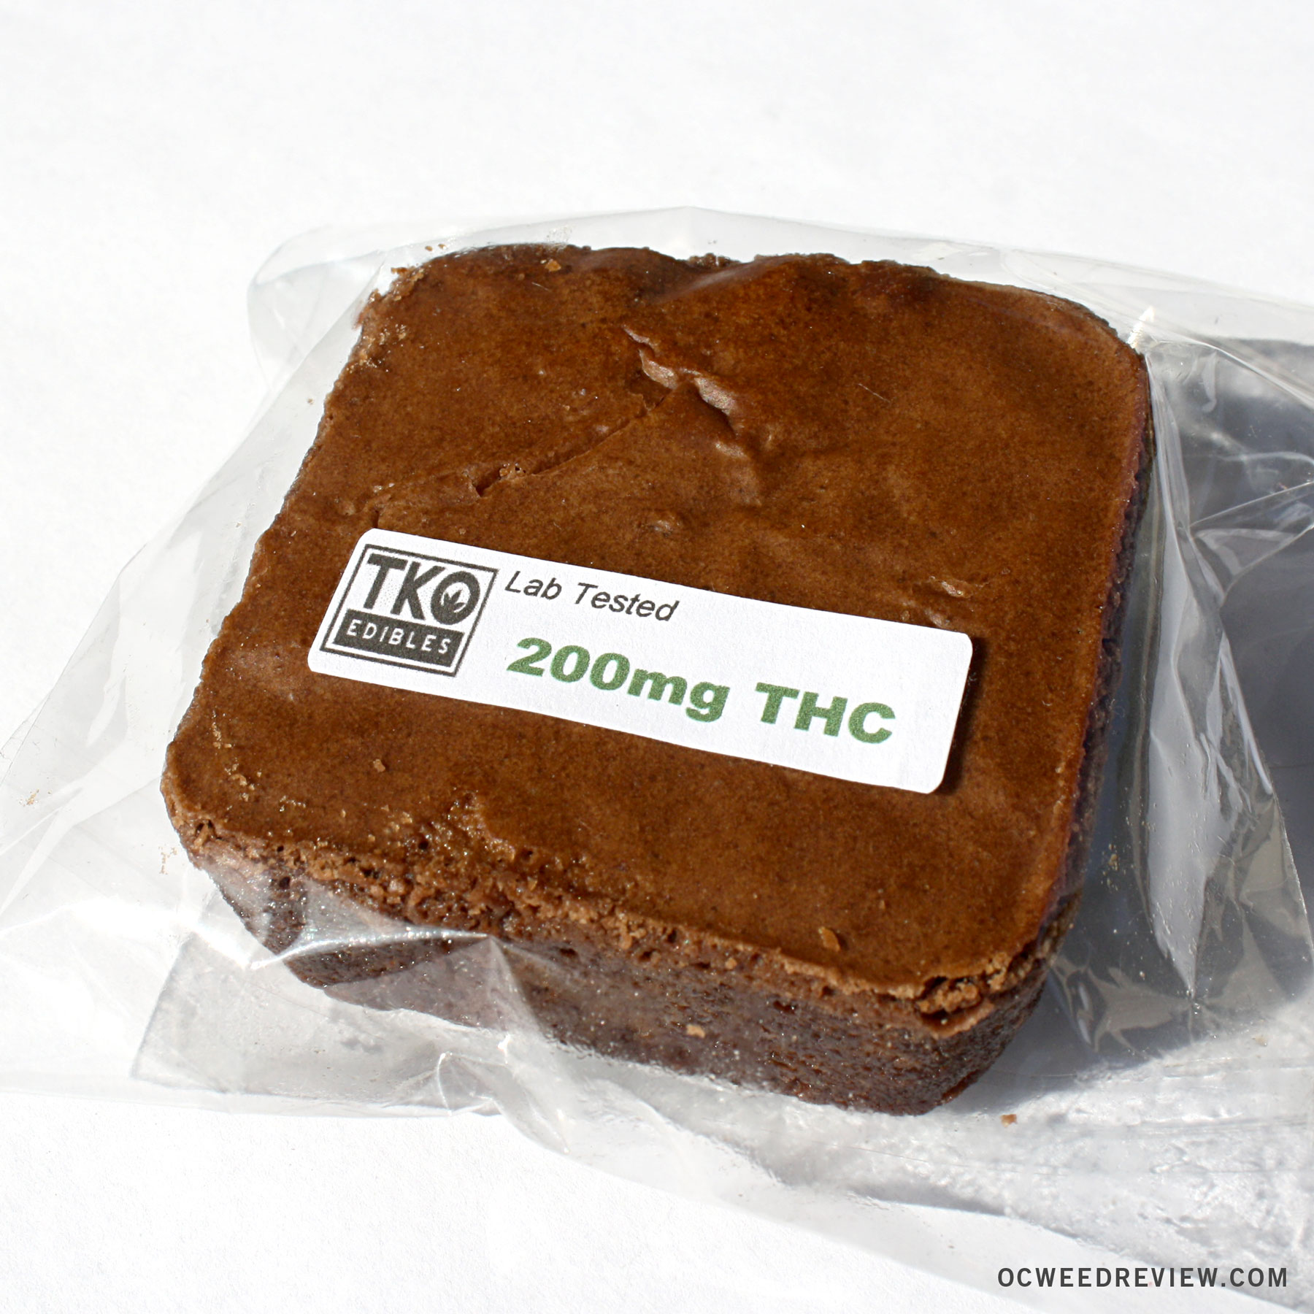
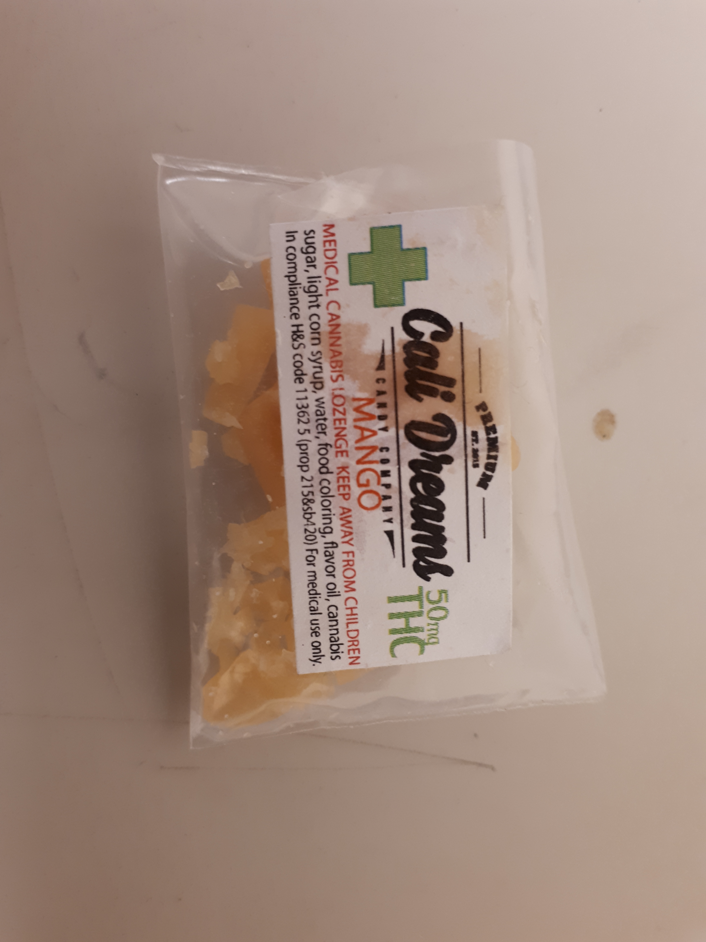
Cannabis edibles
Cannabis Brownies
Dried Infused Fruit
Infused Taffy/ Caramel
Notes:
- Traditionally brownies were made with “regular” batter and crumbled resin or plant material but now it is being produced with cannabutter which alters the appearance of the product. You can imagine if you picked up a brownie with some leaves sticking out of it you might wondering what on earth was going on? Unless of course you knew what it was beforehand. Now with the creation of cannabutter the products just look like “normal” baked treats. People make brownies, cookies, cupcakes. Research suggests you can make fried chicken, macaroni & cheese, pizza… let list goes on. If the butter is correctly made then you can have higher levels of THC in the edibles than previously recorded.

Slide 10
Cannabis products
Homemade Products
Foil wrapped packages
Knotted plastic packages
Parchment paper packages
Commercially Manufactured Products
Properly labelled packages
Cannabinoid content detailed
Usually has a fun name

