Slide 1
An Evaluation of the National Drug Control Master Plan and Action Plan: 2013—2017
October 9, 2018
John Carnevale, Ph.D.
David Theiss, M.Sc.
Carnevale Associates, LLC

Slide 2
Our Approach
Our methodology involved working along two dimensions:
Structural Matters: Looked at the strategic framework itself. This includes the flow among elements including Vision, Mission, Goals, Objectives, Action Plans, and Desired Outcomes.
  For example, was the Master Plan based on a comprehensive needs or situation assessment that involved input from stakeholders about problems needing to be addressed?
  Were action plans achieved?
Performance Success: In the end, the primary objective is to assess whether the Master Plan achieved intended results—in other words, were the desirable results for reducing drug use and its consequences achieved.
Notes:
Carnevale Associates LLC (CALLC) was tasked by the Department for National Drug Control (DNDC) with assessing the effectiveness of Bermuda’s National Drug Control Master Plan and Action Plan: 2013—2017. The assessment includes reviewing the strategy to determine the clarity of its structure and long‐term outcomes sought for 2017. This includes determining whether its goals, objectives, and action plans are easily understood by stakeholders involved in making its drug policy a success. It also includes looking at how the administrative approach Bermuda takes to formulating and managing its drug policy is structured to operationalize the Master Plan, success in implementing the action plans, success in realizing hoped-for funding levels, and success in achieving outcomes. In the end, our principal objective is to determine whether the Master Plan reduced Bermuda’s drug problem.

Slide 3
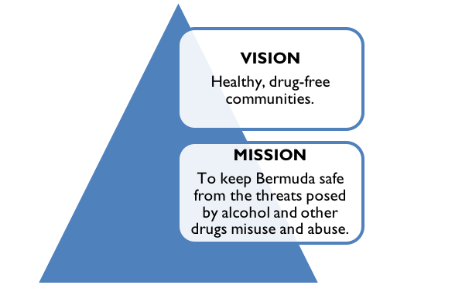
Structure of the Strategy
We find the Master Plan to Be Structurally Sound:
Three goals supported by 18 objectives spanning demand reduction and supply reduction activities.
Supported by 59 action plans.
Action Plans are supported by a detailed projection of resource (budget) requirements to fund them.
All of this is based on a thorough Needs Assessment that includes fairly comprehensive data on drug use, consequences, and enforcement.
Vision and Mission Statements

Slide 4
Strengthen Key Strategic Goals
There are 3 Strategic Goals:
To reduce drug-related harms by recognizing the drug problem as a major public health threat to the nation.
To minimize the immediate concerns to the citizens in the context of the principal harms of drug use and abuse such as crime, public nuisance, drug-related violence, physical and mental health problems, social costs and community degradation.
To respect human rights, local judicial norms, and cultural attitudes toward alcohol and drug use.
These Goals could be made more direct, e.g., Goal 1 could be restated as follows: Reduce Drug-Related Harms
We find Goal 2 to be amorphous; unclear--sounds like Goal 1 (reduce harms)
We find Goal 3 to be more of a value statement rather than a Goal.
Notes:
Perhaps make Goal 1, Reduce Drug Use or Problem Drug Use and make Goal 2, Reduce Drug-related Harms?

Slide 5
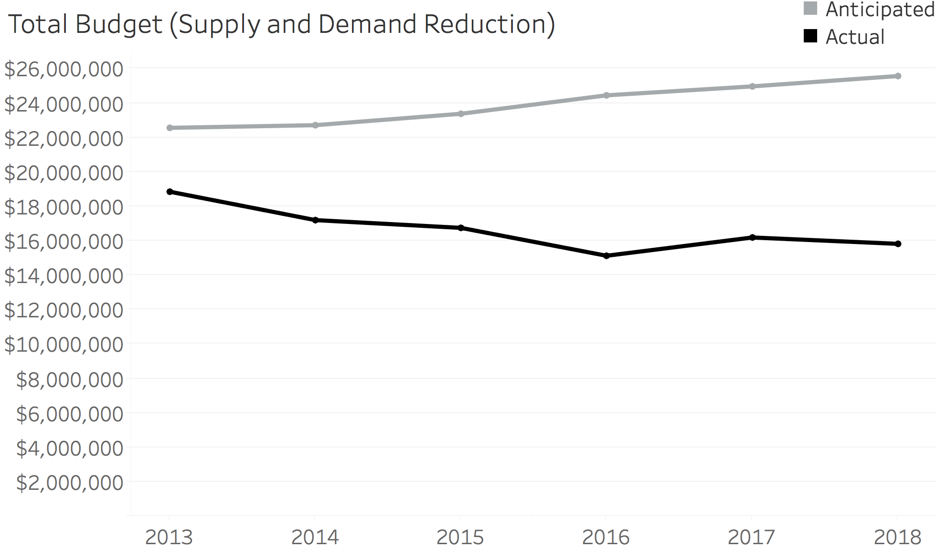
Budget: Comes Up Short (they always do)
Notes:
These figures were compiled using data available from the Bermuda Drug Information Network (BerDIN) annual reports, the Master Plan, and the Key Aspects of the Needs Assessment document provided to the reviewers by DNDC. As will be shown, there is no instance where actual resources exceeded resources anticipated necessary to support the successful implementation of the Master Plan.

Slide 6
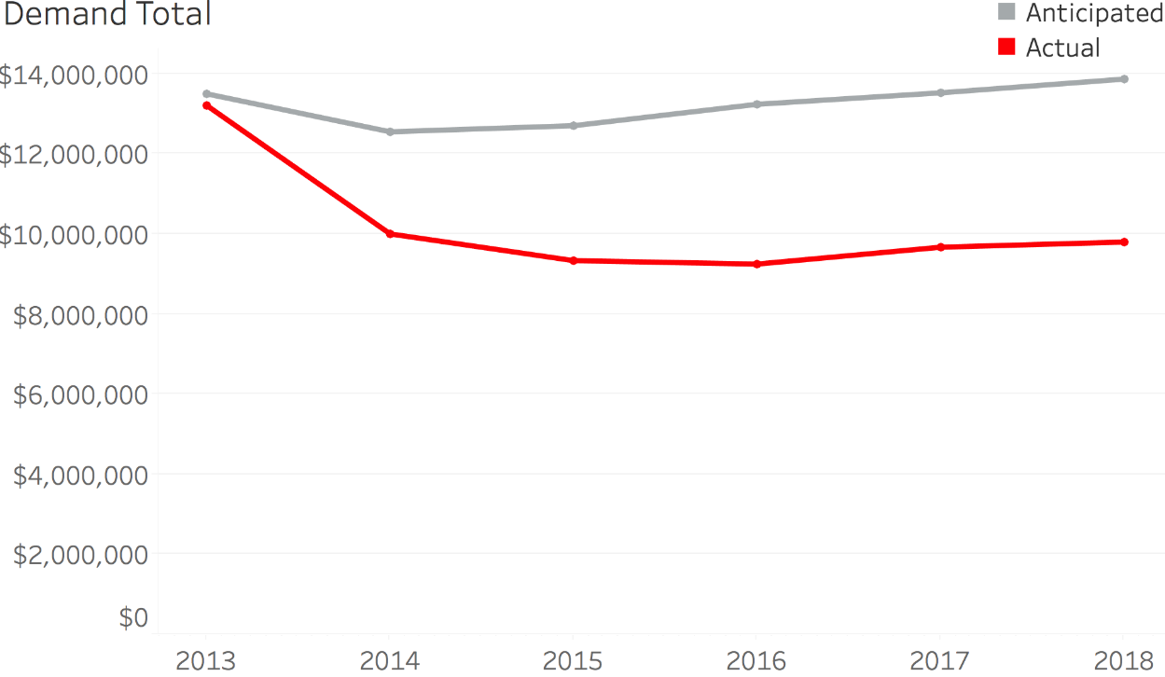
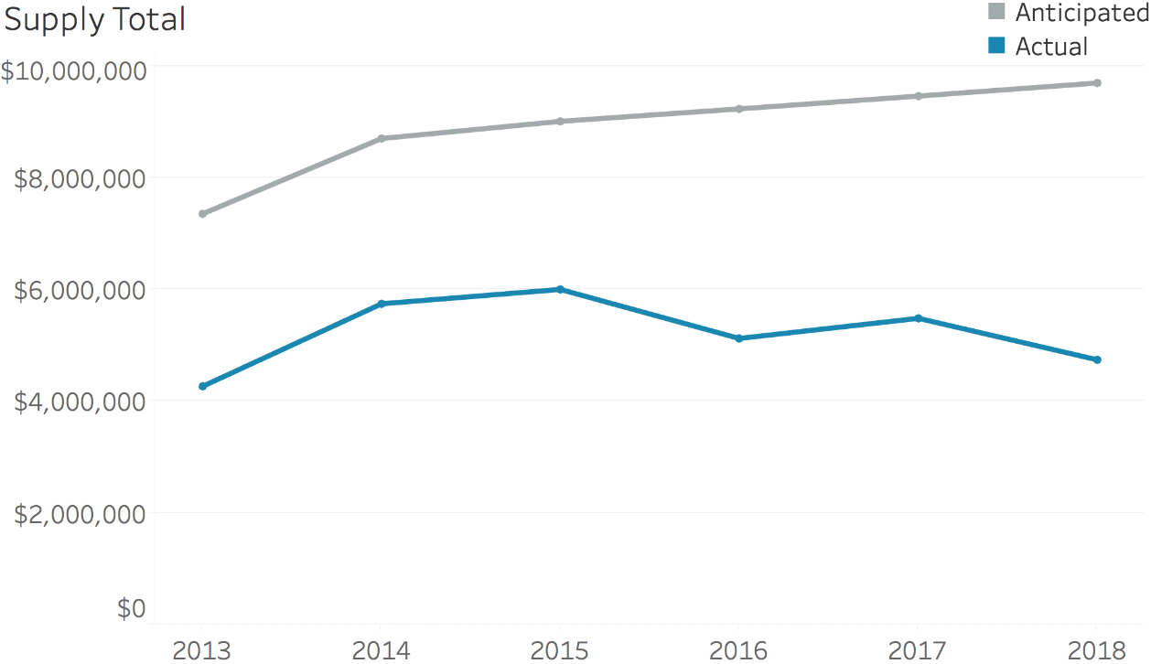
Budget: But Demand does better than Supply
Demand budgets fell short by an average of 30% of anticipated need;
Supply budgets fell short by an average of 50% of anticipated need.
Notes:
While both budgets come up short, demand does better than supply with regard to realizing anticipated need.

Slide 7
Expected Success in Achieving Action Plans
The Action Plan for Bermuda’s Master Plan is divided into five sections: 1) Management and Coordination; 2) Prevention; 3) Treatment; 4) Supply reduction; and 5) Research, Evaluation and Policy.
Bermuda’s drug control plan has made significant inroads in each of these areas, but a large portion of the overall action plan remains incomplete.
As of January 2018,
  27 of the 59 (46 percent) action plan were incomplete.
  Nineteen action plan points are considered complete,
  8 action points are classified as “ongoing”, and
  5 action points are catalogued as “partially complete”.

Slide 8
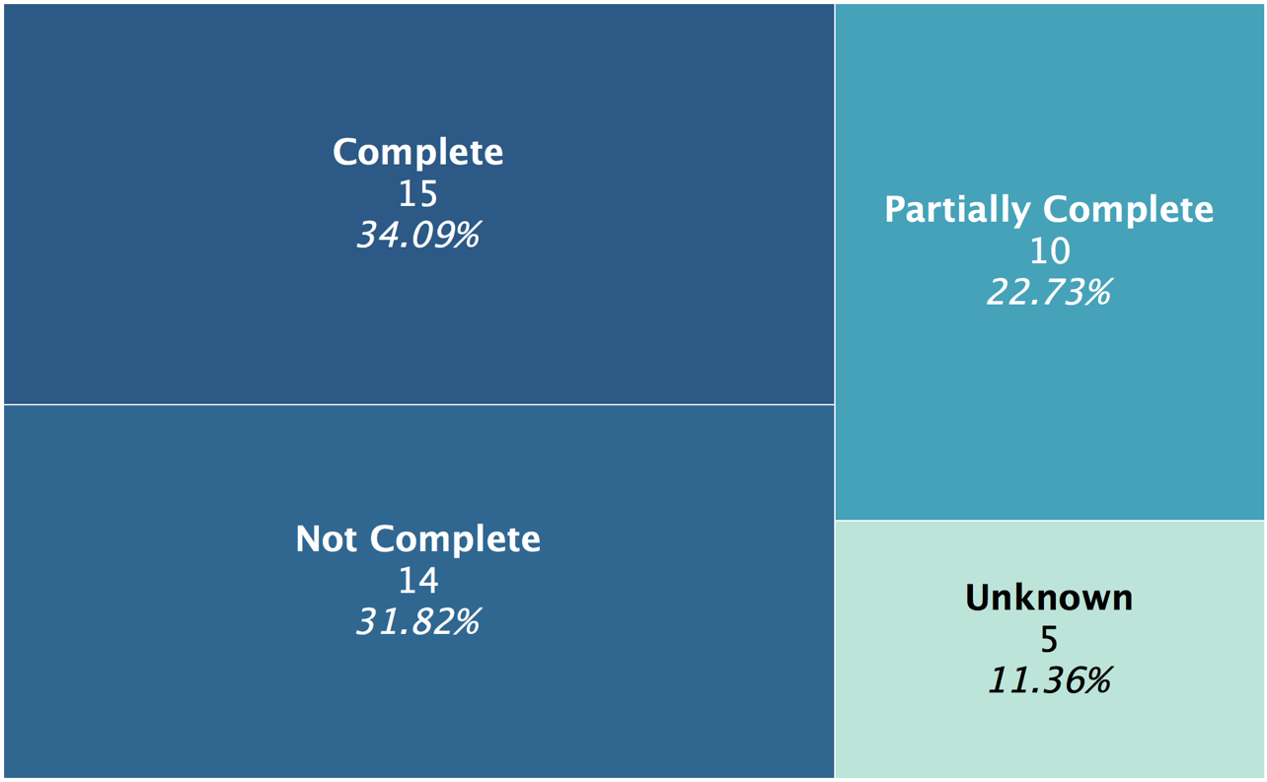
Expected Success in Achieving Action Plans
Notes:
As the previous analysis demonstrated, despite challenges in obtaining all of the resources needed to implement the Master Plan, our analysis finds that Bermuda has successfully completed or partially completed 57 percent of its action plans. This is a remarkable outcome and demonstrates the resolve of the DNDC to address Bermuda’s drug problem. We also note that the action areas under the direct control of the DNDC had the greatest success. The DNDC funds much of the demand reduction programs and research. Not surprisingly, therefore, these areas of the Master Plan demonstrated the most success. The lesson to be learned from this is that the other areas of the budget and their implementation require more oversight from an outside, independent source. Doing this will enable more performance accountability in Bermuda’s organizational framework, an element of the framework where we found some room for improvement.

Slide 9
Finding with Regard to Overall Drug Use
We find progress in reducing adult drug use over the period of the Master Plan—this is the good news—but also find that Bermuda’s youth are using more drugs—this is the bad news.
While the progress achieved with adults is good news for the formulation of the next Master Plan, the news about Bermuda’s youth should be a major cause for concern.
Notes:
In fact, this is the situation for all of the drugs reported in the 2017 Household Survey for adult use:

Slide 10
Findings with Regard to Adult Drug Use
There was a dramatic decline in the use of marijuana among adults. 20.2 percent of adults reported lifetime use of marijuana in 2017 compared with 37.0 percent in 2009.
This change is also reflected in current use of marijuana; it was 4.8 percent in 2017 compared with 7.5 percent in 2009.
Current use of Alcohol and tobacco is down as well.
The use of cocaine, heroin, and hallucinogens continues to be a very small problem for adults.
Notes:
In fact, this is the situation for all of the drugs reported in the 2017 Household Survey for adult use:

Slide 11
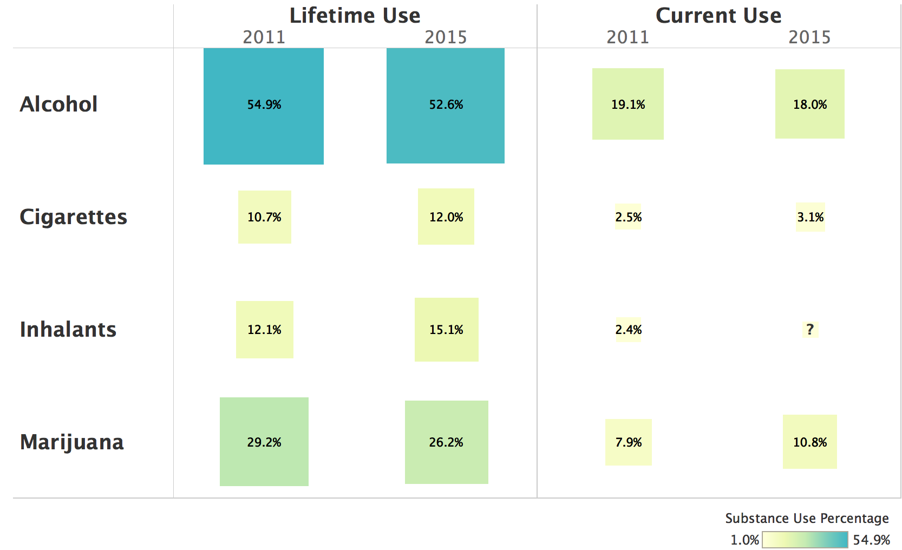
Change in Youth Drug Use: Concern about Current Marijuana Use
Notes:
According to available data, there has been progress in reducing youth alcohol use, but the situation with other drug use is deteriorating:
Lifetime use of alcohol declined modestly from 54.9 percent in 2011 to 52.6 percent in 2015. Similarly, current use of alcohol declined from 19.1 percent in 2011 to 18.0 percent in 2015.
Lifetime use of marijuana increased from 21.2 percent in 2011 to 26.2 percent in 2015. Current use increased as well. The rate of current use in 2015 of 10.8 percent is 37 percent higher than the 7.9 percent reported in 2011. This is clearly a troubling trend.
Likewise, other drug use (though less frequent by comparison to alcohol and marijuana) worsened. Lifetime use of inhalants increased from 12.1 percent in 2011 to 15.1 percent in 2015; current inhalant use increased from 2.4 percent in 2011 to 3.0% in 2015.
Unlike their adult counterparts, youth are smoking more. Lifetime use increased modestly from 10.7 percent in 2011 to 12.0 percent in 2015; current cigarette use increased from 2.5 percent in 2011 to 3.1 percent in 2015.

Slide 12
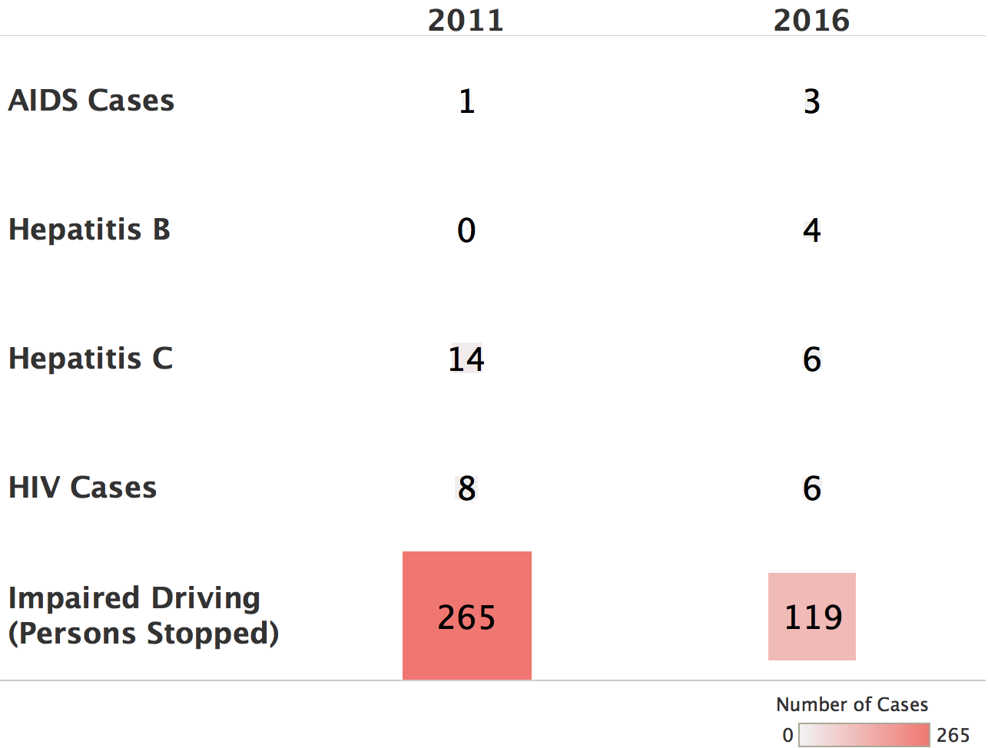
Drug-related Health Consequences Continue to be a Small Problem
There appears to be progress in reducing impaired driving, but it is not clear if this progress is real.
What is unknown is whether this decline is due to a lower level of enforcement by law enforcement targeting impaired driving, or success in educating the public about the dangers of impaired driving.
This issue clearly warrants further exploration by the DNDC.
Drug-Related Health Consequences 2011-2016
Notes:
Drug-related health consequences: Data reported to the DNDC show a handful of cases of HIV/AIDS over the period from 2011 to 2016. In short, the paucity of cases of HIV, AIDs, Hepatitis B and C is laudable, especially compared to other nations.
Given low rates of heroin use in Bermuda, it appears that needle sharing continues to not be an issue for Bermuda.
Hepatitis B and C: As is the case with HIV/AIDS, Bermuda does not see many cases of Hepatitis B or C. Hepatitis C cases declined by over half the level in 2011 (from 14 to 6 cases), but the number of Hepatitis B cases increased from zero to four. In any event, the good news is that Hepatitis remains a very small problem.
Impaired Driving: There appears to be progress in reducing impaired driving, but it is not clear if this progress is real.

Slide 13
Increasing Drug Treatment Admissions
Between 2012 and 2016, the number of individuals admitted to drug treatment at one of Bermuda’s seven identified programs annually climbed from 93 to 152.
During this five-year period, female treatment admissions doubled from 15 in 2012 to 31 in 2016. This jump represents a 107 percent increase in female treatment admissions.
Male treatment admissions also increased during these years, jumping from 78 in 2012 to 121 in 2016. This represents a 55 percent increase in male treatment admissions.
Female admissions increased modestly. In 2012, females accounted for 16 percent of all treatment admissions and 20 percent of admissions in 2016.
Notes:
According to statistics provided in BerDIN annual reports, drug treatment admissions in Bermuda increased between 2012 and 2016.

Slide 14
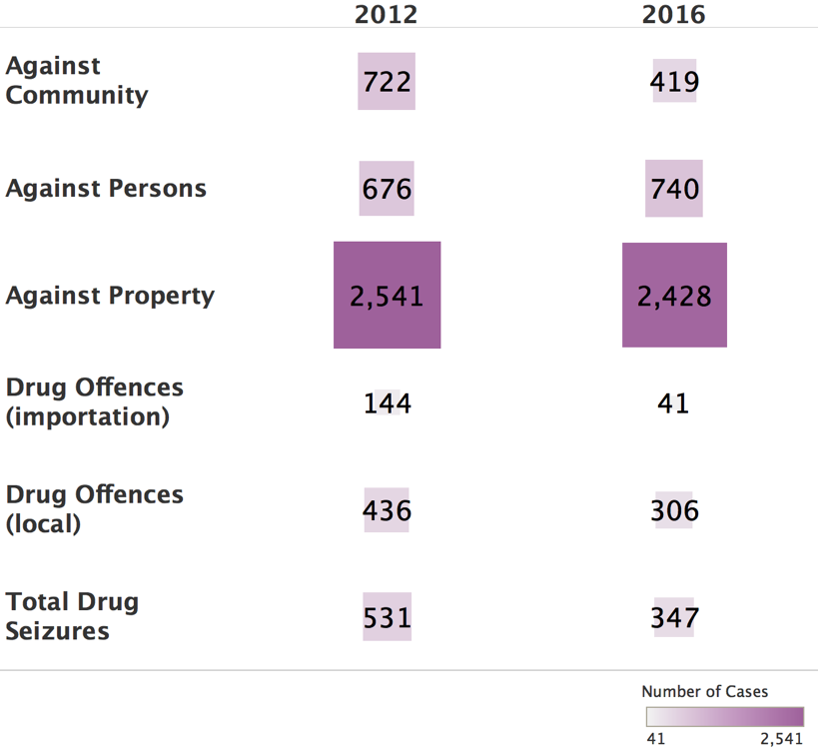
Improvement (reduction) in crimes, drug possession, and importation of drugs
  Crimes reported against persons or the community declined
  Crimes against property declined
  Drug offences for importation or local offenses also declined
  Substantial reduction in drug offenses, both local and importation offenses
  Drug Possession: The largest reported area of drug offenses in 2011 was for cannabis possession
  Drug seizures are also down over the period
Drug-Related Crime Consequences 2012-2017

Slide 15
Our Six Major Recommendations (w/o detail)
Establish a National Centralized Coordinating Body that reports to Cabinet regularly on the progress in implementing the Master Plan.
Strengthen the DNDC’s ability to manage the implementation of the Master Plan.
Require annual pubic progress reports for the Master Plan.
Improve the structure of the Master Plan by clarifying its strategic goals.
Continue to strengthen and expand the Drug Information Network to improve monitoring and evaluation.
Conduct ongoing research and evaluation of Bermuda’s cannabis reform.

Slide 16
Our Six Major Recommendations (with detail)
Establish a National Centralized Coordinating Body that reports to Cabinet regularly on the progress in implementing the Master Plan.
  Elevate the DNDC to a higher executive level policy office, independent of any Ministry.
  Require the DNDC to provide direct support to the National Centralized Coordinating Body.
Strengthen the DNDC’s ability to manage the implementation of the Master Plan.
  Designate an individual in each Ministry involved in drug control to report to the DNDC about budget, progress on action plans, and performance results.
  Expand external, private sector stakeholders to include the business community.
Require annual pubic progress reports for the Master Plan.
Improve the structure of the Master Plan by clarifying its strategic goals.
Continue to strengthen and expand the Drug Information Network to improve monitoring and evaluation.
  Strengthen oversight of program and budgets of the supply reduction agencies.
  Include information showing progress in funding drug control activities against desired levels in the government’s annual budget.
Conduct ongoing research and evaluation of Bermuda’s cannabis reform to include:
  Lessons learned from public health approaches implemented under cannabis reform, occurring in areas outside of Bermuda, to include effective prevention strategies and messaging.
  Special studies to better understand the epidemiology and trends in cannabis use, frequent use, and cannabis use disorder and its criteria (also called abuse, dependence, or addiction).
  Annual analyses of changes in incidence and prevalence of cannabis use and consequences such as impaired driving, psychological or medical consequences, and drug treatment needs.
  Effect of cannabis reform on tourism (e.g., drug tourism).
Notes:
With regard to the recommendation on cannabis reform, we note in the report:
Research is needed to understand the impact of cannabis reform. Whether it comes in the form of decriminalization, medicalization or use for non-medical purposes (sometimes called recreational use), cannabis reform policy is well ahead of the science. A recent study for the U.S. National Institute on Drug Abuse proposed a policy research agenda to close the substantial knowledge gap that exists between the science and the policy related to cannabis reform. The recent decriminalization of cannabis in Bermuda will likely lead to changes in use, health and public safety consequences, and perhaps the cannabis market. To achieve Bermuda’s vision stated in its Master Plan (healthy, drug-free communities), we urge the DNDC to develop a research agenda that supports a public health approach to ensure that Bermudians public perceptions about the health risks associated with cannabis use are informed by science.
Report: National Advisory Council on Drug Abuse, Cannabis Policy Research Group, “Recommendations for NIDA’s Cannabis Policy Research Agenda”, National Institute on Drug Abuse, Rockville, Maryland, February 6, 2017.

Slide 17
Conclusions
Our evaluation of the National Drug Control Master Plan and Action Plan 2013—2017 (the Master Plan) finds that Bermuda did make progress in improving its drug situation.
There were improvements in supply and demand outcomes, with the exception being youth drug use, particularly related to marijuana use. This area should be addressed in the next Master Plan, particularly in light of recent cannabis reform in Bermuda.
Our six recommendations are intended to address structural matters related to how drug policy is managed (recommendations I, II, and III), provide greater clarity in the Master Plan’s goals (recommendation IV), and to continue to expand knowledge of best practices from research/ data collection (recommendation V).
We also recommend a new research focus on assessing the effect of cannabis reform in the wake of evidence what may be the start of a growing trend in drug use among Bermuda’s youth (recommendation VI).

