Slide 1
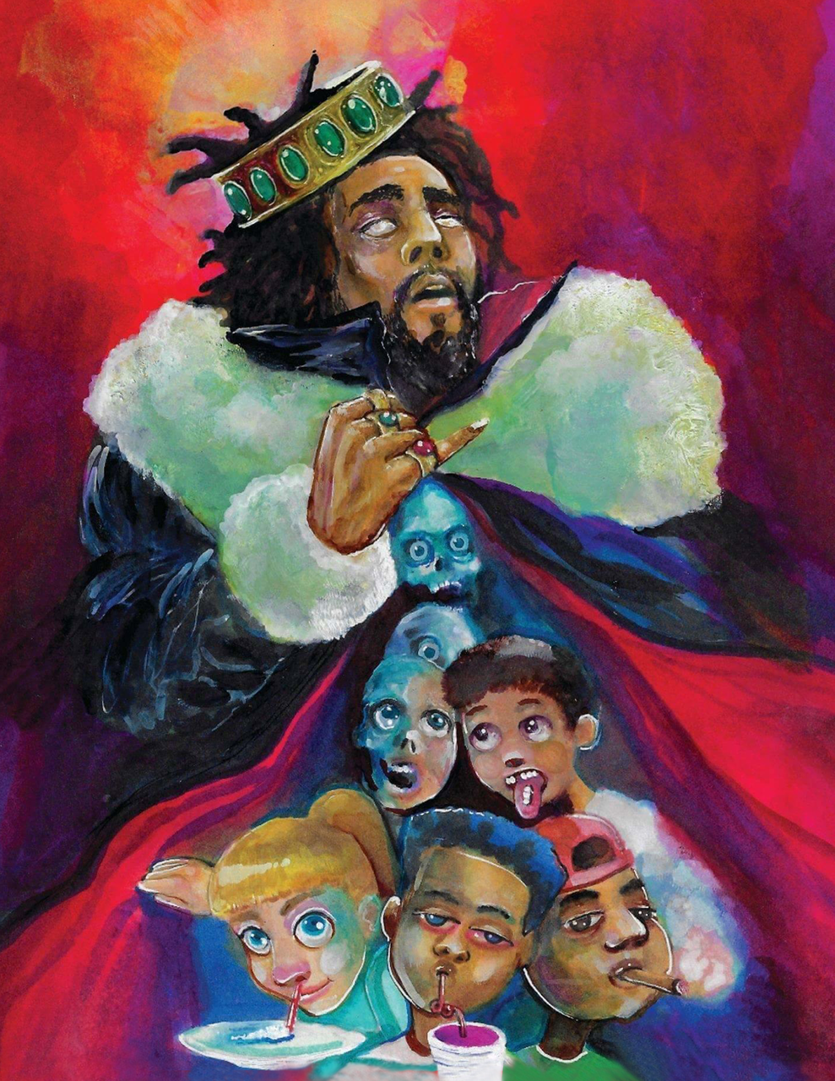
THE GLORIFICATION
OF
SUBSTANCE ABUSE
The Worshipful Juan P. Wolffe
2018 Annual Meeting of BerDIN
The Fairmont Hamilton Princess
18th & 19th October 2018

Slide 2


Slide 3
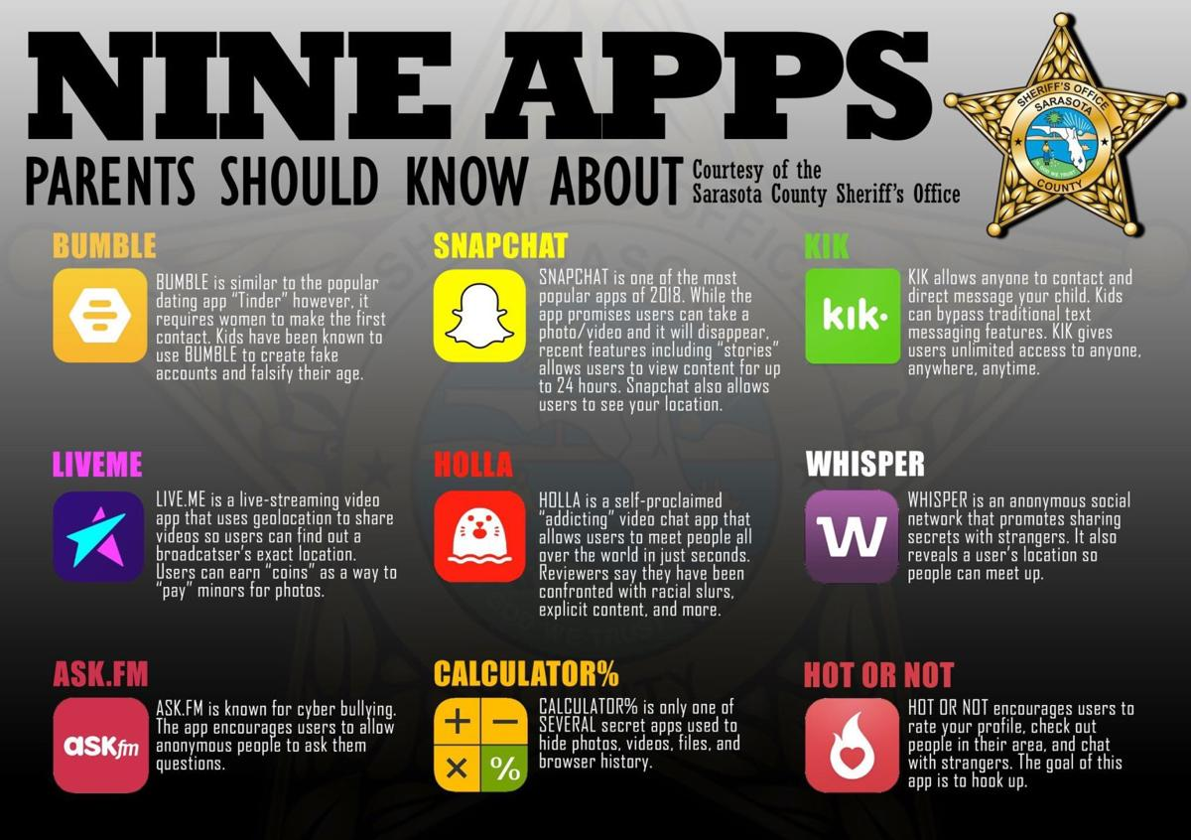

Slide 4
THE RESEARCH
Images are powerful as they quickly transmit information to our brain and they trigger our emotions.
BUT THEY ALSO IMPACT OUR ABILITY TO MAKE DECISIONS
AND COULD INFLUENCE WHAT ACTIONS WE TAKE
The more vivid the image, in terms of movement, colour and accuracy of representation, the more realistic, the more its going to stimulate your response to it.*
*Smarandescu and Mennecke (2013)(Iowa State University)

Slide 5
- Youth claim the Internet as a defining part of their culture and an integral part of their daily lives.
In Canada, teenagers see between 1000 and 2000 beer commercials carrying the message that “real” men drink beer.
50% of G-rated animated feature films, as well as music videos, show alcohol use as normative behaviour without conveying the long term consequences.
Convincing data suggest that advertising increases beer consumption (in countries like Sweden, a ban on alcohol advertising has led to a decline in alcohol consumption).
Pediatric & Child Health (2003)

Slide 6
Statistics regarding teens, social networking sites, and substance abuse indicate that*:
40% Had viewed pictures on social media depicting teens and adolescents drinking, passed out or using drugs
50% Of viewers saw such images when they were 13 or younger
90% First viewed the photos when they were 15 or younger
*Casa Palmera, June 2015

Slide 7
MUSIC:
Is a part of growing up
Provides a distraction from problems and relieves tension
Used to form and control emotional status or mood
Serves as the basis for establishing relationships
Used in the process of identity formation
Used to achieve group identity and integration into youth culture
Defines social and subcultural boundaries
American Academy of Pediatrics (November 2009)

Slide 8
Music plays an important role in the socialization of children and adolescents.
Parents are often unaware of the lyrics to which children are listening.
The effect that music has on children’s and adolescents’ behaviour and emotions are of paramount concern.
A teenager’s preference for certain types of music could be correlated or associated with certain behaviours.
Use of substances in music videos might produce significant changes in behaviours and attitudes.

Slide 9
20% Of modern top ten songs (UK) contains a reference to alcohol (twice as many as 10 years ago)*
Since 2001, the number of alcohol-related lyrics has more than doubled.
Songs glamorize drinking and ignore potential risks.
Mentions of alcohol most common in tracks from the US and in R&B, rap and hip-hop genres.*
Fans of rap music showed a greater tendency to engage in reckless behaviour than fans of other types of music, and consistently showed below average school grades.**
*Daily Mail (UK), January 2018
**American Academy of Pediatrics (November 2009)

Slide 10
The sheer number of times that people (including our children) hear or see references to alcohol, marijuana, cocaine, heroine, and club drugs is part of what makes them more comfortable with experimentation.
ALSO
People who see their favorite singer, musician, actor, performer or character use drugs without consequences in a way which makes them seem “cool” or “tough” want to emulate that.

Slide 11
IN OTHER WORDS:
THEY BECOME DESENSITIZED
Problem is: When you are young, you’re IMPRESSIONABLE and you feel INVINCIBLE!
THIS IS A PRECARIOUS COMBINATION*
*HipHopDX, January 2018 (By Kyle Eustice)

Slide 12
WHY DOES THIS MATTER?
TEENS WHO VIEW PICTURES ON SOCIAL MEDIA DEPICTING SUBSTANCE ABUSE ARE AT HIGHER RISK TO ABUSE SUBSTANCES:
3x’s more likely to use alcohol
4x’s more likely to obtain and/or use marijuana

Slide 13
WHO DOES THIS AFFECT?
In music videos, blacks engaging in risky behaviours are overrepresented and whites are underrepresented.
People from minority and immigrant groups
Children with learning disabilities
Children who are abused by their parents
People in families in distress
Pediatric & Child Health (2003)

Slide 14
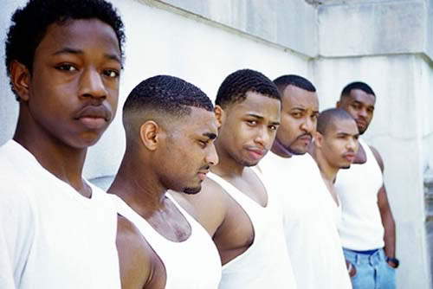

Male adolescents are more likely to use music as a stimulant, to boost energy levels, and create an image of themselves.
Female adolescents are more likely to use music to reflect their emotional state

Slide 15
THE PROOF

Slide 16
THE GLORIFICATION OF ALCOHOL ABUSE
The Bermuda Context

Slide 17
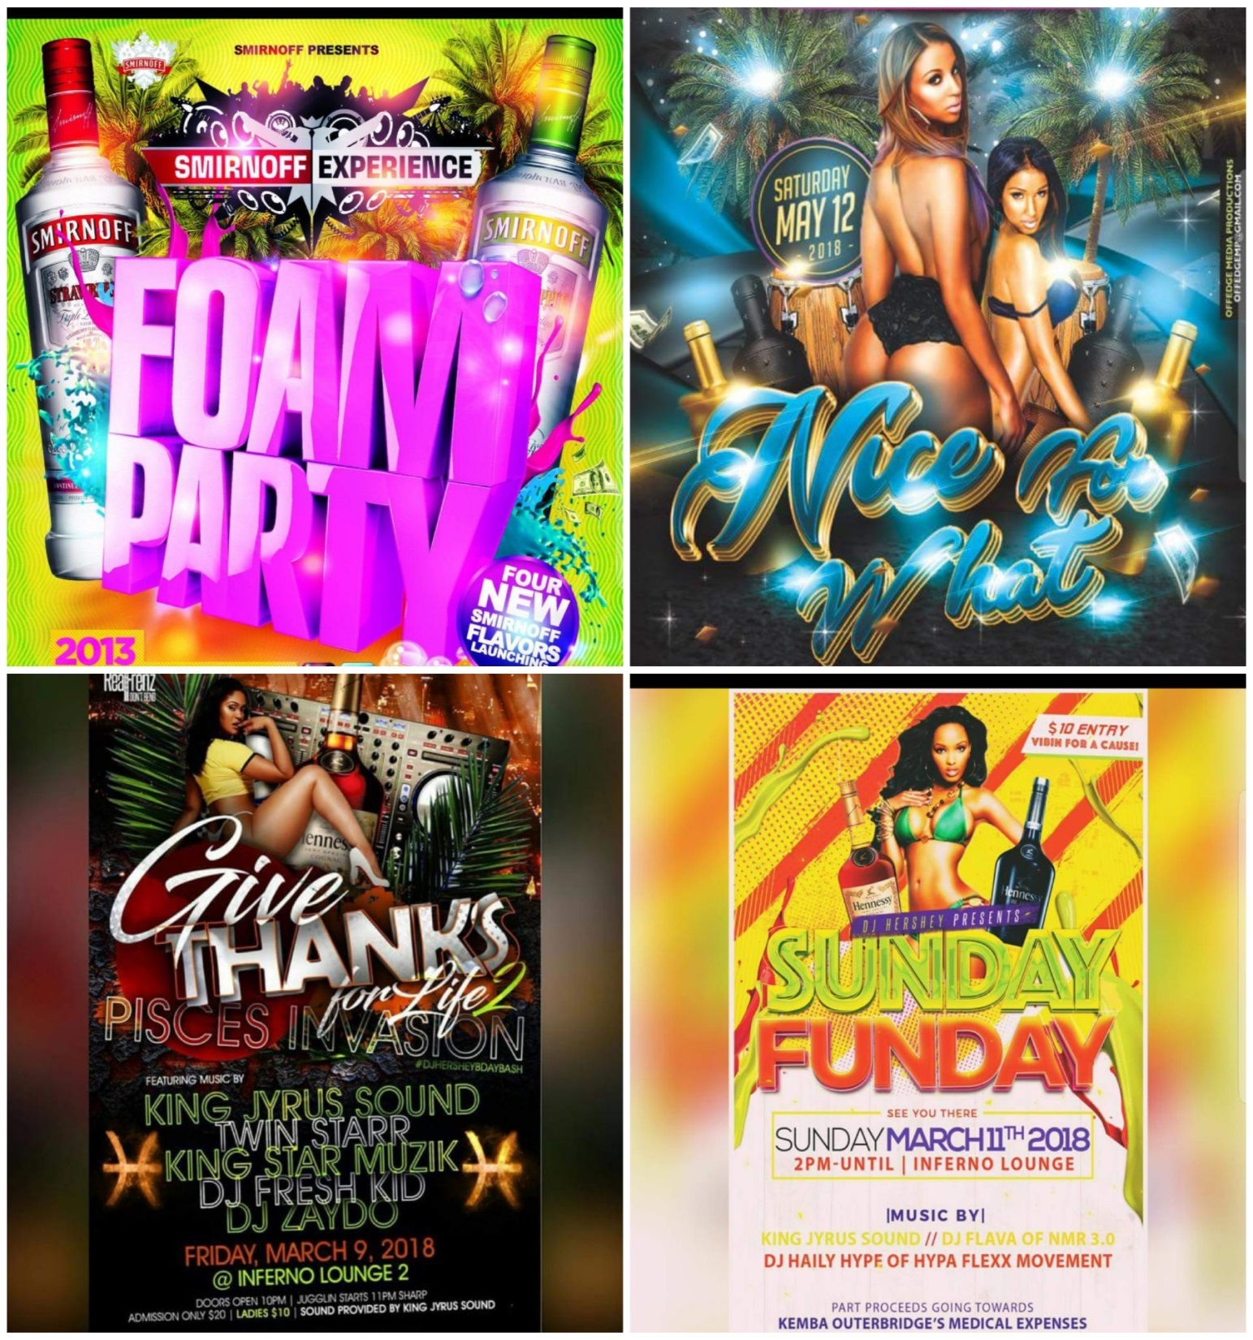

Slide 18
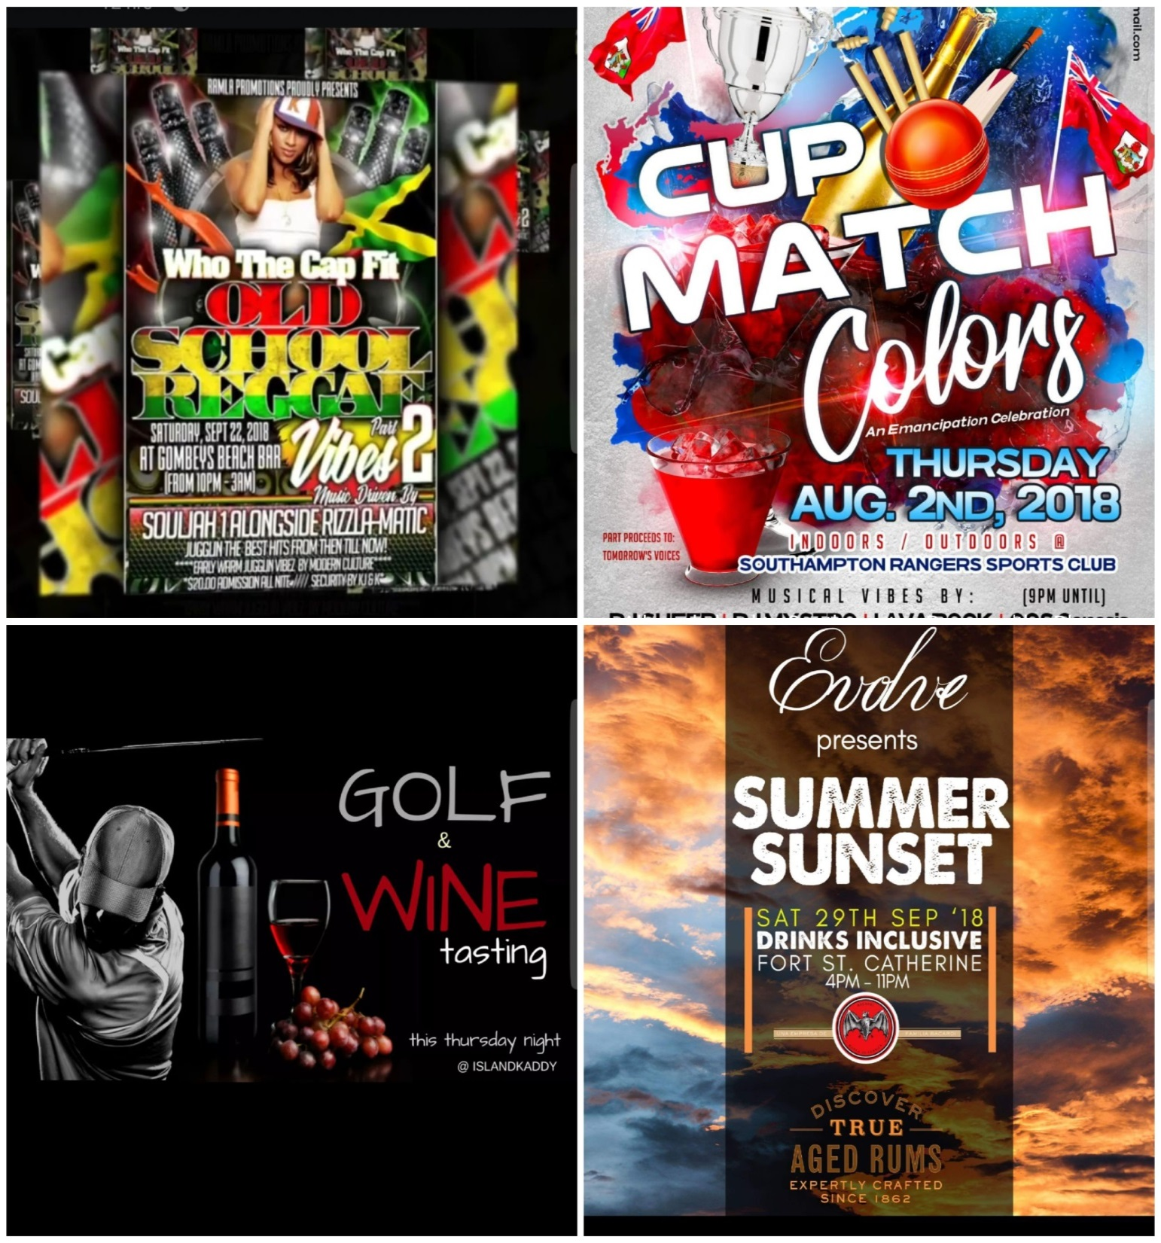

Slide 19
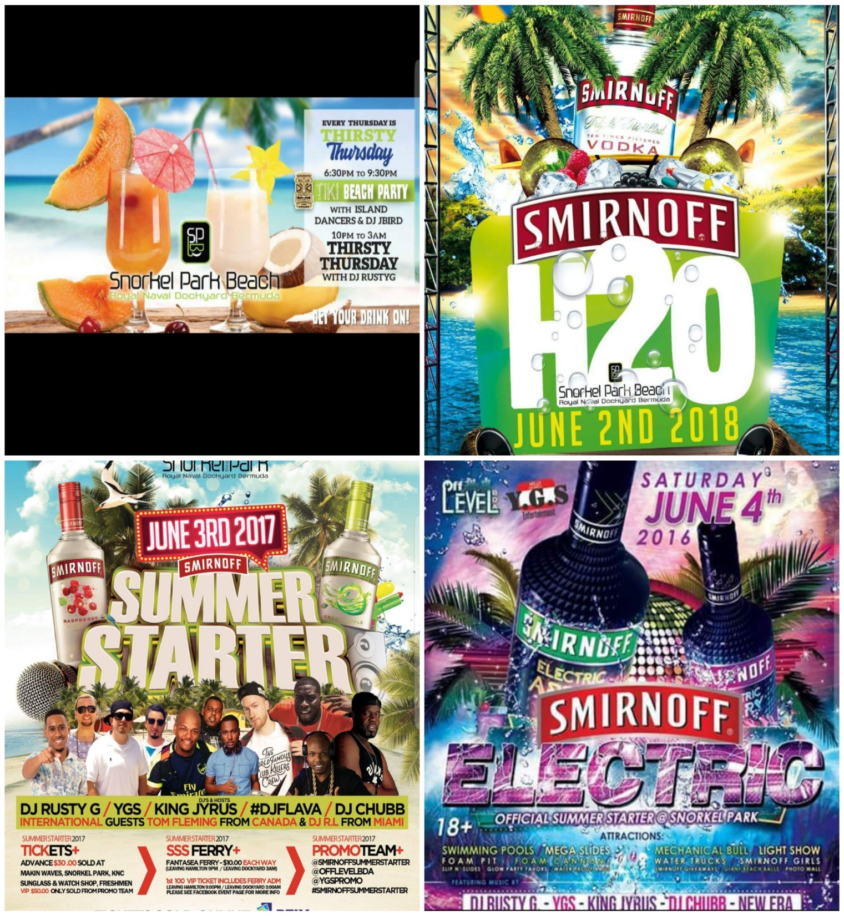

Slide 20
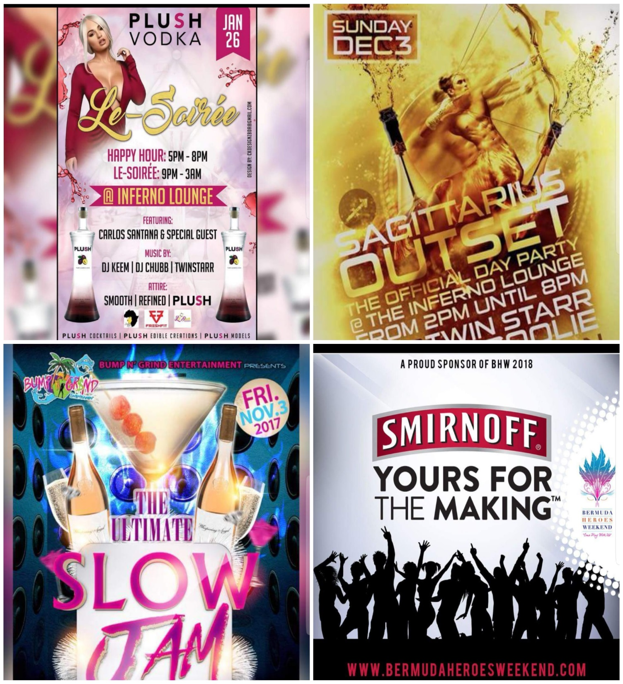

Slide 21
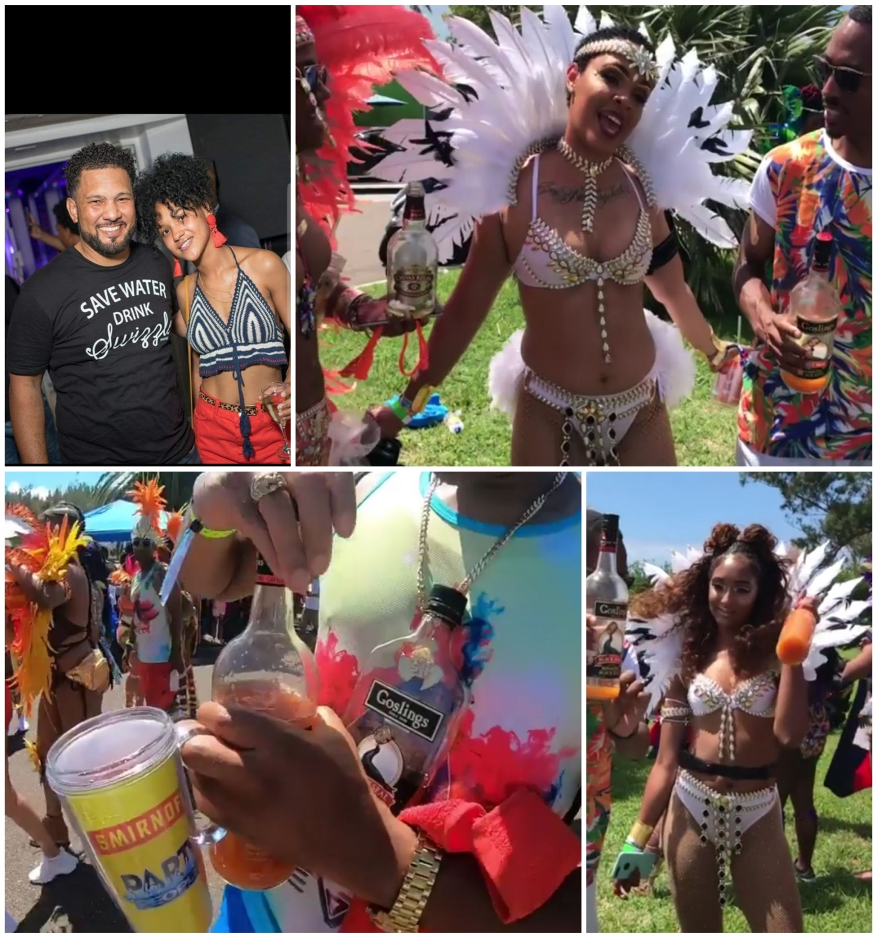

Slide 22
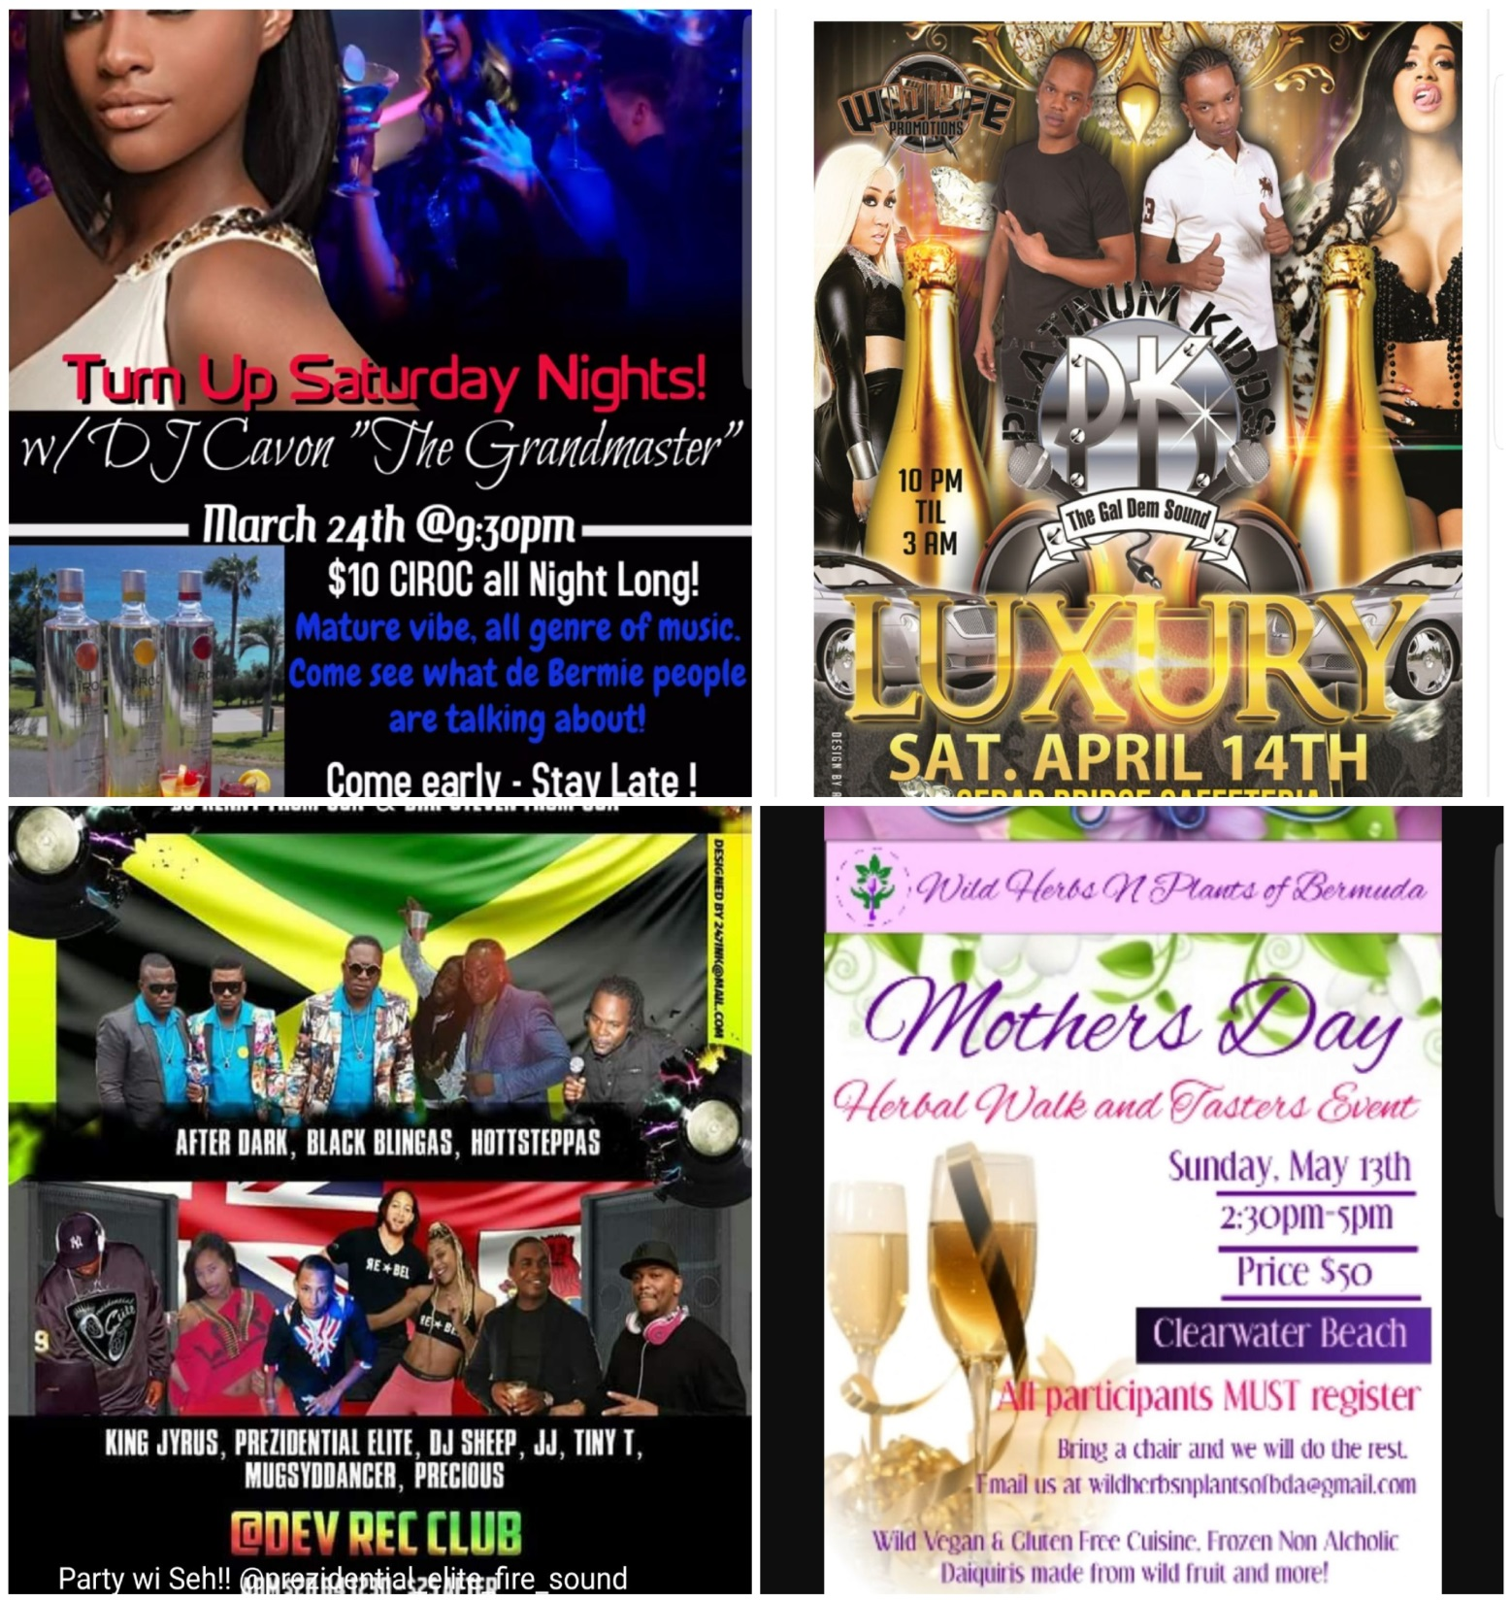

Slide 23
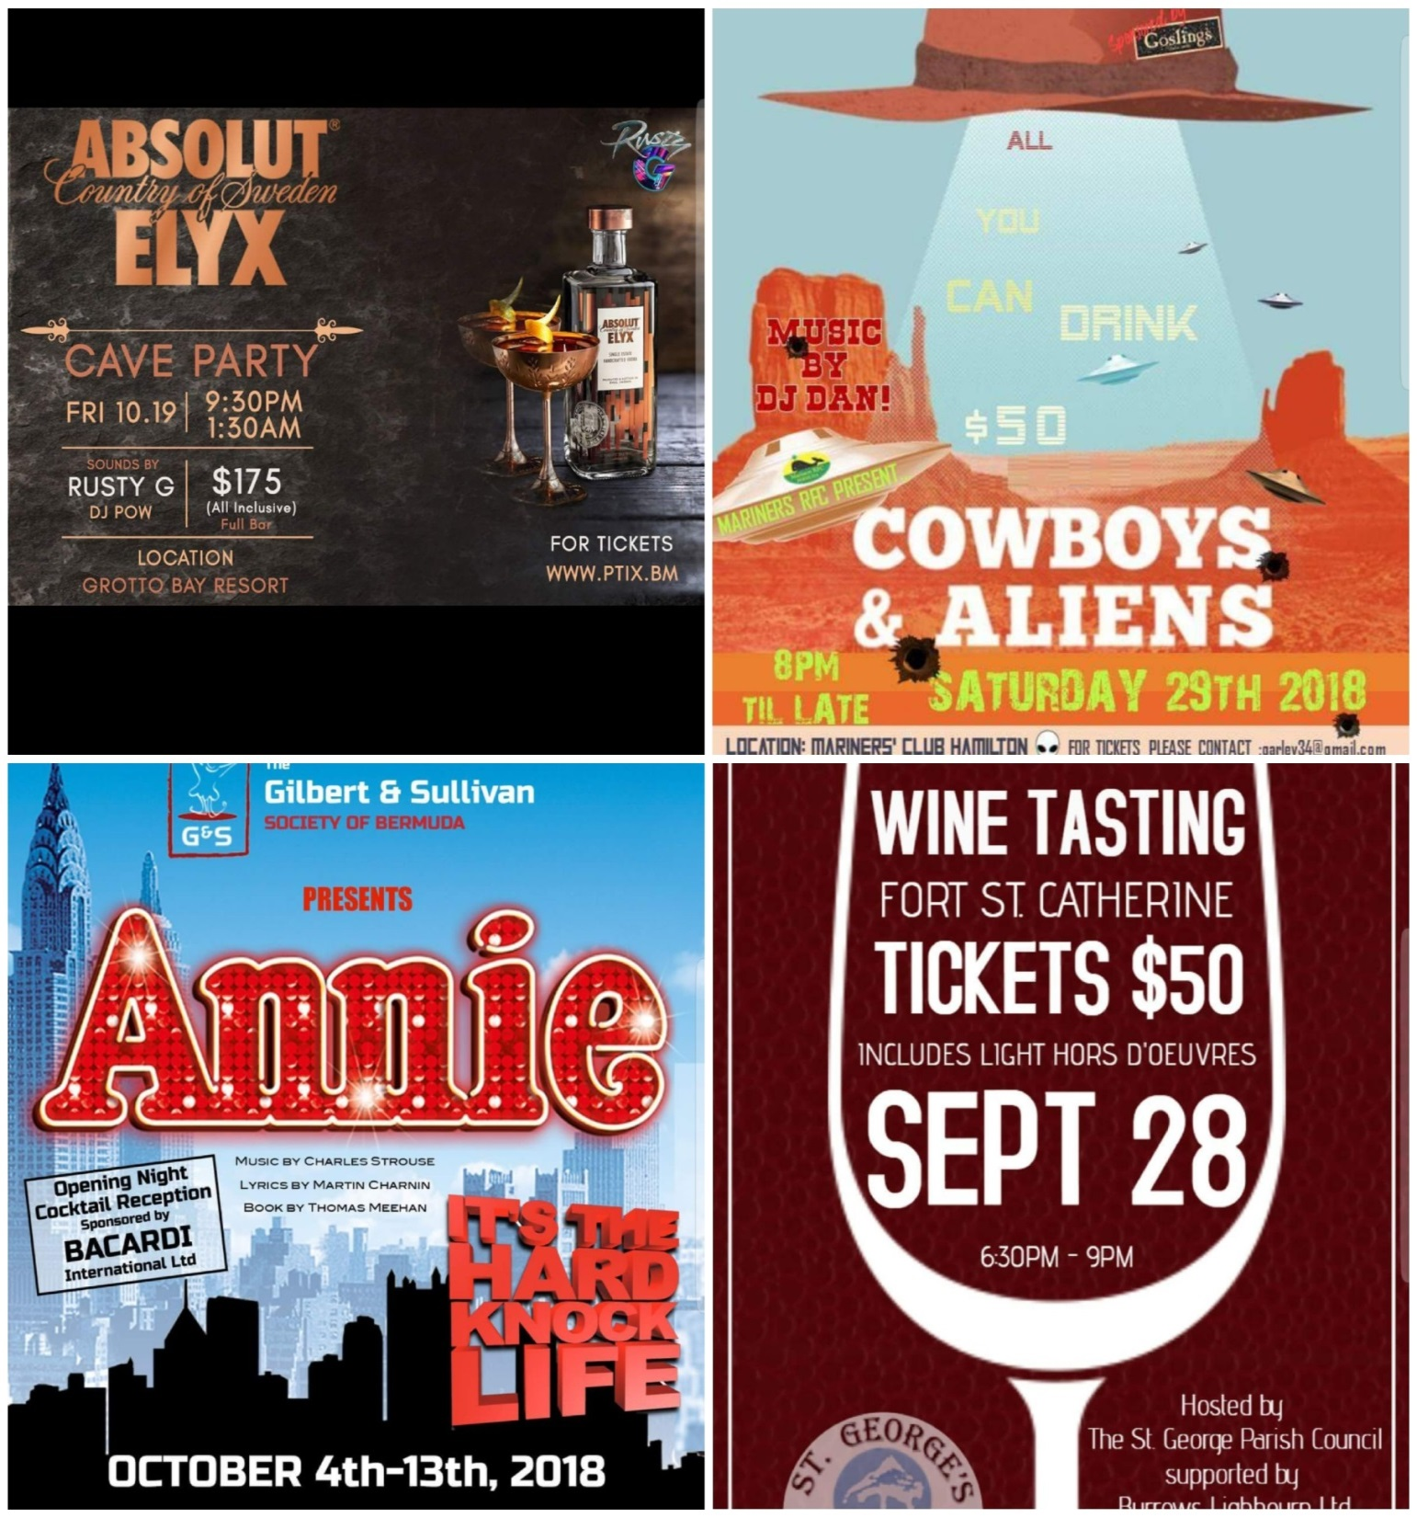

Slide 24
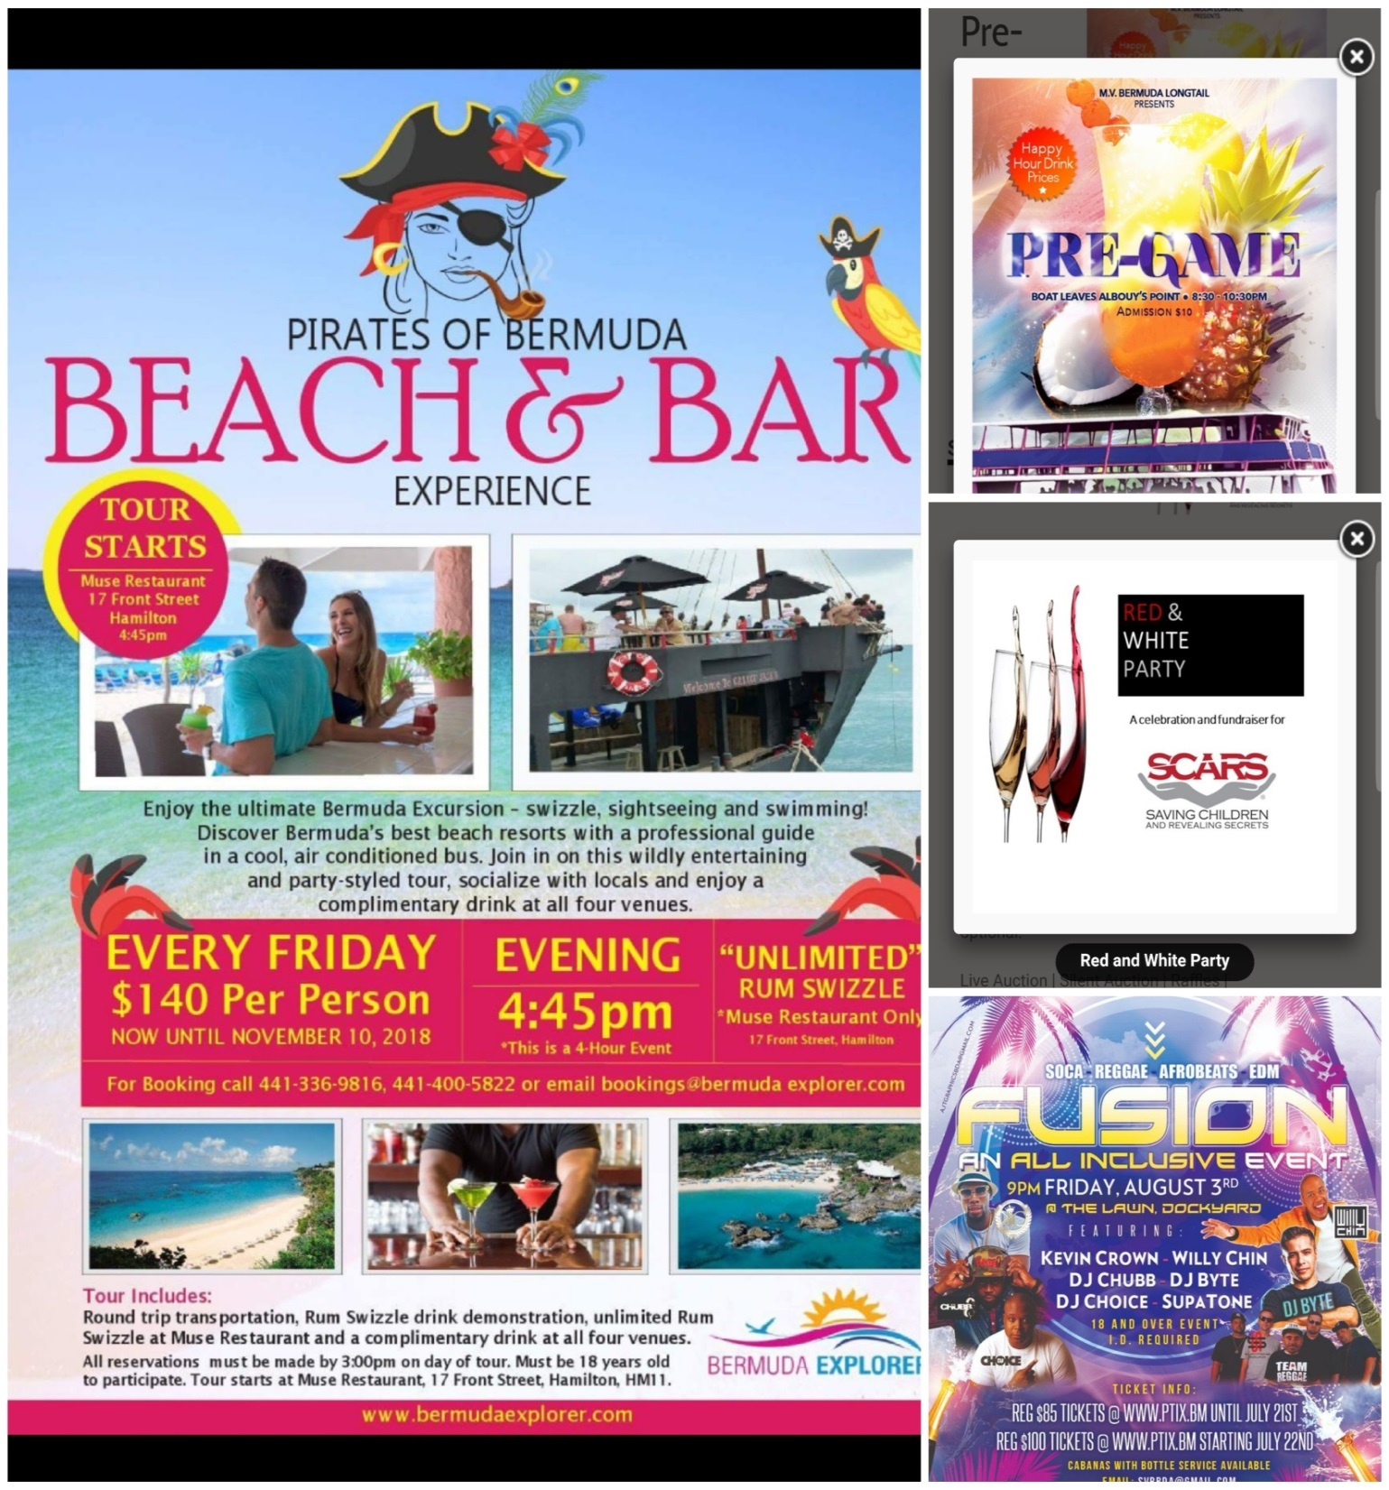

Slide 25


Slide 26
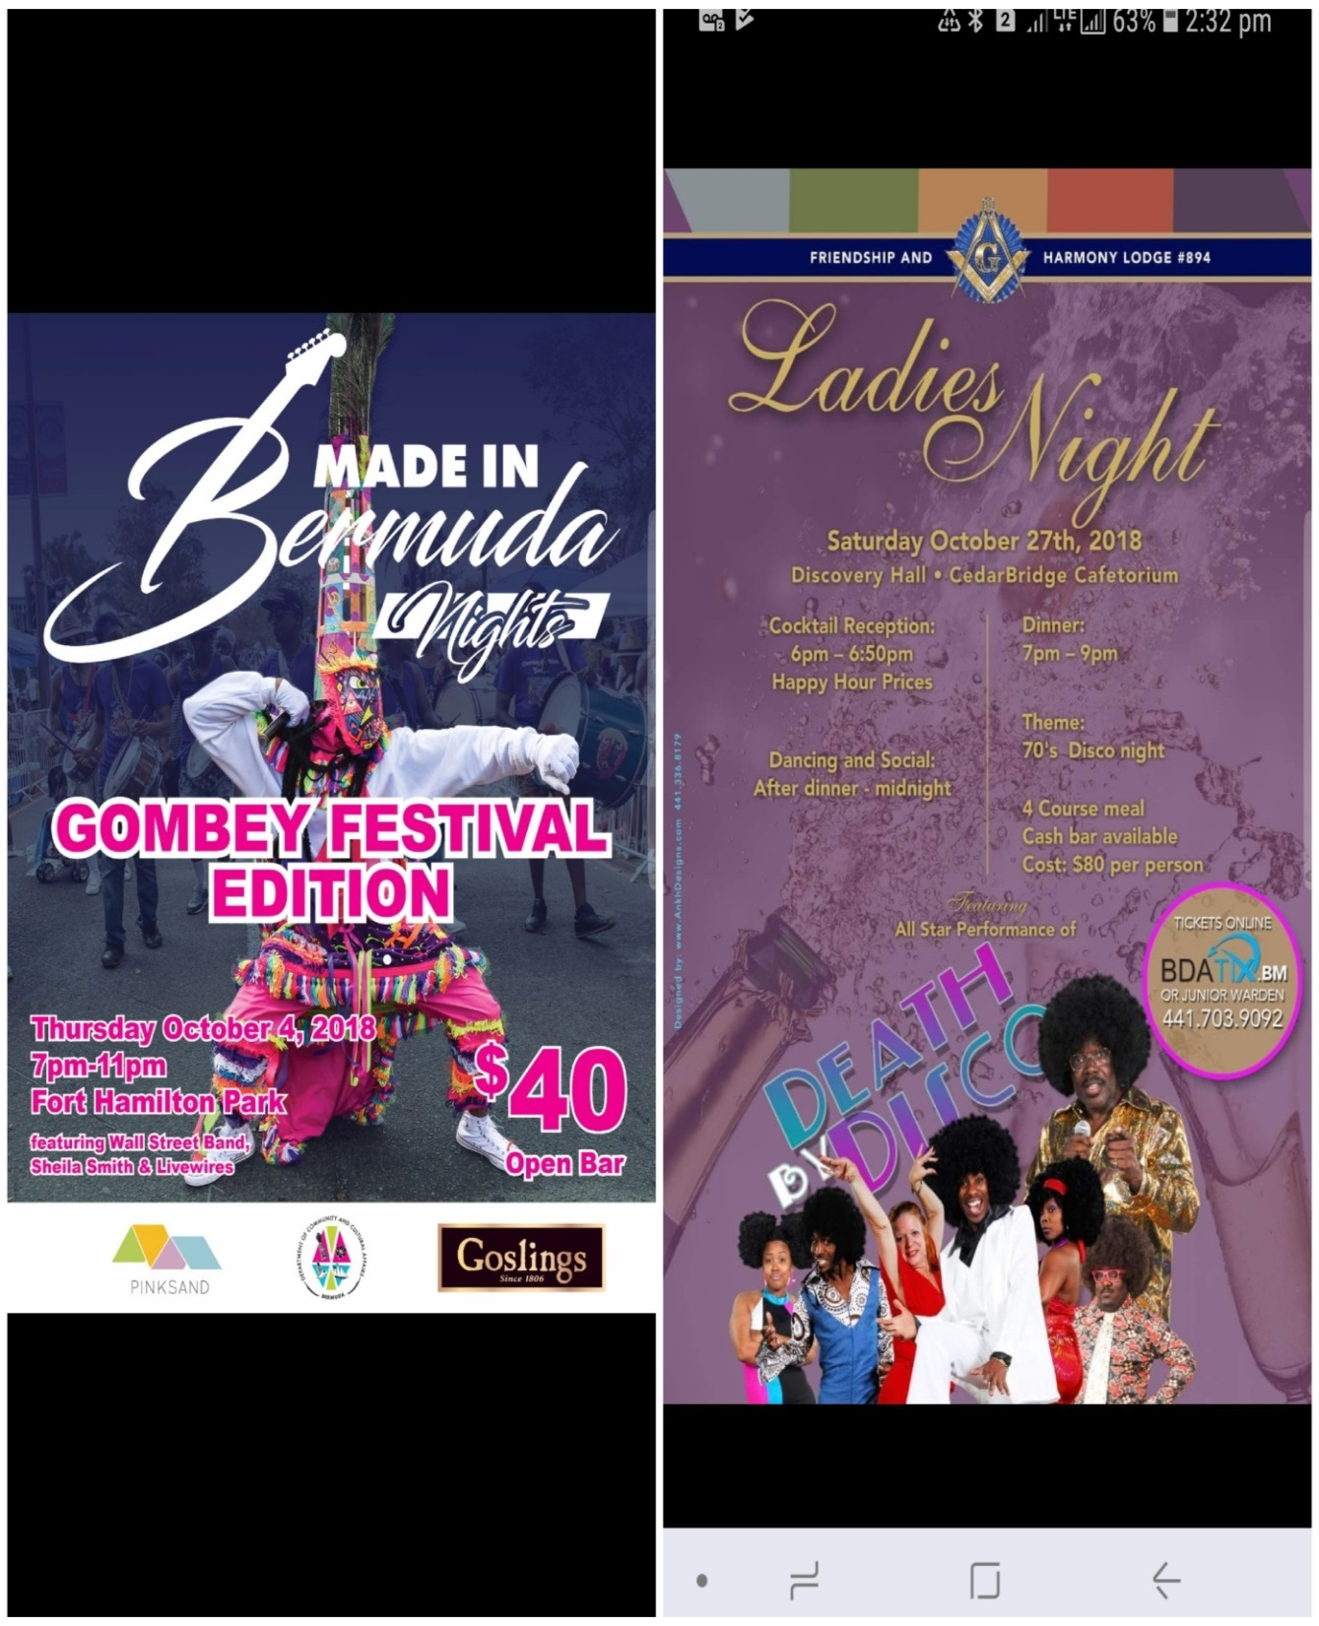

Slide 27
Celebrities Glorifying Substance Abuse

Slide 28
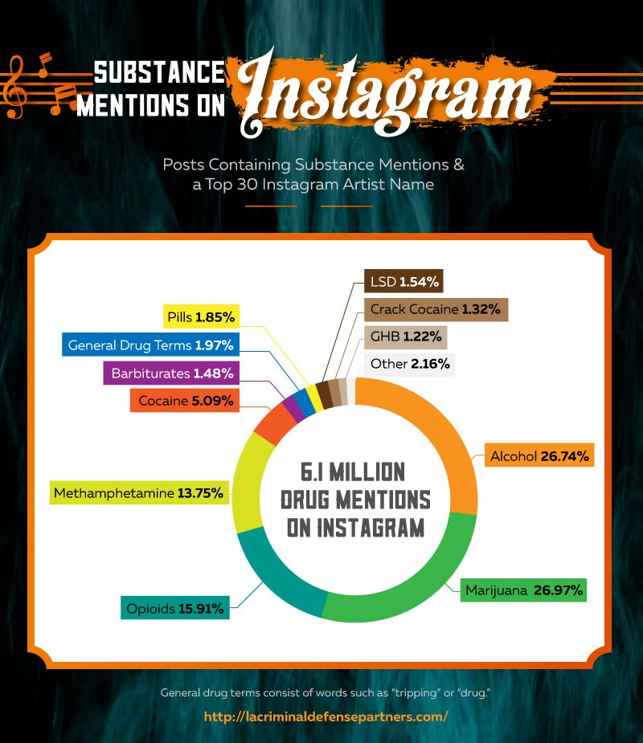

Slide 29
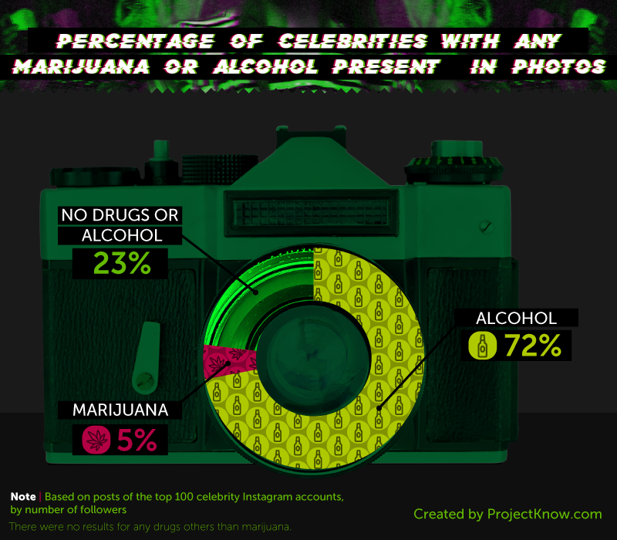

Slide 30
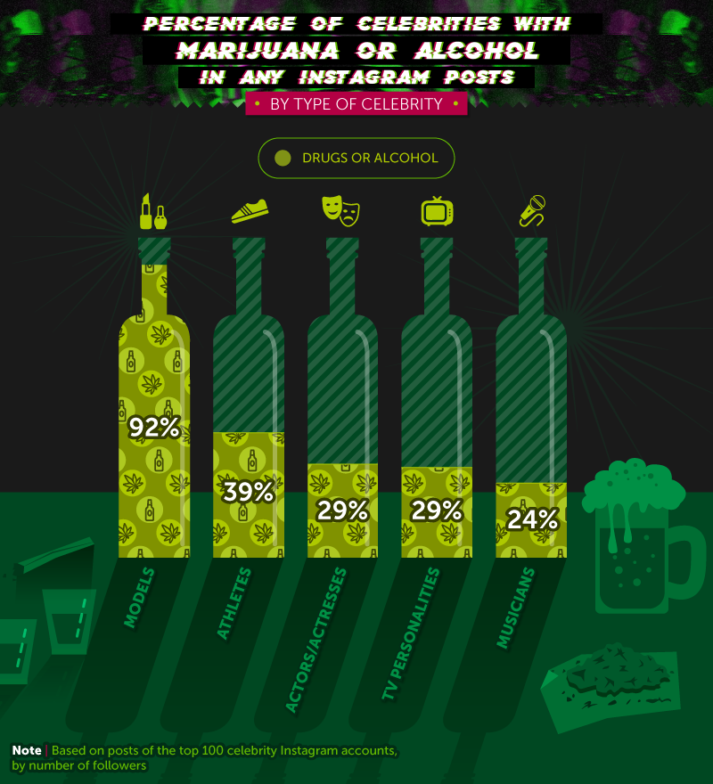

Slide 31
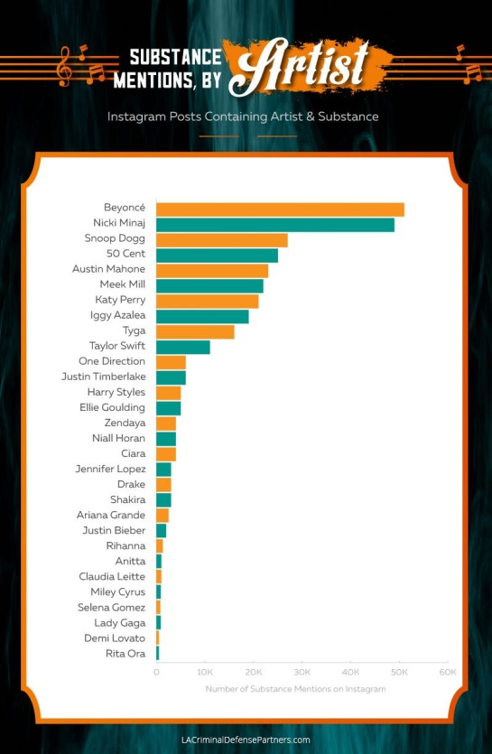

Slide 32
Beyonce – “Drunk In Love”
https://www.youtube.com/watch?v=FytvZdlrpKA

Slide 33
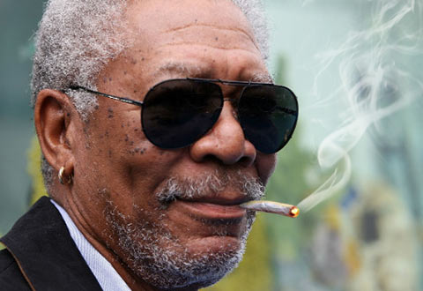

Slide 34
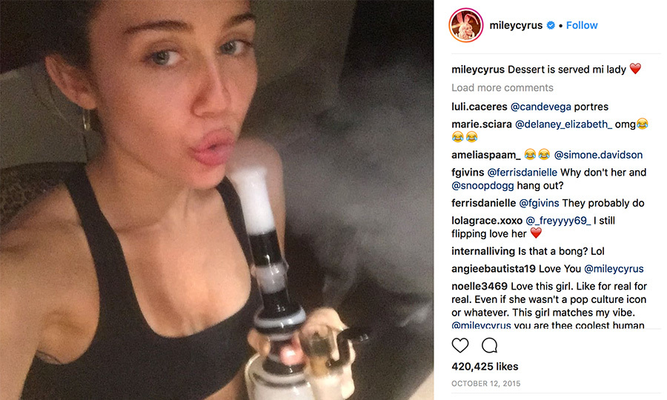

Slide 35
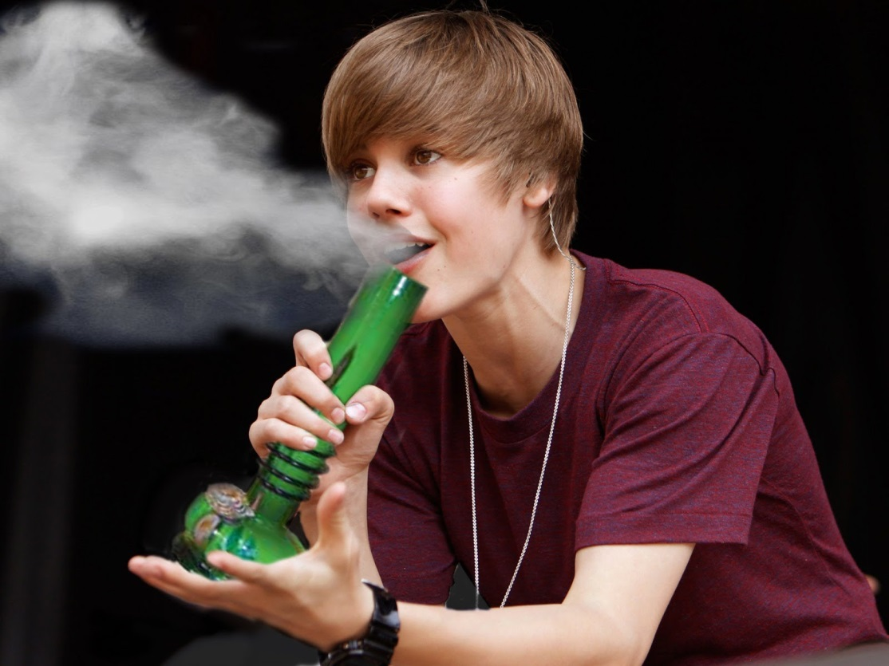

Slide 36
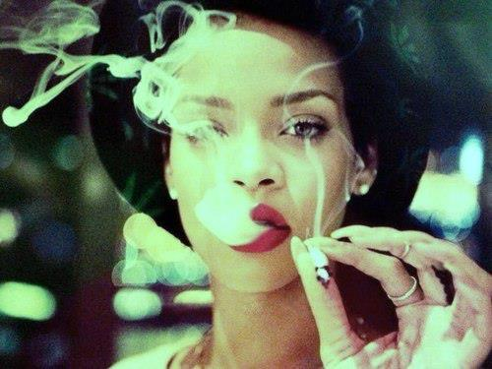

Slide 37
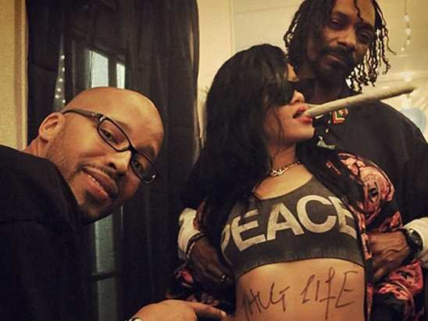

Slide 38
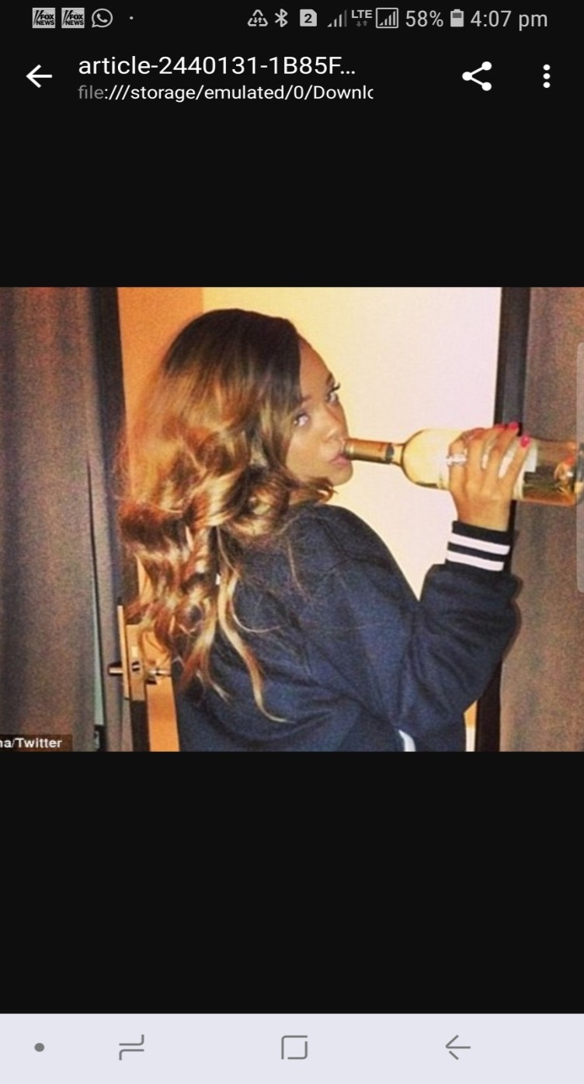

Slide 39
Rihanna – “Cheers (Drink to That)”
https://www.youtube.com/watch?v=h26xENEsaog

Slide 40
Jamie Foxx – “Blame It”
https://www.youtube.com/watch?v=rfjtpp90lu8
https://www.youtube.com/watch?v=iFCWVwNk9to (lyrics)

Slide 41
Wiz Khalifa – “Gin & Drugs”
https://www.youtube.com/watch?v=La0BNB487YM

Slide 42
Wiz Khalifa
https://www.youtube.com/watch?v=2YLsce89Z_Y

Slide 43
Future – “Mask Off”
https://www.youtube.com/watch?v=GGTfFBz0M1c

Slide 44
Nicki Minaj – “Super Bass”
https://www.youtube.com/watch?v=7u5LoW-S4ZM

Slide 45
Camila Cabello – “Never be the Same”
https://www.youtube.com/watch?v=IFp6FsH83c0

Slide 46
Kendrick Lamar – “Swimming Pools”
https://www.youtube.com/watch?v=zt0hLBF0rN8

Slide 47
Damian J. Gong Marley ft. Stephen Marley – “Medication”
https://www.youtube.com/watch?v=9PukqhfMxfc

Slide 48
King Bubba FM – “Who Drinking Rum”
https://www.youtube.com/watch?v=G5ti09MVRHo

Slide 49
Jagwa De Champ – “Drinka”
https://www.youtube.com/watch?v=Q086Ts4IJrk

Slide 50
Lokolos X Mack Steez – “No Thoughts”
https://www.youtube.com/watch?v=GUnfLkt5k6k

Slide 51
MUSIC VIDEOS
The Bermuda Context

Slide 52
General Kaution – “Hustla Baby”
https://www.youtube.com/watch?v=mzAP2ngQEs0

Slide 53
KD Da Beast – “Pourin Up”
https://www.youtube.com/watch?v=DHeeENk-Fq8

Slide 54
FourteenFourtyThree – “Right Next to Me”
https://www.youtube.com/watch?v=rCHqe9LTPsE

Slide 55
Pugi – “Bermuda”
https://www.youtube.com/watch?v=B9Ig_JWgQCI

Slide 56
Fiyah Marshall – “Take You Away”
https://www.youtube.com/watch?v=BxvpIOyUTvE

Slide 57
Dant$ ft. Storma – “It Be Alota”
https://www.youtube.com/watch?v=TaQCs7cEviw

Slide 58
King Keem – “Pull Up Wit Yo’ Bxtch”
https://www.youtube.com/watch?v=lJgP3wef2uY

Slide 59
Bermudian Island Girl Rapper – “Neva Been”
https://www.youtube.com/watch?v=mNRsobfS8fM

Slide 60
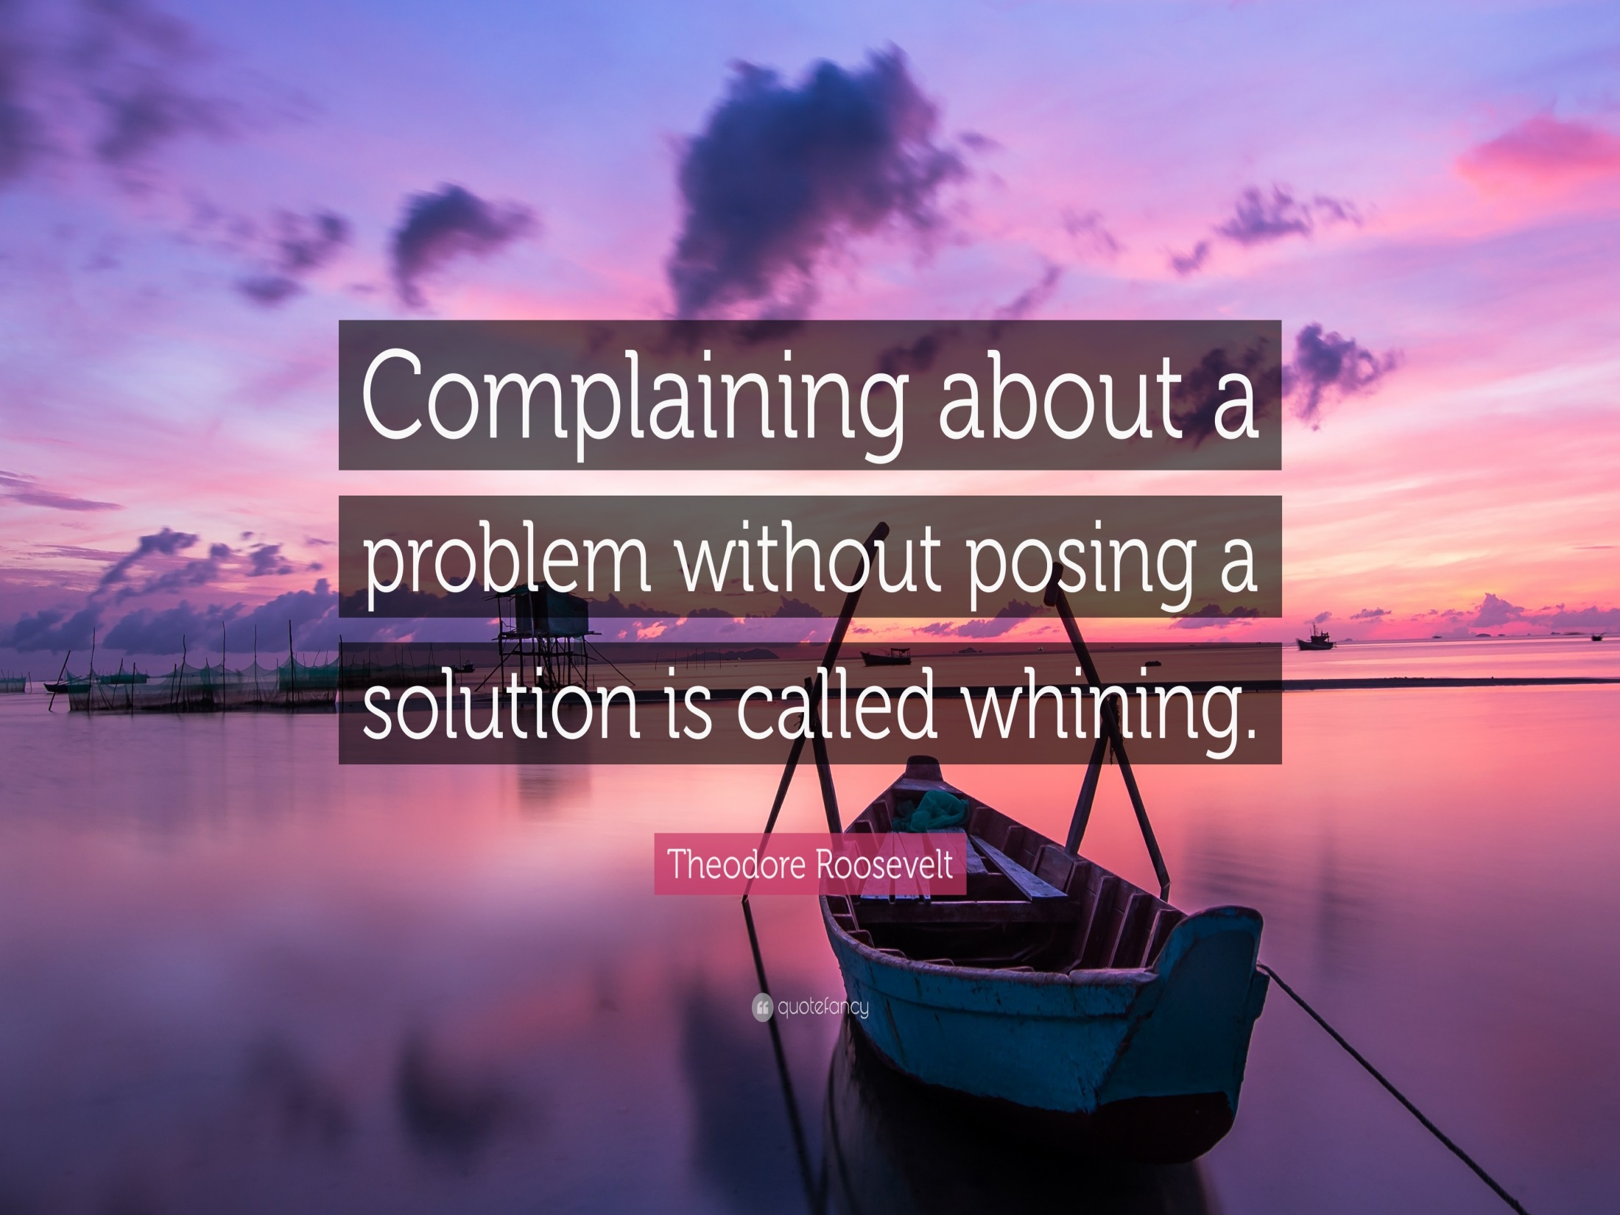

Slide 61
SOLUTIONS
A ROBUST and PERPETUAL educational/media awareness program in the schools and on social media to COUNTERACT the glorification of substance abuse by HAMMERING HOME the negative consequences of drug and alcohol consumption.
Encouraging parents (and maybe showing them how) to limit their child’s access to media, social media, and television.
Providing parents with resources and information to promote media awareness programs in their communities and schools.

Slide 62
Various Artists – “Proud to be Bermudian”
https://www.youtube.com/watch?v=frydTHUf1Ws

