Slide 1

Bermuda’s Drug Situation
2018 ANNUAL MEETING OF THE
BERMUDA DRUG INFORMATION NETWORK
Kyla Raynor, DrPH
BerDIN Coordinator
Senior Research Officer/Policy Analyst DNDC
Princess Victoria Room
Hamilton Princess & Beach Club
18th & 19th, October 2018
Notes:
Thank you to the morning’s presenters for tackling some of the issues that exist in substance abuse and for highlighting the challenges that we collectively face in preventing and intervening with young people.
I would also like to thank the planning committee members, Peter Stableford, Anthony Santucci, Duncan Barclay, Kimwana Eve, and Stephanie Tankard for their interest and hard work in ensuring that this meeting is successful and engaging.
I will speak very briefly about the drug situation over the past 5 years (since the last meeting), pointing out some worrisome areas.

Slide 2
Background
OBJECTIVES
To provide information essential for policy making, organisation of drug-related services, and on drug-related issues of general interest.
Identify existing drug abuse patterns
Monitor changes/ emerging drug problems
Raise awareness through dissemination of information
Identify changes in drug abuse patterns
Integrate agencies involved in drug reduction or control
MISSION
The BerDIN is committed to providing the evidence that allows for discussions and decisions to be informed by sound, centrally available, local data, on a wide range of issues that increase understanding of the complex, dynamic, and evolving nature of the Island’s drug problem.
PURPOSE
→ Build a Bermuda picture to analyse the situation and the evolution of the phenomenon and responses.
→ Compile information used to monitor and assess the implementation of the national drug strategy.
FACILITATED & COORDINATED BY DNDC
→ Collect, collate, monitor, analyse, interpret, produce, and disseminate.
→ Standardise drug literature dissemination mechanism and processes.
→ Conduct primary drug-related research.
→ Provide technical assistance and capacity building.
A group of people who represent either themselves or an agency that aims to provide Bermuda with factual, objective, and comparable information concerning drugs and drug addiction, and their consequences.
Notes:
The Bermuda Drug Information Network is an ever evolving, live network of people, usually representing an agency, who provide the DNDC with drug- and alcohol-related information.
Your agencies provide local information that assist the user with having a local, culturally-relevant picture of the current substance use/misuse situation in Bermuda.
The DNDC job really is to collect your information and make sense of it all through the annual publication.
As such, we are reminded of our Mission (on the banner/sign) as being “…committed…”
BerDIN is a dynamic group that has really allowed the DNDC to:
Identify existing drug abuse patterns (over different time periods and population groups) and changes in those patterns.
Monitor the changes to determine if they represent emerging drug problems.
Raise awareness of drug-related issues facilitated through dissemination of information generated from detailed analysis of the drug situation.
Our mission, purpose, and objectives are all tailored to contribute to the development of policy and the implementation of appropriate programmes and responses.

Slide 3
Monitoring Mechanisms
Since 2006
From 7 to 32 data providers
45 drug control areas
150+ indicators
12-year series for most indicators
Notes:
It is, therefore, an impressive achievement that this fledgling monitoring mechanism, established in 2008, has now matured into a national system, encompassing over 30 data providers, and is recognised both locally and internationally.
Although the Network formally began in 2008, information is available from as far back as 2006 to as recent as 2016 (last year).

Slide 4

Surveys
Updated in Report
(Prison) Drug Abuse Monitoring Survey (2017/2018)
Omnibus (2nd Quarter 2017)
Consumer Experience Surveys
Stakeholder Feedback Surveys
Treatment Demand Indicators Survey
Notes:
These were the primary surveys undertaken this over the last year. You will hear a more later on the National Household Survey Data highligts.
In addition, we undertake to survey the quantity od drugs used and prices paid by clients in treatment in an effort to estimate drug spending (or the demand side contribution to the Island’s Gross Domestic Product).

Slide 5
Missing from the Report
        Drug enforcement activity
        Drug prices, missing for 2 years
        Post-natal drug use (KEMH VII)
Notes:
Challenges with internal processing of information at the BPS has resulted in…..
We are working with them however to process the information needed to aid our understanding of the drug situation from an interdiction stand point. This would also include identification of new information we currently do not report on.
Post natal drug use has not been reported in 8 years, we are hoping that with the renewal of the National Drug Strategy we may be able to re-engage KEMH to figure out how to better operationize this indicator.

Slide 6

Data Gaps
    Problem drug use
    Drug availability and drug market (synthetics)
    Alcohol and tobacco sales
    Dual-diagnosed clients
    Mandatory breathilyser testing at accidents
    Drug-related harms
Notes:
The issues remain the same concerning missing information, some of the more pressing ones are listed here. It is highly possible there may be other indicators that we should look at especially as it related to cannabis use and the use of synthetic drugs.
Problem drug use, so how many addicted people from a population perspective, so not just social users but those who use consistently and may not necessarily be in the criminal justice system.
Inability to determine the value of drugs seized

Slide 7
Organisational Challenges
STAFFING
DATA
Changes in terms of what was collected and reported in previous year; missing/incomplete, inconsistent, or no longer collecting certain data.
Lack of qualitative/ supporting data to supplement quantitative data (e.g., why certain trends were observed)
Still unable to obtain additional Drug Prevention data to add to the report.
DEADLINE
DATABASE
Less than 100% utilisation of BerDIN database directly by BerDIN Members.
Shortages, turnover, or organisation restructure resulting in a need for relationship building and advocacy.
Not all agencies met the target submission date.
Key indicators not reported by interdiction agency.
7
Notes:
Overall the challenges experienced this past year continued to be related the management of data at respective agencies.
BPS, e.g., has a new data management system, so the trend in their reported data seems off and some data previously collated and reported are now unavailable because of how the data is presently captured in their record management system. The BPS was very late in submitting its complement of BerDIN data.
A few agencies (e.g., BPS) continue to not meet the deadline.
Some agencies are yet to input their data directly into data management system. Further, a couple Member agencies are unable to log into the BerDIN data management system because of their computer firewalls. This is currently done on their behalf by the DNDC.

Slide 8
Key Demand and Supply Reduction Activities
DNDC consulted regarding special licenses for terminally ill patients requiring medical marijuana.
Five grants to demand reduction programmes.
NDC Act of 2013 gazetted.
WTC, Turning Point 3-year CARF International accreditation.
Eleven facilities submitted their licensure documents.
Road Traffic (Road Sobriety Checkpoints) Amendments Act 2018.
Misuse of Drugs (Decriminalization of Cannabis) Amendment Act 2017.
DNDC, Prevention Unit held first LGBT training for service providers.
Parenting skills for persons in recovery implemented with parents at RLH.
Financial crime training with HM Customs.
Prison Survey and Survey on Public Perceptions of Substance Use.
Green paper on substance abuse/misuse
Completion of National Drug Strategy 2013-2017.
Notes:
The process to make medical marijuana available to the community; CBD oil accessibility and a request to import Krantom.
In so many ways the country is moving forward when it comes to policy reform that targets the environment in which alcohol and drug use occurs.
Road Traffic (Road Sobriety Checkpoints) Amendments Act 2018
Notifies public through the Gazette of pending checkpoint, no more than 14 days and no less than five days prior to the date provided in a written authorization, may provide for more than one checkpoint; specifies the date and parish in which the road sobriety checkpoint will occur.
Misuse of Drugs (Decriminalization of Cannabis) Amendment Act 2017
Removes criminal sanctions in relation to possession of 7 grams or less of cannabis.
Regulations providing for substance abuse education or treatment for any person and in particular any minor found to be in possession of any amount of cannabis.

Slide 9
Adult Drug Use
There was a dramatic decline in the use of marijuana among adults. 20.2 percent of adults reported lifetime use of marijuana in 2017 compared with 37.0 percent in 2009.
This change is also reflected in current use of marijuana; it was 4.8 percent in 2017 compared with 7.5 percent in 2009.
Current use of alcohol and tobacco is down as well.
Use of cocaine, heroin, and hallucinogens continues to be a problem for adults, although a small proportion.
Notes:
This year I am presenting the data looking at the trend over the past five years instead of the usual annual comparison.
In fact, this is the situation for all of the drugs reported in the 2017 Household Survey for adult use:

Slide 10
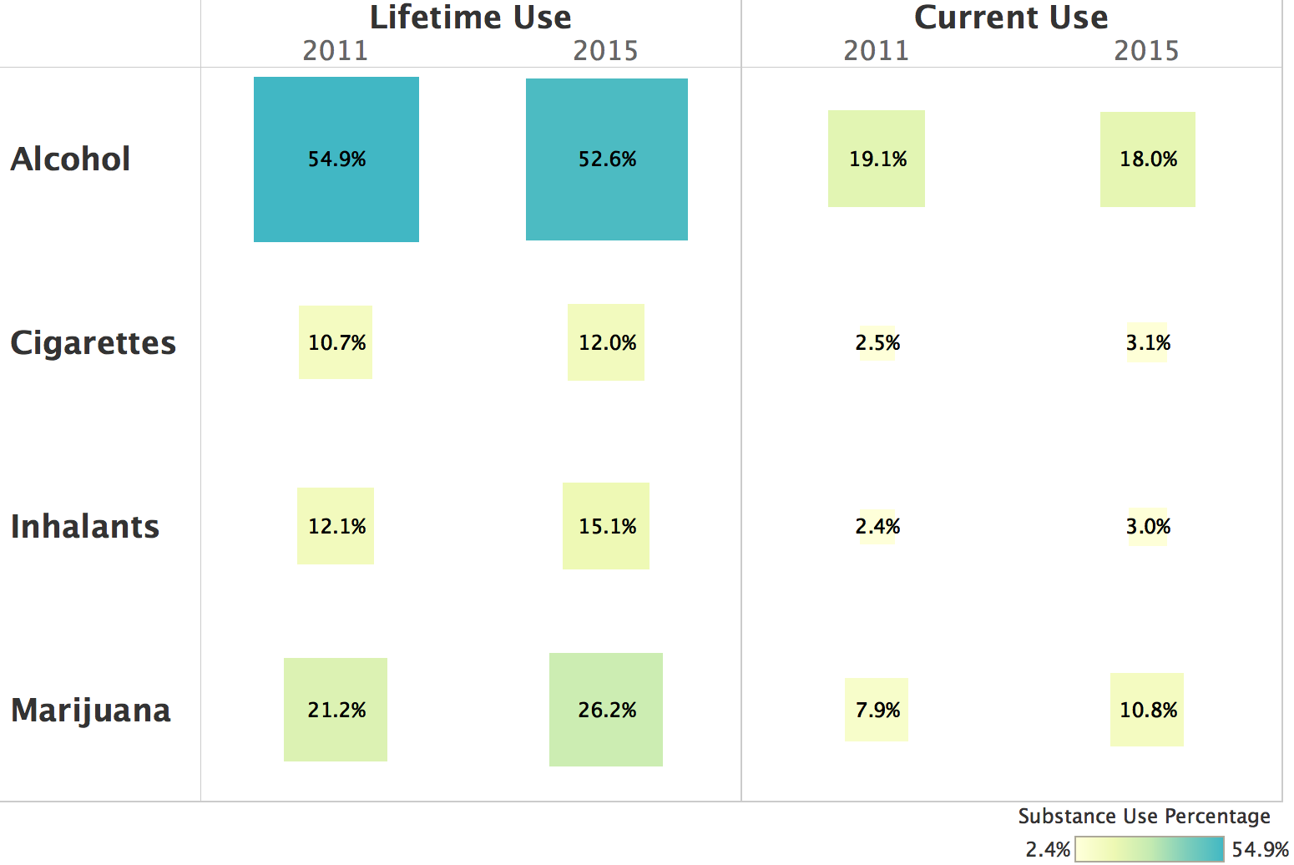
Youth Drug Use
Notes:
According to available data, there has been progress in reducing youth alcohol use, but the situation with other drug use is deteriorating:
Lifetime use of alcohol declined modestly from 54.9 percent in 2011 to 52.6 percent in 2015. Similarly, current use of alcohol declined from 19.1 percent in 2011 to 18.0 percent in 2015.
Lifetime use of marijuana increased from 21.2 percent in 2011 to 26.2 percent in 2015. Current use increased as well. The rate of current use in 2015 of 10.8 percent is 37 percent higher than the 7.9 percent reported in 2011. This is clearly a troubling trend.
Likewise, other drug use (though less frequent by comparison to alcohol and marijuana) worsened. Lifetime use of inhalants increased from 12.1 percent in 2011 to 15.1 percent in 2015; current inhalant use increased from 2.4 percent in 2011 to 3.0% in 2015.
Unlike their adult counterparts, youth are smoking more. Lifetime use increased modestly from 10.7 percent in 2011 to 12.0 percent in 2015; current cigarette use increased from 2.5 percent in 2011 to 3.1 percent in 2015.

Slide 11
Cannabis
1 in 5 seeking treatment said cannabis DOC
Increase in prevalence of use amongst youth
Decrease prevalence of use by adults in the household.
In 2017, 21 women tested THC + during pregnancy, 11 in 3rd trimester
Notes:
The overall picture when it comes to cannabis use is not so straight forward. We know that BARC reports that 1 in 5 people since 2016 or 19% of the 530 people seen, were seeking substance abuse treatment services for cannabis. 26 had a clinical diagnosis of severe abuse or dependence on cannabis
Among adults, measured by the NATIONAL HOUSEHOLD SURVEY, which occurs every 4 years, in 2013 22.6% admitted lifetime use of marijuana compared to 20.2% in 2017.
Similarly among young people, measured by the SCHOOL SURVEY, which also occurs every 4 years, in 2011 21.2% amitted ever using marijuana compared to 26.0% in 2015.

Slide 12
Bermuda’s Drug Situation:
Drug Market
Cannabis and alcohol remain DOC
Poly drug use constant
Increase in Benzodiazepine positives
Increase in the number of liquor licences
DOC of choice remains available
Synthetic drugs present
Notes:
Cannabis and misuse/abuse of alcohol continue to be worrisome in our community from a public health perspective.
Poly drug use constant especially amongst those in the criminial justice system. Combinations of HEROIN/CRACK/THC and HEROIN/CRACK/ALCOHOL
Benzo’s positive at TP, WTC, MT
Although not as much was seized in 2017, synthetics include: fentanyl, MDMA, cathinone derivative

Slide 13
Improvement in crime, drug possession and importation of drugs
  Crimes reported against persons or the community declined
  Crimes against property declined significantly
  Substantial reduction in drug offenses, both local and importation offenses, in 2016
  Drug Possession: largest reported area of drug offenses in 2012 and 2017 was for cannabis possession
  Drug seizures are also down over the period
 | 2012 | 2017
Against Community | 722 | 329
Against Persons | 676 | 331
Against Property | 2,541 | 461
Drug Offences (Importation) | 144 | 41 (2016)
Drug Offences (Local) | 436 | 306 (2016)
Total Drug Seizure Arrests | 531 | 419
Notes:
Drug enforcement activity both importation and local offences were not available for 2017, however in 2016 there were 41 and 306 respectively.

Slide 14
Alcohol and Driving
In 2017, 194 persons were stopped for a breathalyzer, 194 of whom gave samples.
vs.
In 2012, 246 persons were stopped for a breathalyzer, 205 of whom gave samples.
Source: Bermuda Police Service
Notes:
As can be seen there were fewer persons stopped for the breathalyzer test in 2017 then 5 years ago and there were fewer breathalyzer samples taken as well in 2017
Overall the number of people being stopped that were 2-3 times over the limit significantly declined over the past 5 years.

Slide 15
Alcohol-Related Offences
Source: Supreme Court
Notes:
Overall, both TRIALS and convictions for alcohol related offences have decreased between 2012-2017.
While there remains challenges to drink driving, the decrease was seen in both trials and convictions for specific offences such as impaired driving, excess alcohol while operating a motor vehicle, and refused to take the breathalyser test.

Slide 16
TIPS & LIQUOR LICENCES
TIPS 2012
25 sessions
326 participants
TIPS 2017
16 sessions
427
participants
146
establishments
75
establishments
still no regulations
There were 310 liquor licences issued to establishments in 2017; down from 663 issued in 2012.
Source: CADA & Magistrate's Court (Liquor Licence Authority)
Notes:
When we look at 2012, the were significantly less liquor licences issued in 2017.
SEVEN years after TIPs was legislated, the statistics demonstrate a consistent and steady progress has been implemented to ensure that island wide all servers of alcohol are certified.

Slide 17
Drug related Health Consequences
DRUG RELATED HEALTH CONSEQUENCES 2011-2017
100% increase in number of pregnant women testing positive for THC in 3rd Trimester.
Forty-nine tobacco-related deaths.
Two drug-induced deaths, two alcohol induced deaths.
Five cases of death by homicide in which alcohol or drugs present.
 | 2011 | 2017
AIDS | 1 | -
Hepatitis B | 0 | 7
Hepatitis C | 14 | 8
HIV | 8 | -
Road Fatality: Alcohol/drugs | 4 | 10
Notes:
This is incidence not prevalence
Decrease in Hepatitis C cases.
Increased proportion of cases that exceeded legal limit for alcohol.
Two drug-induced deaths, two alcohol induced deaths.
10 road traffic fatalities with alcohol and drugs present. (transport accident)
Five cases of death by homicide in which alcohol or drugs present.
49 tobacco-related deaths.
100% increase in number of pregnant women testing positive for THC in 3rd Trimester. 0 in 2016 and 11 in 2017.

Slide 18
Drug Treatment Admissions
Between 2012 and 2016, the number of individuals admitted to drug treatment at one of Bermuda’s seven identified programs annually climbed from 93 to 152. Decreased to 82 in 2017.
During this five-year period, female treatment admissions doubled from 15 in 2012 to 31 in 2016. This jump represents a 107 percent increase in female treatment admissions. Decreased to 14 in 2017.
  Male treatment admissions also increased during these years, jumping from 78 in 2012 to 121 in 2016. This represents a 55 percent increase in male treatment admissions. Decreased to 68 in 2017.

Slide 19
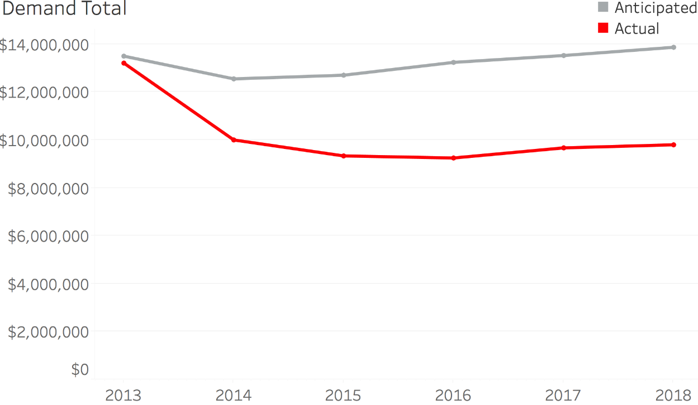
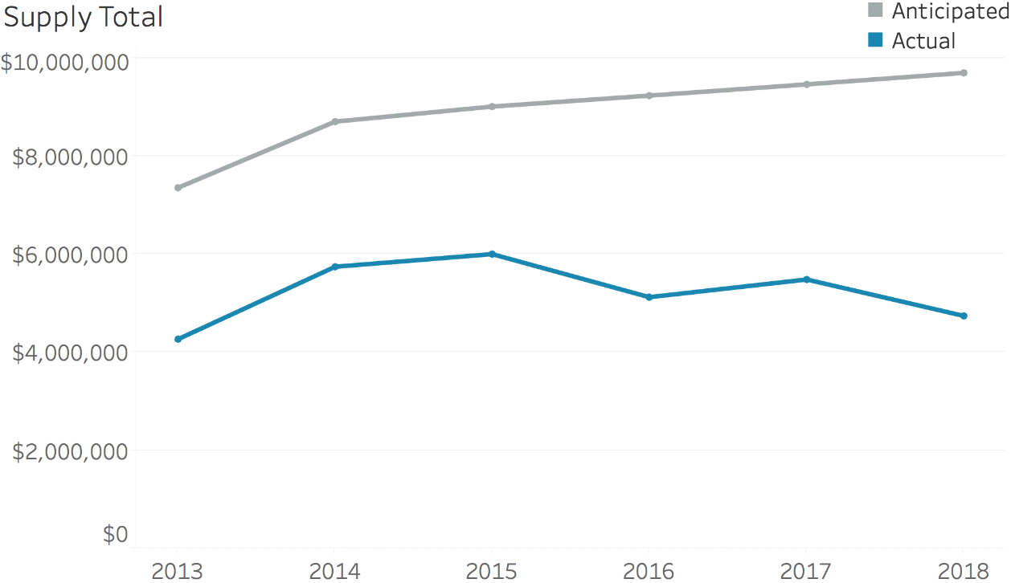
Drug Control Financing
Demand budgets fell short by an average of 30% of anticipated need;
Supply budgets fell short by an average of 50% of anticipated need.
Notes:
The projected budget for drug control was calculated with the help of a consultant and found to be around 24 mil between 2013-2017. However the budgets have come up significantly short.
While both budgets come up short, demand does better than supply with regard to realizing anticipated need.

Slide 20
CHALLENGES
Lack of enforcement of legislation.
Grant agencies received level funding for third consecutive year
Treatment gap continues.
Budget and grant cuts affecting service provision.
Insufficient understanding of the epidemiology and trends in cannabis market and synthetic drug use and consequences.
Notes:
Persons seeking treatment do not necessarily follow-up with the recommended level of care or the level of care recommended may not be available at time for the client in need; hence, posing a gap in treatment.
Legislation relating to various aspects of drug control are not fully enforced, e.g., …TIPS legislation still without REGULATIONS and Sales to Minors not enforced

Slide 21

Technical and Other Assistance
  Assistance with small data projects or surveys.
  Support for training
    Opportunity here is to keep looking for more of these types of technical assistance and training occasions as promised in the last meeting.
21
Notes:
We will continue to aim to enhance the expertise of our Members by offering assistance in whatever way(s) possible. In the last year the DNDC was able to send Members to:…

Slide 22
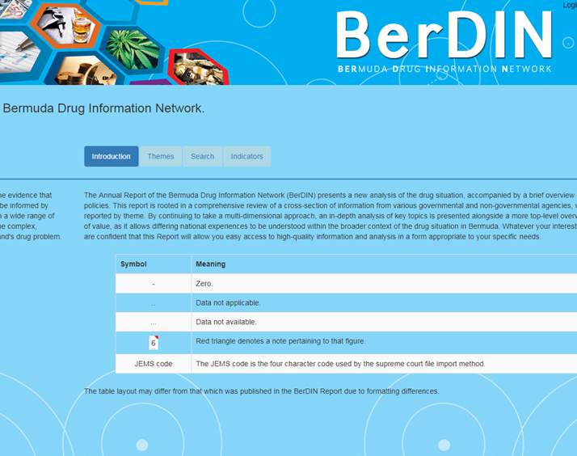
BerDIN Data Management System
  Public interface nearing completion
  Link off of government portal
  Allows anyone to run input queries on indicators in the database
  DNDC to complete backfill of survey data

Slide 23

Next Steps/New Initiatives
WHERE DO WE GO FROM HERE?
National Drug Control Master Plan 2019-2023.
Public interface of the BerDIN data via government portal
Determine research agenda to fill gaps in data.
Notes:
Over the next 6 months our focus will be on developing and releasing National Drug Control Master Plan 2019-2023 that will guide our focus for the next five years. Ms. Dean will speak to this in her agenda item.
However, should time and resources permit. we will consider filling some of the data gaps by obtaining additional information such as…cannabis and youth, number of addicts/problem drug users.
Or assist agencies, where possible, to begin collecting and collating relevant data.

Slide 24
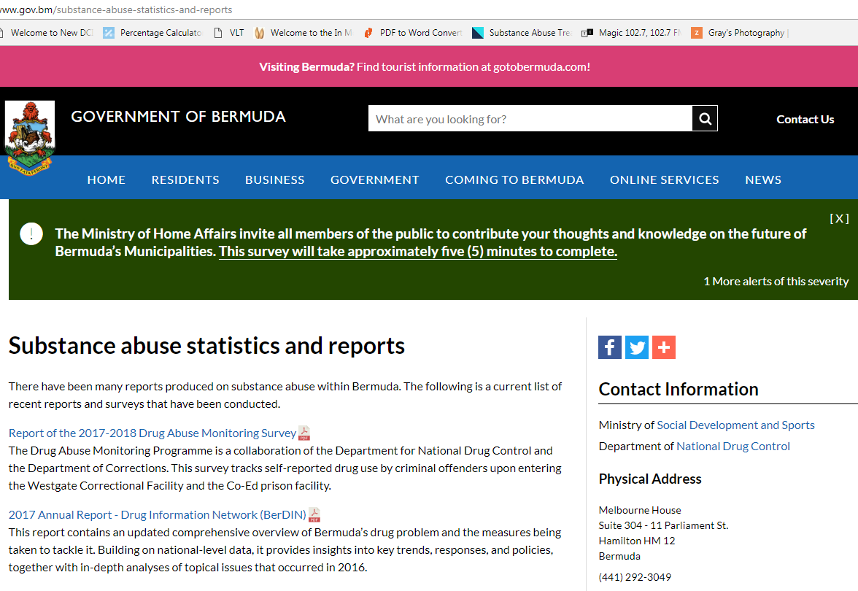
www.gov.bm/substance-abuse-statistics-and-reports
Notes:
You can find all of the BerDIN reports and other surveys on the Government’s portal by a search for “substance abuse statistic and reports.”

Slide 25
Thank You!
Questions & Discussion
Princess Victoria Room
Hamilton Princess & Beach Club
18th & 19th, October 2018
Dr. Kyla Raynor
BerDIN Coordinator
Senior Research Officer/Policy Analyst DNDC
Notes:
=

