Slide 1
BERDIN 2018
Department of Public Prosecutions
Cannabis Decriminalization Update

Slide 2
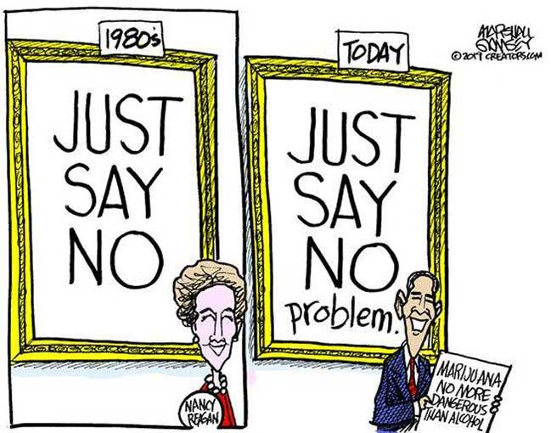
Presentation
Background
Terms – decriminalisation, legalization
Misuse of Drugs (Decriminalisation of Cannabis) Amendment Act 2017
Statistics
Discussion
Q&A

Slide 3
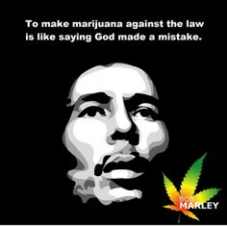
Defining the Terms - Decriminalization
Defining the terms
Legalization and regulation must be distinguished from "decriminalization," as the terms are easily confused.
Generally, decriminalization is referred to as removing criminal sanctions for some offences, usually simple possession, and replacing them with administrative sanctions, such as fines.
This maintains the illegality of cannabis but prevents individuals from acquiring a criminal record for simple possession.
With decriminalization the production, distribution and sale of cannabis remain criminal activities. Thus, individuals remain subject to the potential dangers of untested cannabis. Criminal organizations continue to play the role of producer, distributor and seller, thereby increasing risk, particularly to vulnerable populations.

Slide 4
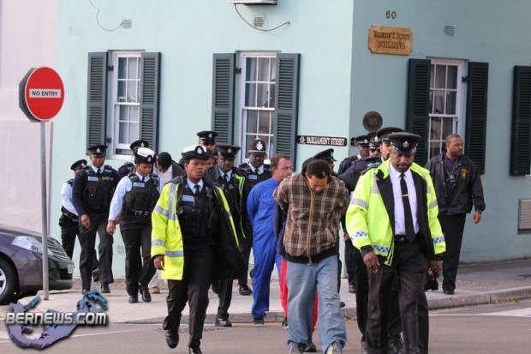
Background in Bermuda
Arrest, Prosecution
Convictions
Lost job opportunities
US Stop List
  Lost education opportunities
  Travel – leisure/medical
Other

Slide 5
Misuse of Drugs (Decriminalisation of Cannabis) Amendment Act 2017
Operative Date – 20 December 2017
Amends section 6 of the MDA 1972
To decriminalise the possession of cannabis lower than the statutory amount (7 grams) where criminal sanctions will not apply, and makes savings provision for prosecution for intent to supply.

Slide 6
Misuse of Drugs (Decriminalisation of Cannabis) Amendment Act 2017
Inserts new section 25A into the MDA
Empowers the police to seize cannabis in the possession of any person
Provides that the Minister shall make regulations that provide for substance abuse education or treatment for any person and in particular any minor found to be in possession of any amount of cannabis.
Thus far, no regulations have been introduced
Some of you may be working on them

Slide 7
Misuse of Drugs (Decriminalisation of Cannabis) Amendment Act 2017
Inserts new Schedule 8
That specifies the amount of cannabis below which criminal sanctions for simple possession will not apply ie 7 grams

Slide 8
BPS Statistics - Drug offences importation vs local Q1 2014 to Q3 2018 .
You will notice the recent sharp increase in importation, which is a result of drug seizures on cruise ships.
The local offences refer to all drug offences in Bermuda that didn’t happen at a port. They include:
  (a) Possession with intent to supply
  (b) cultivation
  (c) obstruction MDA,
  (d) possession of drug equipment
  (e) misusing controlled drug and
  (f) possession.
In Q3 2018 there were 98 importation and 59 local drug offences = 157 total.

Slide 9
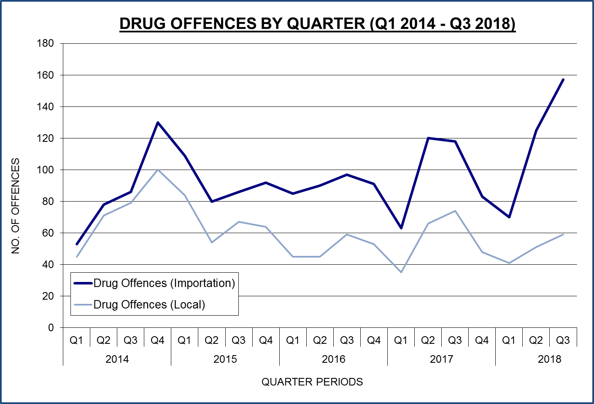
DRUG OFFENCES IN BERMUDA

Slide 10
BPS Statistics - Drug offences local and possession only.
Possession of a controlled drug and Possession of a controlled drug in an increased penalty zone are combined in the orange line and compared against the previous slide data of local drug offences.
The difference between the orange and blue lines are offences for: (a) Possession with intent to supply
(b) cultivation
(c) obstruction MDA
(d) possession of drug equipment and
(e) misusing controlled drug.

Slide 11
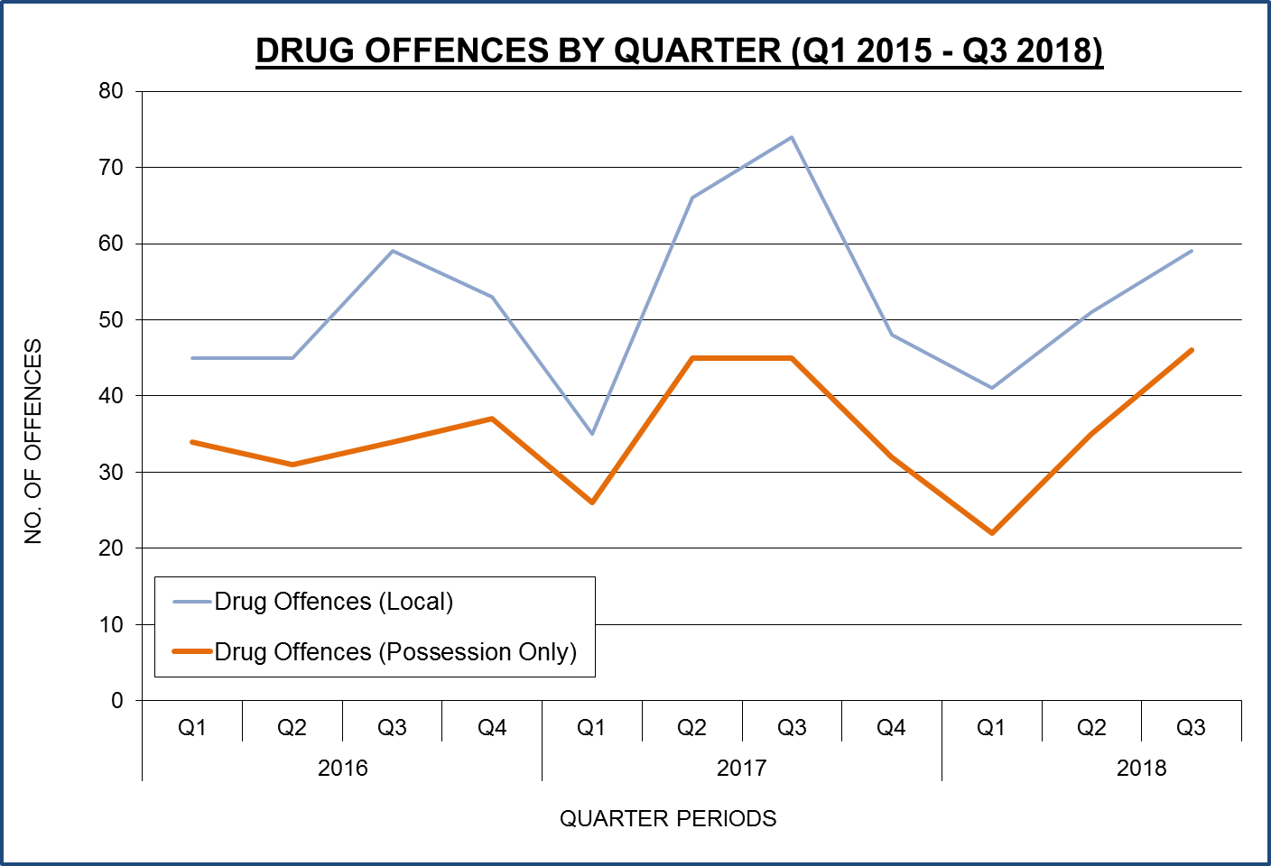
DRUG OFFENCES IN BERMUDA

Slide 12
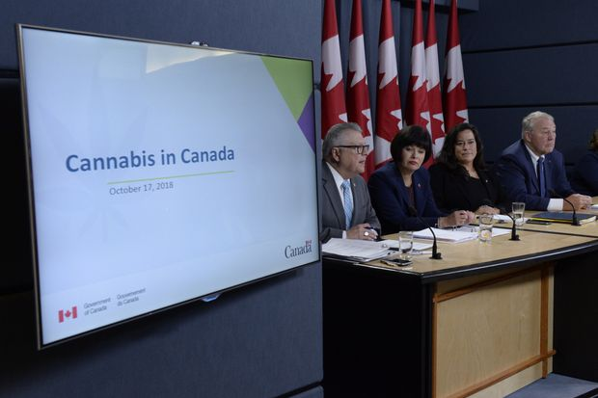
Canada
Canada became the second country in the world after Uruguay and the first Group of Seven country to legalize cannabis use on Wednesday 17 October 2018.

Slide 13
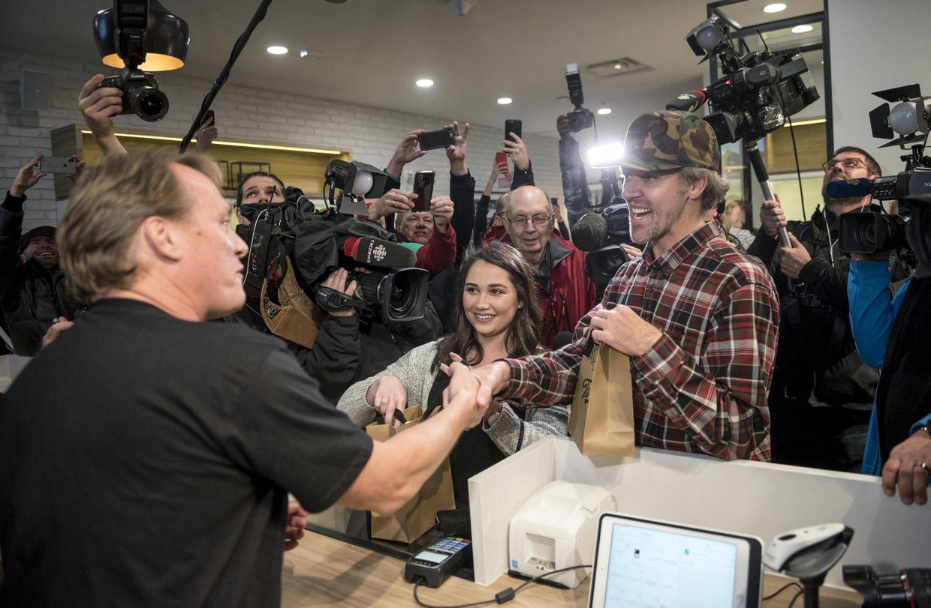
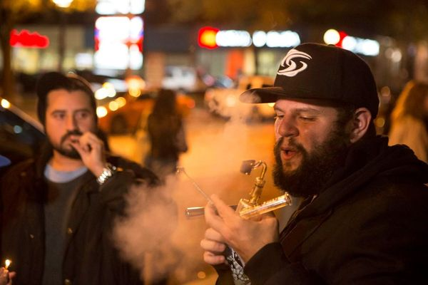
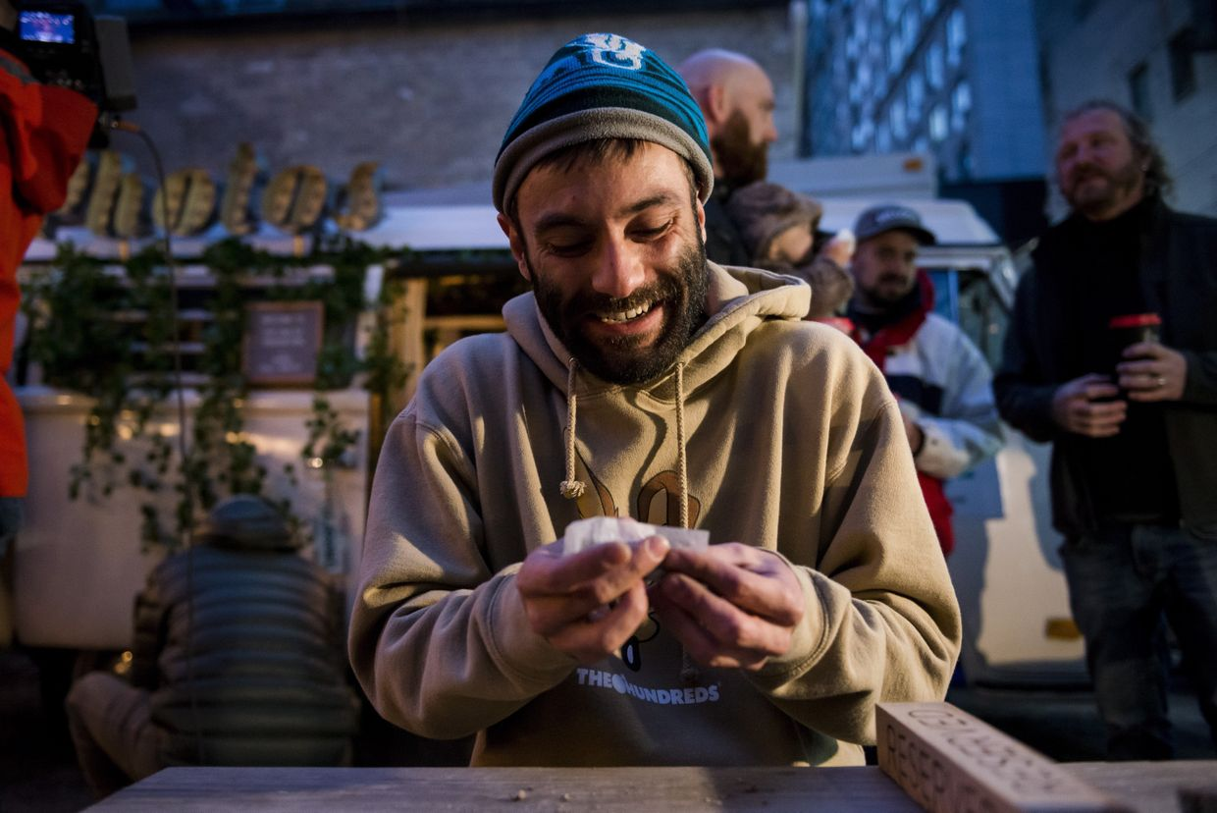
Canada

Slide 14

Q&A

